Slide 1
LiF: Mg,Ti dosimeter in practice (ULB - old) (1)
The dosimeter is made as a sheet composed of a mixing Teflon-lithium fluoride
The sensitive material is LiF: Mg,Ti with a concentration of 15% → the Teflon is the mechanical support for the LiF and a heat insulator between the different reading slots
In addition to the reading slot, the dosimeter has a back-up slot (use in case of reading incident or for confirmation of a large dose)
The body of the dosimeter is composed of four distinct slots having different filters allowing an analyze of the type of incident radiation as well as its intensity →
slot I : 2.4 mm Teflon (plastic) + 0.8 mm Cd
slot II : 1 mm Cu + 1 mm Al
slot III : 3.2 mm Teflon
slot IV : bare window

Slide 2
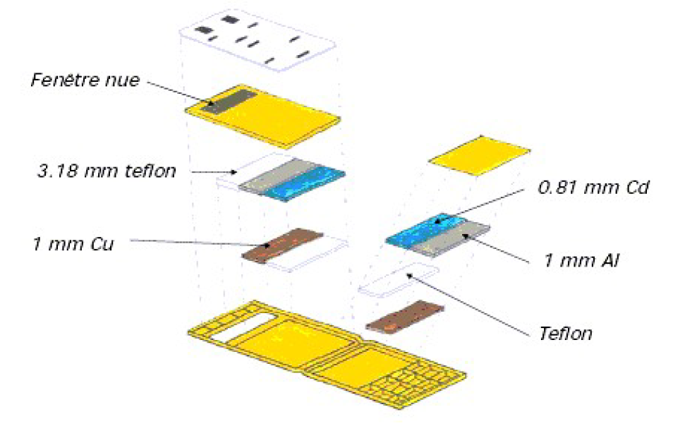
LiF: Mg,Ti dosimeter in practice (ULB - old) (2)

Slide 3
LiF: Mg,Ti dosimeter in practice: Interpretation of results
Slot under Teflon/Cd filter→ neutrons dosimetry
The Cu/Al filter allows a discrimination between ° rays and X rays generally used in medicine (20 keV < E < 60 keV) → the absorbed dose under this filter is due to large E ° (as a first approximation)
Teflon filter → this window is used to discriminate the ¯ rays and to settle an electronic equilibrium sufficient for ° with larger E
The deep dose is the combining result of these 2 slots: Cu/Al and Teflon
The bare window has practically a response curve identical to the one of the plastic window for ° with E > 20 keV → this window allows the detection of ° with E < 10 keV and of ¯ rays (fragile window)

Slide 4
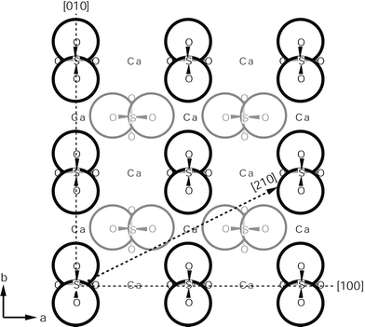
CaSO₄:Dy: Structure of CaSO₄
Orthorhombic structure largely more complicated than LiF
(…) efforts have been focused on making an efficient material, and this has been achieved. Understanding the mechanisms has been of secondary importance. Indeed for a material of such great complexity (…), it is well beyond the scope of current condensed matter scientists.

Slide 5
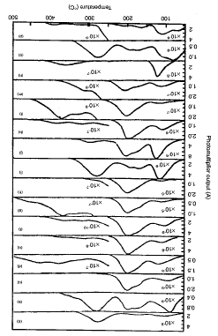
Additional impurities: primary impurities
Y
Lu
Yb
Tm
Er
Ho
Dy
Tb
Gd
Eu
Sm
Nd
Pr
Ce
La
-
Rare earths are chosen as primary impurities, give a good sensitivity, limit the peaks at small T° and induce a good stability at about 200 °C
Dysprosium (Dy) and Thulium (Tm) give the best sensitivity

Slide 6
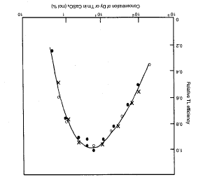
Sensitivity as a function of the amount of Dy
Each Dy (or Tm) site requires an independent volume of the crystal → if these volumes are superimposed (large concentration of impurities) → sensitivity ↘
There is an optimum concentration of impurities

Slide 7
Additional impurities: secondary impurities
Dy³⁺ replaces a Ca²⁺ion → compensation is required to conserve the charge → ≠ mechanisms have been considered:
Dy³⁺ is compensated by a secondary impurity deliberately added to the TLD (hydrogen or alkaline) → good results have been obtained with Na⁺
A Dy³⁺ pair is associated to a Ca²⁺ vacancy
Replacement of oxygen by nitrogen as secondary impurity
Practically → it « seems » that there is a combination of the 3 mechanisms

Slide 8
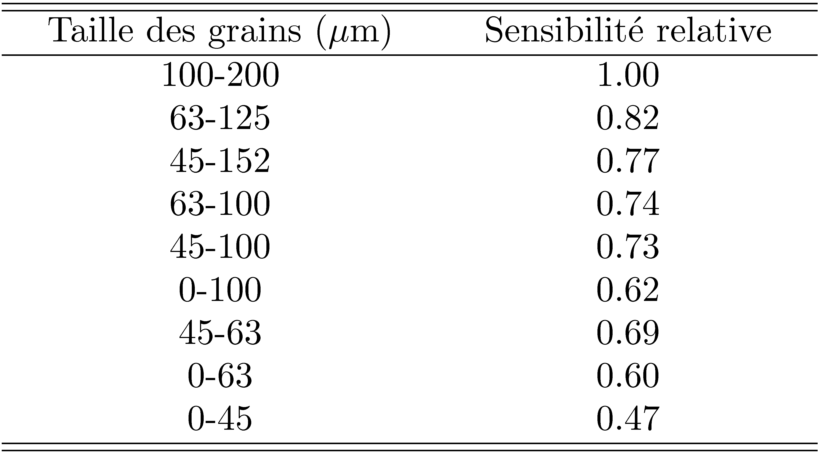
Size of the CaSO₄ grains
CaSO₄ is generally obtained as polycrystal with grain size depending of the manufacturing process
If the grain size ↗ → the sensitivity ↗ ↔ the larger grains have a larger impurities %
Attention → if the grain size ↗ too much → becomes fragile

Slide 9
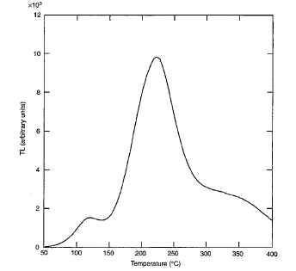
Example of GC for CaSO₄: Dy
Main Peak at 220 °C
Large dependence on the annealing conditions and of the secondary impurities (here a small amount of Na)

Slide 10
Emission mechanisms (1)
A possibility is that, under irradiation →
then the recombination of Dy²⁺ with h⁺ produces light
Another possibility: considering a « larger » site →
Recombination → light
Or also →

Slide 11
Emission mechanisms (2)
We cannot ignore the possibility of a combination of the 3 previous mechanisms
Anyway the recombination mechanisms are not known
Roles of the secondary impurities?

Slide 12
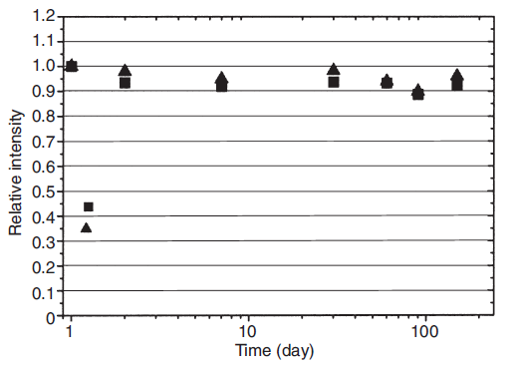
Fading for CaSO₄: Dy
The fading of CaSO₄: Dy is of about 5% for a 6 months period at ambient T° → 2 £ larger than for LiF: Mg,Ti (but it is always very good)
If small T° peaks are taken into account (80 and 120 C°) → fading of 15% during the 5 first days at ambient T° and then of 5% during 6 months
Attention: very sensitive to light → luminescence loss of 50% after 3h of sun exposition (9000 lux)

Slide 13
Sensitivity of CaSO₄: Dy
Sensitivity of CaSO₄: Dy → 30 to 50 £ larger than the sensitivity of LiF: Mg,Ti
The property associated to a weak fading → particularly adapted for the measurement of weak doses (environmental applications)
Attention: large variation of the sensitivity as a function of the manufacturing process

Slide 14
Dose response of CaSO₄: Dy (1)
D < 10 Gy → linear response
10 Gy < D < 5 10³ Gy → supralinear response
5 10³ Gy < D < 10⁵ Gy → sublinear response (saturation)
D > 10⁵ Gy → decrease of the luminescence (damages due to irradiation)
Addition of secondary dopant → CaSO₄: Dy,Cu → linearity extended up to 100 Gy
The degree of supralinearity strongly depends on the size of the CaSO₄ grains
Unrealistic to theoretically demonstrate these properties

Slide 15
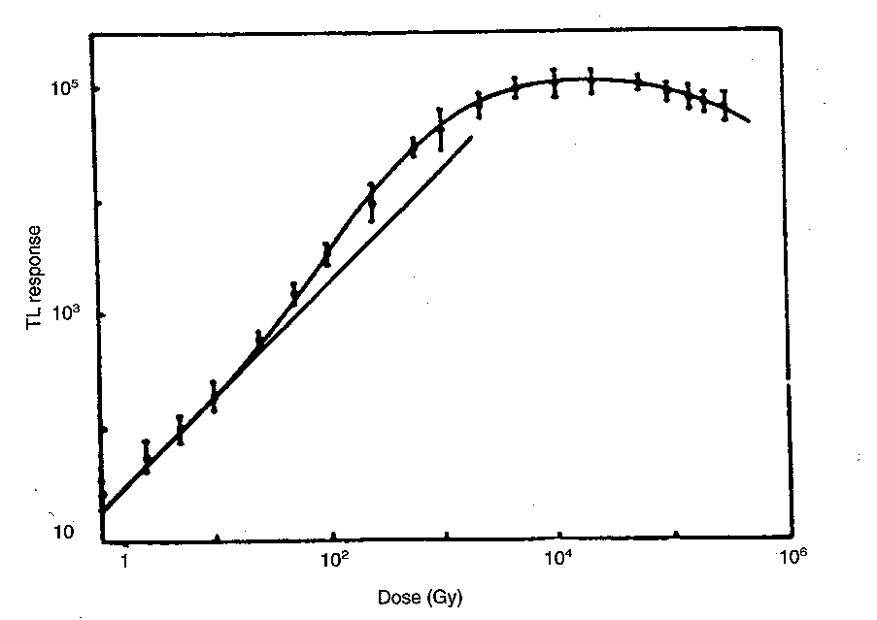
Dose response of CaSO₄: Dy (2)

Slide 16
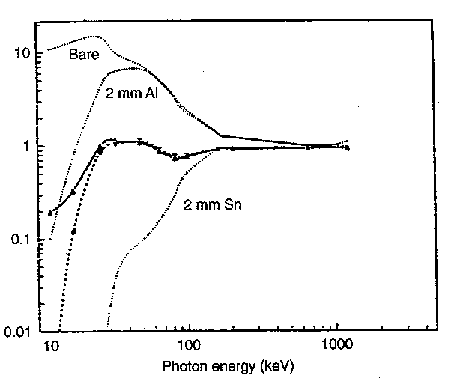
Energy response of CaSO₄: Dy (1)
CaSO₄: Dy is characterized by a significant overestimation for energies < 200 keV
k₁=0.1, k₂=0.0, k₃=0.9
TL response
k₁=0.00, k₂=0.12, k₃=0.88

Slide 17
Energy response of CaSO₄: Dy (2)
Z_{eff}(CaSO₄) = 15.3 → not tissue-equivalent at all → major disadvantage of CaSO₄: Dy
Solution → put filters (Al and Sn in previous example)
Sn improves the response between 100 keV and 200 keV but implies a loss of sensitivity for E < 100 keV
Al gives a good result for E ≈ 20 keV
The best result is obtained by considering a linear combination R of the 3 responses (bare, Sn, Al) →

Slide 18
Summary for CaSO₄: Dy
Not tissue-equivalent
Very dependent on the energy for E < 200 keV (° rays) → necessary to use filters
The main luminescence is at ≈ 220 °C for 2 emission peaks at 478 nm and 571 nm
The response of CaSO₄: Dy as a function of the absorbed dose is linear to a ° dose of 10 Gy (100 Gy if addition of Cu)
Minimum dose boundary ≈ 2 ¹Gy
Good long term stability of the information
Optimum reusing

Slide 19
CaSO₄: Dy dosimeter in practice (ULB) (1)
The dosimeters are made as CaSO₄ :Dy/PTFE
PTFE (i.e. polytetrafluoroethylene or Teflon) is added to CaSO₄ in order to make the chips more flexible and less brittle
The dosimeters are symmetric and are composed of 8 reading slots (4 « useful » slots and 4 back-up slots)
The box in polyethylene is composed of 2 areas → in these 2 areas there are ≠ filters →
Polyethylene filter (7 mg/cm²)
Al filter (2.5 mm)
PTFE filter (3.18 mm)
Filter of Al (0.13 mm) – Cu (0.50 mm) – Pb/Sn (0.75 mm) with holes

Slide 20
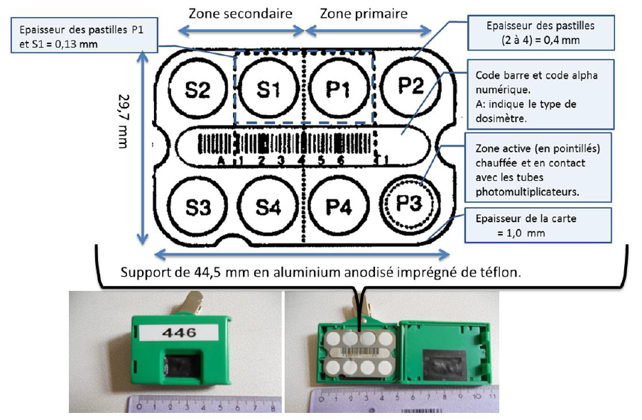
CaSO₄: Dy dosimeter in practice (ULB) (2)

Slide 21
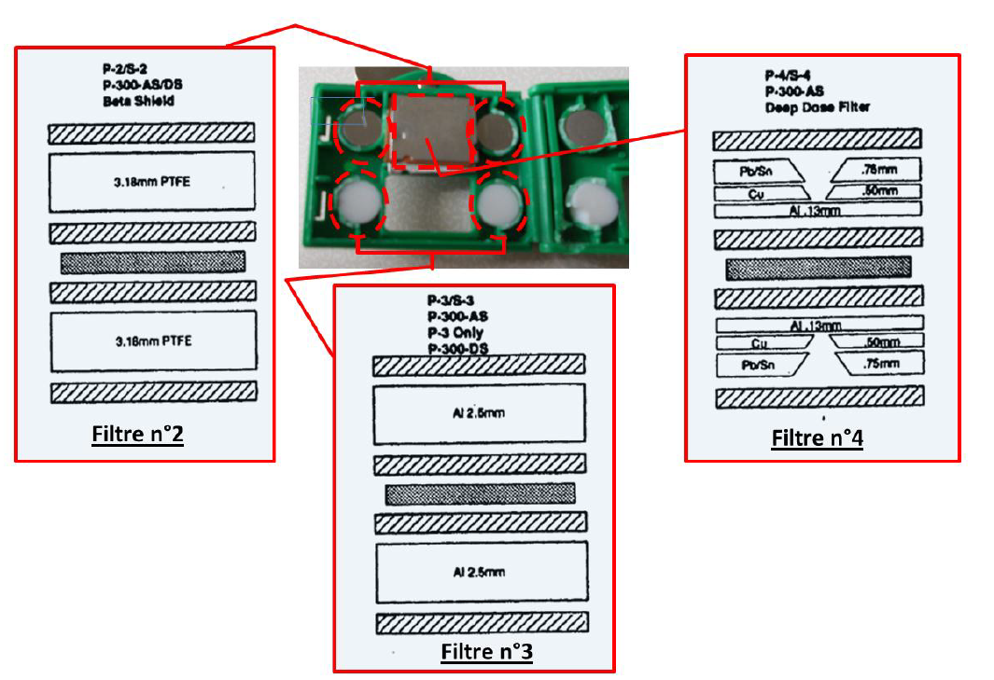
CaSO₄: Dy dosimeter in practice (ULB) (3)

Slide 22
CaSO₄: Dy dosimeter in practice: Interpretation of the results
Slot under polyethylene → this window allows the detection of small E ° and of ¯ rays → the E response for this slot implies an overestimation of a factor 20 for small E (X-ray) → overestimation compensated by the other slots with a calculation algorithm
Slot under Teflon → allows to approximately determine the energy to which the dosimeter was exposed and to correct the measurement of the previous slot via a algorithm
Slot under Al → stopping of ¯ with E < 2.2 MeV → ° measurement
Slot with mixing filter → allows to measure the ° dose in depth (the holes hallows the crossing of a part of the °)

