Slide 1
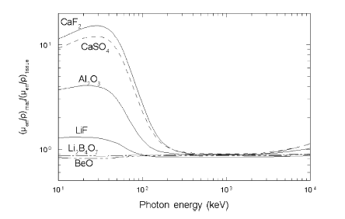
Energy response (1)
Ideal case → energy response equal (or at least proportional) to human tissue
It is desirable for the ratio between the energy absorption coefficients to be constant
Photoelectric effect varying in Z³ - Z⁴

Slide 2
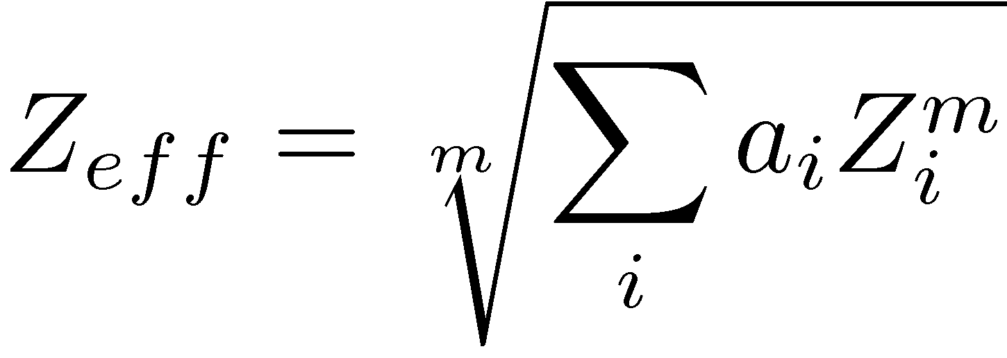
Energy response (2): Effective atomic number
Instead of comparing the response with curves → useful to define a « number » conveniently allowing this comparison → effective atomic number, Z_{eff}:
with a_{i}, the fraction of the total number of e⁻ associated to each element with atomic number i
m include between 3 and 4 gives a reasonable agreement with experiment → m = 3.5 is generally chosen (empirical choice!)
Z_{eff} = 7.35 for tissues (in this model) → TLD with Z_{eff} ≈ 7.35 → tissue-equivalent TLD

Slide 3
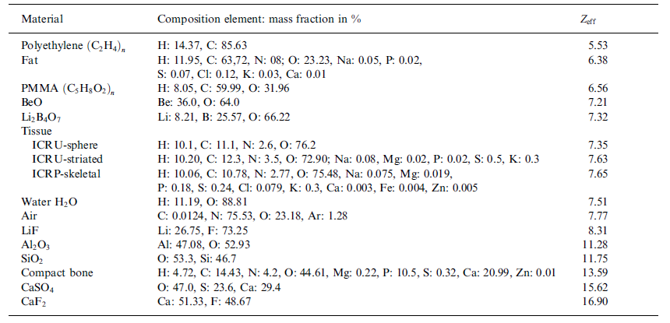
Examples of Z_{eff}

Slide 4
Z_{eff} – fading – sensitivity – limits for ≠ TLD

Slide 5
Annealing
One of the interests of the TLD → reuse
To have always the same properties → procedure of annealing → to maintain the TLD at a high T → to cool it to ambient T at a given velocity, ® → following by annealing at low T
Usefulness:
To empty the traps non-completely emptied during reading
To restore the thermodynamic equilibrium of the defects
To empty deep traps (not used during reading) that can influence the sensitivity of the TLD
Sometimes → annealing at low T after irradiation → elimination of low T GP with high fading

Slide 6
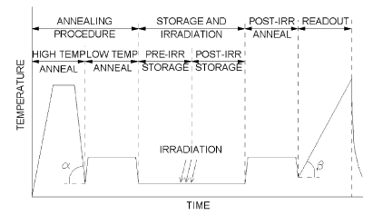
Procedure of annealing

Slide 7
TLD in practice
TLD has to be placed into a support whish is carried by people that must be controlled
After some predetermined time → analyze of the signal
The TLD is heated → luminescence measured with a photomultiplier → classical amplification chain → voltmeter
The chain is calibrated with a light intensity measurement from a luminescent source submitted to a known dose
Afterward → annealing at high T° (to empty deep traps) → reusing (depends on the type of TLD)

Slide 8
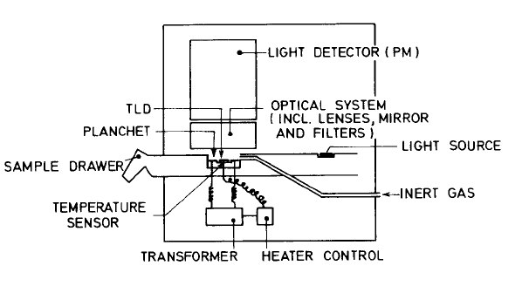
Reading of the TLD

Slide 9
Examples of TLD
The 2 TLD used actually or having been used at ULB
LiF: Mg,Ti (TLD-100)
CaSO₄: Dy (TLD-900)
Reference:
S.W.S. McKeever, M. Moscovitch, P.D Townsend, Thermoluminescence dosimetry materials: Properties and use (Nuclear technology Publishing) 1995.

Slide 10
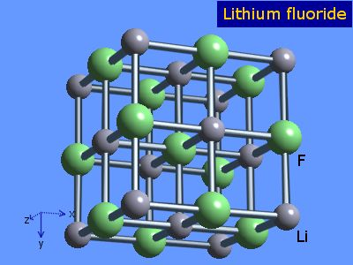
LiF: Mg,Ti: Structure of LiF
LiF consists of 2 interpenetrating FCC lattices (one for Li⁺ and another one for F⁻)
The thermodynamic defaults consist of Shottky and Frenkel defaults

Slide 11
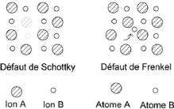
LiF: thermodynamic defaults
Shottky default: pair of Li⁺ and F⁻ vacancies
Frenkel default: pair vacancy-interstice of Li⁺ or F⁻

Slide 12
Additional impurities: Mg
Mg²⁺ replaces Li⁺ → charge neutrality is kept due to the presence of an excess of Li⁺ vacancies
Coulomb interaction between the impurity and a vacancy → impurity-vacancy pair (Mg-Li_{vac}): dipole
At ambient T → free energy of the crystal is minimum for the association of the dipoles into « cluster » → the most important: trimer (cluster of 3 dipoles) because it can be shown that the sensitivity of the TLD is maximum for Mg as trimer → the trimers are the traps
Process: annealing at 400 °C during 1h → formation of dipoles → annealing at 80 °C during 24h → formation of trimers
Attention: for T < 250 °C → precipitation as MgF₂ → decrease of the sensitivity at ambient T

Slide 13
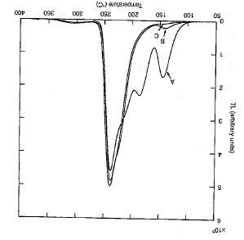
GC as a function of annealing
Annealing at 400 °C (1h) following by fast return at ambient T
Annealing at 400 °C (1h) following by annealing at 80°C (24h)
Annealing at 400 °C (1h) following by annealing at 100°C (2h)

Slide 14
Additional impurities: Ti
Substitution of titanium for du Li⁺ as Ti³⁺ or Ti⁴⁺
Different mechanisms to keep the charge neutrality → formation of Ti⁴⁺(O²⁻)₃ and especially Ti(OH)_{n} → responsible for the light emission at 3.01 eV (412 nm) → essential for the luminescence
The Ti(OH)_{n} are the luminescence centres
Other mechanism → bonding with Mg and formation of Mg(OH)_{n} → decrease of the TL emission → conflictual role between Ti(OH)_{n} and Mg(OH)_{n} → concentration of Mg and Ti is preponderant and must be scrupulously controled

Slide 15
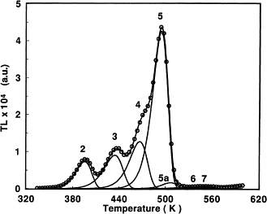
Global effect of the impurities: emission mechanisms
The traps responsible of the main peak in dosimetry are the Mg-Li_{vac} trimers
The Mg of the default is spatially correlated with a Ti(OH)_{n}
The Ti(OH)_{n} is a luminescence centre → Peak 5
The other combinations of defaults create supplementary peaks in the GC

Slide 16
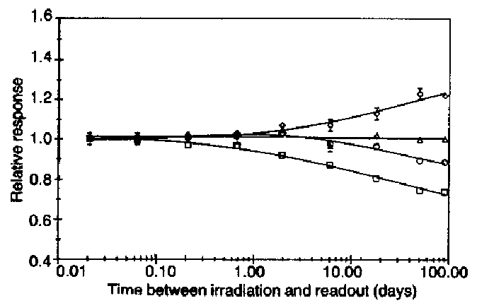
Fading for LiF: Mg,Ti (1)
The fading depends on a large number of parameters: storage T, process of annealing, type of radiation, integration range of the GC
Peaks at « small » T (peaks 2, 3, 4) → more important fading → fading depends on the peaks considered in the GC integration
Peak 5
Peaks 4 +5
Peaks 3 + 4 +5
Peaks 2 + 3 + 4 + 5

Slide 17
Fading for LiF: Mg,Ti (2)
Light sensitivity → 11% of luminescence loss is observed after 3h exposure to sun (9000 lux)
It remains a small light sensitivity

Slide 18
Sensitivity of LiF: Mg,Ti
LiF: Mg,Ti is considered as the standard of sensitivity
Sensitivity depends on a large number of parameters → ≠ LiF: Mg,Ti will have ≠ sensitivities
Some companies keep TLD in conditions perfectly controlled → considered as standards
Deviations of § 15% between various LiF: Mg,Ti commercially available

Slide 19
Response to the dose for LiF: Mg,Ti (1)
D < 1 Gy → linear response for LiF: Mg,Ti
1 Gy < D < 1000 Gy → supralinear response
D > 1000 Gy → sublinear response (saturation region)
Spatial correlation between a Mg-Li_{vac} trimer and a Ti(OH)_{n} →
Correlation
T
DT
RC

Slide 20
Response to the dose for LiF: Mg,Ti (2)
When RC and T are correlated → no interaction with a DT → linear response
When the dose is weak → important proportion of correlated RC and T → linear response
When the dose ↗ → contribution of non-correlated RC and T ↗ (because non-linear ↗)
For a given dose → non-linear contribution is dominating → supralinearity

Slide 21
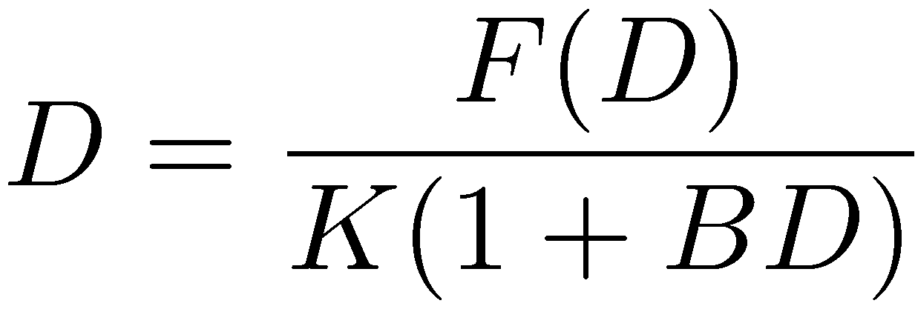
Response to the dose for LiF: Mg,Ti (3)
Useful to determine a correction factor for supralinearity (phenomenological expression)
Experimentally it can be shown that in the supralinear region →
With K = F(D₁)/D₁ (weak dose for which the response is linear) →
Assuming A = 1 (in agreement with experimental results)→

Slide 22
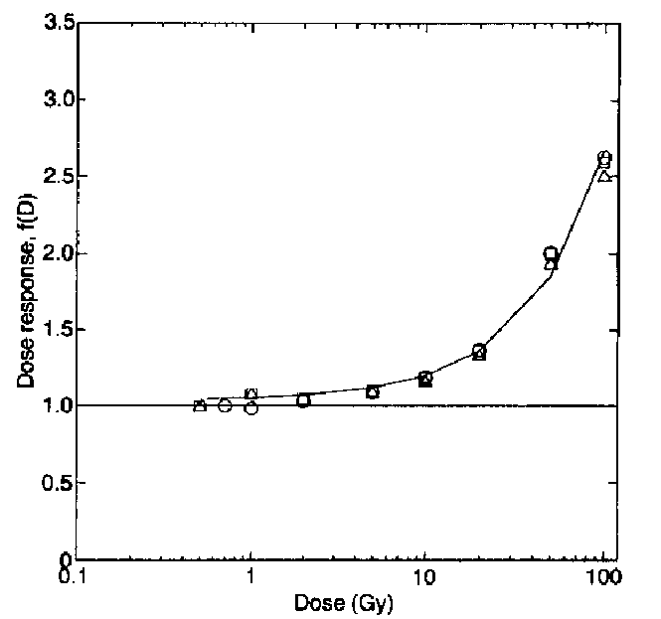
Response to the dose for LiF: Mg,Ti (4)
Assuming BD < 1 (with B ≈ 0.015 → D < 65 Gy) →
Resolving for D with D₀ = F(D)/K → D = D₀(1+D₀B)⁻¹
Response curve of LiF: Mg,Ti irradiated by ⁶⁰Co ° at ≠ depths in plastic equivalent water

Slide 23
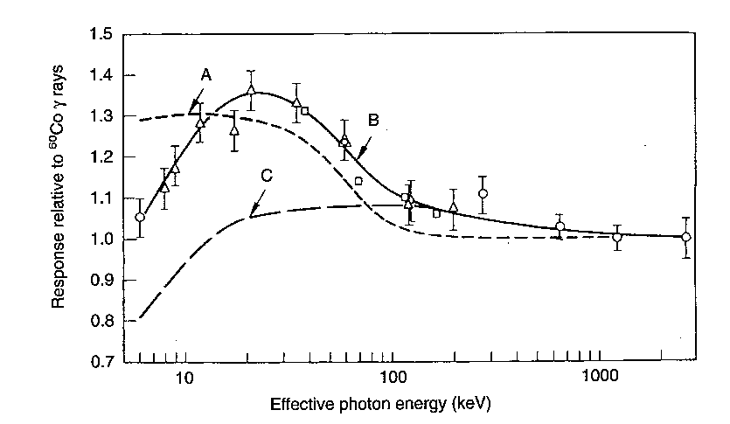
Energy response of LiF: Mg,Ti
↘ of the efficiency of the TLD for a ↗ E linear transfer
Absorbed dose in the LiF by X unit calculated via the ratio of the E mass absorption coefficients of LiF and air
Response of LiF: Mg,Ti by X unit (experimental result)
Response of LiF: Mg,Ti by dose unit → B/A
Considering Z_{eff}(LiF) = 8.2 → tissue-equivalent

Slide 24
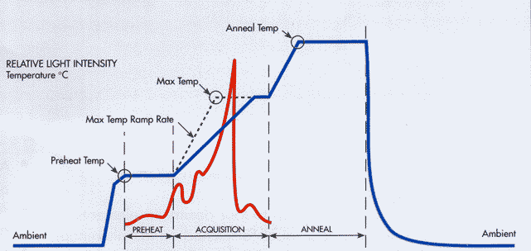
Reading procedure

Slide 25
Sensitivity to neutrons
The LiF has besides the advantage to be made in natural condition of 92.6 % of Li⁷ and of 7.4 % of Li⁶ → Li⁶ has a very large cross section for thermal neutrons (945 barns) → shows the presence of neutrons according to:
Li⁷ has a negligible cross section for these neutrons →measure of everything that is not neutrons (electrons, photons)
By simple difference → highlight the presence of neutrons

Slide 26
Summary for LiF: Mg,Ti
Tissue-equivalent (Z_{eff}(LiF) = 8.2)
Energy independent between » 100 keV and 1.3 MeV for ° radiation
The main luminescence is at ≈ 500 K for a maximum of the emission spectrum at 412 nm
The response of the LiF as a function of the absorbed dose is linear up to a ° dose of at least 5 Gy
Minimum boundary of dose ≈ 20 ¹Gy
Good stability at long term of information
Optimum reusing

