Slide 1
Luminescence efficiency
Simple model → description of kinetics → no indication about absolute intensity of luminescence
The intrinsic efficiency ´_{i} is defined as the ratio of the energy emitted as visible light during heating to the energy absorbed during the exposure to ionizing radiation
For the calculation of ´_{i}, distinct steps are considered

Slide 2
Different physical steps for the calculation of ´_{i}
The absorption of ionizing radiation → creation of N e⁻-h⁺ pairs → N / 1/W et W = ¯‘E_{g} (avec 1 < ¯‘ < 4)
Thermalization and trapping of the charge carriers → the fraction that is captured in traps, which can be thermally stimulated → trapping efficiency: ´_{tr}
Release of the charge carriers (probability p), transport to a luminescent centre (efficiency S), exciting the luminescent centre that de-excite under emission of a photon (quantum efficiency Q)
Escape of the produced thermoluminescent photons from the sample (escape fraction: ´_{esc})

Slide 3
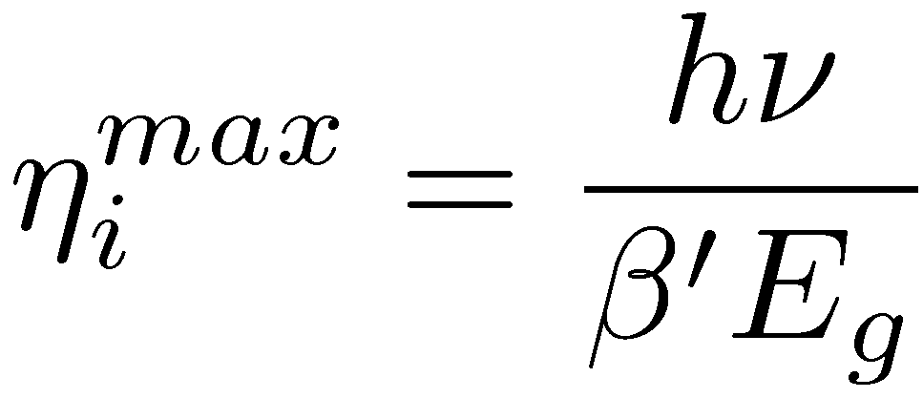
Intrinsic efficiency
With hº, the mean E of the emitted TL photons →
With all steps efficiency at maximum →
For all media used as TL → ´_{i}^{max} ≈ 13% → only a small part of the absorbed E is converted into e⁻-h⁺

Slide 4
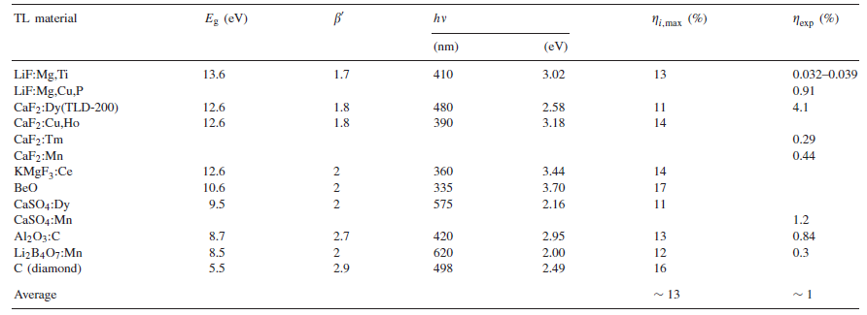
Intrinsic and maximum efficiencies

Slide 5
Parameters influencing the efficiency (1)
Trapping efficiency : ´_{tr} → crystal imperfections serve as trapping centres and by adding dopants → ↗ of the number of traps → increase of ´_{tr} only for low traps concentration ↔ when the traps concentration is too large → average distance among the dopants become so small that interaction becomes possible → the energy levels are no more localized → decrease of ´_{tr} (« concentration quenching »)
For S → for a direct recombination of a thermally excited e⁻ into a trap → S ≈ 1

Slide 6
Parameters influencing the efficiency (2)
Q strongly depends on temperature → when T ↗ → Q ↘ (« thermal quenching ») (→ when ¯ ↗ → Q ↘) → with C and W: quenching parameters:
Escape fraction: ´_{esc} → for monocrystals which can be transparent to their own radiation: ´_{esc} ↗ and for powders and sintered materials: ´_{esc} ↘ (ex: ´_{esc}(Al₂0₃:C) = 94% and ´_{esc}(BeO) = 35%)

Slide 7
Thermoluminescent dosimeters (TLD)
The most used TLD in radiation dosimetry are:
LiF:Mg,Ti
LiF:Mg,Cu,P
Li₂B₄O₇:Mn
because they are tissue-equivalent
Are also used due to their large sensitivity:
CaSO₄:Dy
Al₂O₃:C
CaF₂:Mn
They are available as variable forms (powders, pastilles, ribbons,…)

Slide 8
General characteristics of TLD
Fading
Sensitivity
Detection limits
Response to the dose
Response to the energy
Annealing

Slide 9
Fading (1)
A « perfect » TLD has the capacity to store information (trapped charge carriers) during an infinite time without losses
However → there is always a probability of escape for the e⁻ before reading → fading → underestimation of the absorbed dose
Various causes for fading
Thermal fading: following Arrhenius’ law →
it is possible to obtain the half-live of thermal fading →

Slide 10
Fading (2)
Optical fading: some materials (CaSO₄ , CaF₂) are very sensitive to light (materials with best sensitivity obviously) → must be store in opaque containers
Quantum fading: quantum tunnelling between the trap and the recombination site
Recommendation of the European Communauty: fading < 5 % during monitoring time at 25°C

Slide 11
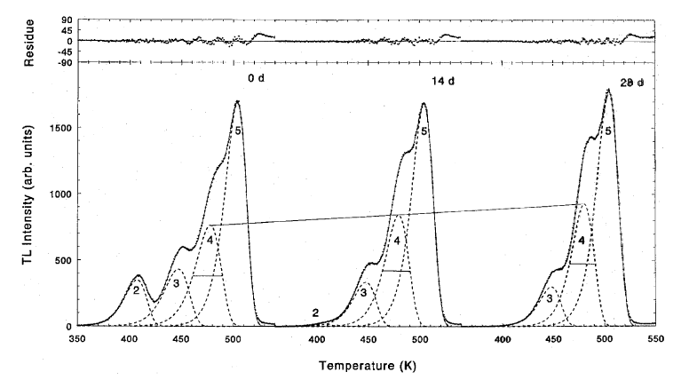
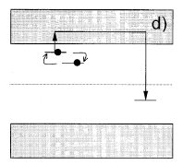
Fading (3)
GC for a LiF:Mg,Ti after a 60 mGy irradiation from ⁶⁰Co measured after 0, 14 and 28 days
Interactions between defaults

Slide 12
Sensitivity
TLD sensitivity: Intensity of the signal integrated over a time given per unit of absorbed dose and per unit of mass → depends on the TLD but also on the type of radiation, on the energy of radiation as well as on the reading system (heating, light detection,…)
Generally → we define sensitivity relatively to the LiF:Mg,Ti TLD in same conditions of radiation and analyze
Generally → radiations with high linear energy transfer (®, neutron,…) give signal < radiations with low linear energy transfer (°, ¯,…)

Slide 13
Detection limits
Means both: lower and upper levels of detection
Lower level: smallest absorbed dose that can be detected with a specified confidence level → same order of magnitude a the background
Upper level: largest dose that can be detected → theoretical maximum limit: all traps are filled → practically: the dose response has to be considered

Slide 14
Response to the dose (1)
The signal of the TLD depends on the dose → F(D): response to the dose
Ideally a TLD has to shown a response to the dose linear over a large range of doses, at least over the range of interesting doses
Practically → many non-linear effects exist for all materials
The linearity index f(D) (or normalized dose response) is defined as:
with D₁, a weak dose for which the response is linear

Slide 15
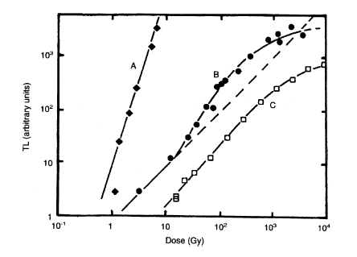
Response to the dose (2)
We have:
f(D) = 1: linear response (ideal TLD)
f(D) > 1: supralinear response
f(D) < 1: sublinear response (traps saturation)
SiO₂: supralinearity for the whole range of doses
LiF:Mg,Ti: behaviour linear - supralinear
CaF₂: Mn: very weak supralinearity
Dash-curve: linear response
slope = 1 or ≈ 1

Slide 16
Explanation of supralinearity (1)
Many parameters influence supralinearity: type of radiation, E of the radiation, speed of heating, defaults quantities,…
To explain supralinearity → many models (up to now) → for some of them: critical process during the E absorption, for other ones: critical process during heating
During heating → e⁻ are released from traps → recombination with h⁺ to create light or trapping in deep traps (DT) without creation of light → concurrent centre (CC)

Slide 17
Explanation of supralinearity (2)
At small dose → large distance between the trap (T) and the recombination center (RC) → high probability for a e⁻ released by a trap to reach a DT before a RC → reduced dose response
When the dose ↗ → the distance between T and RC ↘ but also the number of DT ↘ (they have a larger probability to be filled → but a DT must be empty) → the dose response ↗ (up to saturation of the T)
Combining 1 and 2 → f(D) > 1 (SiO₂)
If there is no DT in the medium → dose response has to be higher and a linear response is observed up to saturation (CaF₂: Mn)
The supralinearity is an underestimation at small dose rather than an overestimation at large dose

Slide 18
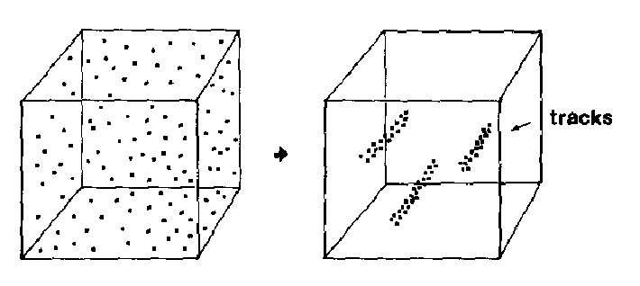
Supralinearity ↔ linear energy transfer (1)
(a)
(b)
Spatial distributions of T-RC pairs for (a) ° of high energy (weak linear energy transfer) and for (b) heavy charged particles (large linear energy transfer)
Heavy ions: dose deposited in a cylindrical area of a few tens of nm along the ion trajectory → large concentration of filled traps and few DT in the tracks cylinders / small concentration of filled traps and many DT outside the tracks cylinders
MFP of the released e⁻ < cylinder radius → no interaction with a DT → reaching a RC → light → linear response
Attention → quicker saturation

Slide 19
Supralinearity ↔ linear energy transfer (2)
For particles with weak linear energy transfer → the released e⁻ can leave the tracks area and enter the area with large concentration of DT → loss of luminescence
When the dose ↗ → the inter-tracks distance ↘ → the e⁻ reaches a RC with a larger probability → the dose response ↗ → supralinearity
When the linear energy transfer ↘ → supralinearity ↗

Slide 20
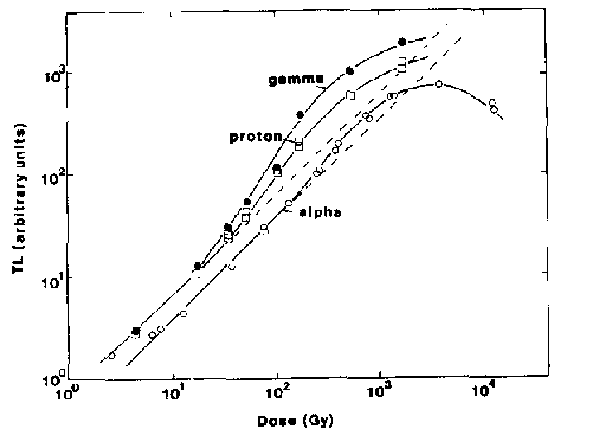
Supralinearity ↔ linear energy transfer (3)

