Slide 1
First-order GP
If T is raised as a linear function of time →
with T₀: T for t = 0 and ¯, the constant heating rate
The GP becomes (as a function of T) →
First-order expression of Randall-Wilkins for the GP

Slide 2
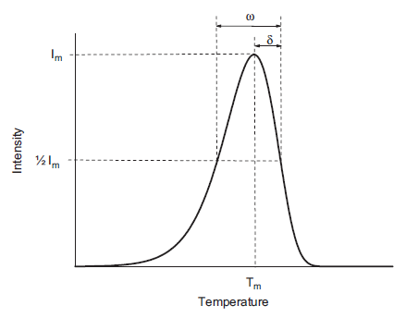
Form of the first-order GP
Asymmetric peak
Geometry factor ¹_{g} = ±/! with !, the full width at half maximum and ±, the half width at half maximum (for high T) → typically ¹_{g} = 0.42
T_{m}: the T at maximum I_{m}
For small T → exponential decrease (exp[-E/kT]) is dominating

Slide 3
Maximum of GP
The condition to have the maximum →
This gives the Randall-Wilkins relation →
that can be iteratively resolved
In the Randall-Wilkins relation → there is no n₀ → T_{m} is independent on n₀

Slide 4
Importance of n₀
n₀: important parameter in radiation dosimetry → n₀ / D
n₀ is equal to the area of the GP →
with n₁ → 0 for t → 1

Slide 5
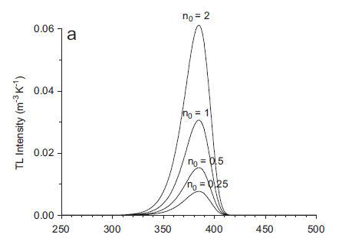
Variation of the GP with n₀
Temperature (K)
GP(T,n₀) for E = 1 eV, s = 10¹² s⁻¹ and ¯ = 1 Ks⁻¹ ([n₀] = m⁻³)
T_{m} is constant for varying n₀

Slide 6
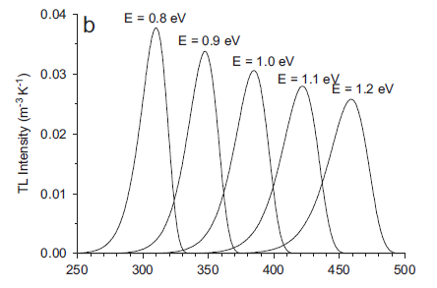
Variation of the GP with E
Temperature (K)
GP(T,E) for n₀ = 1 m⁻³, s = 10¹² s⁻¹ and ¯ = 1 Ks⁻¹ ([E] = eV)
E ↗ → shift of the GP to high T, ↘ of the height and ↗ of ! with a constant area
Shift of the GP to high T for E ↗ because deeper trap → more energy is needed (→ higher T) for e⁻ detrapping

Slide 7
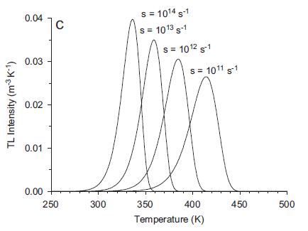
Variation of the GP with s
GP(T,s) for n₀ = 1 m⁻³, E = 1 eV and ¯ = 1 Ks⁻¹ ([s] = s⁻¹)
s ↗ → shift of the GP to small T, ↗ of the height and ↘ of ! with a constant area
s ↗ → probability to free the e⁻ is larger → less E necessary (→ smaller T)

Slide 8
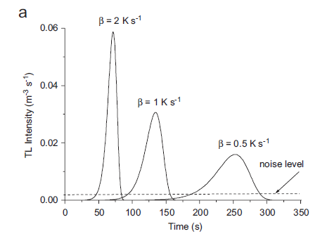
Variation of the GP(t) with ¯
GP(t,¯) for n₀ = 1 m⁻³, E = 1 eV and s = 10¹² s⁻¹ ([¯] = Ks⁻¹)
Height of the GP / to n₀ but also to ¯ → it is confirmed by the I_{m} expression due to Hoogenboom →

Slide 9
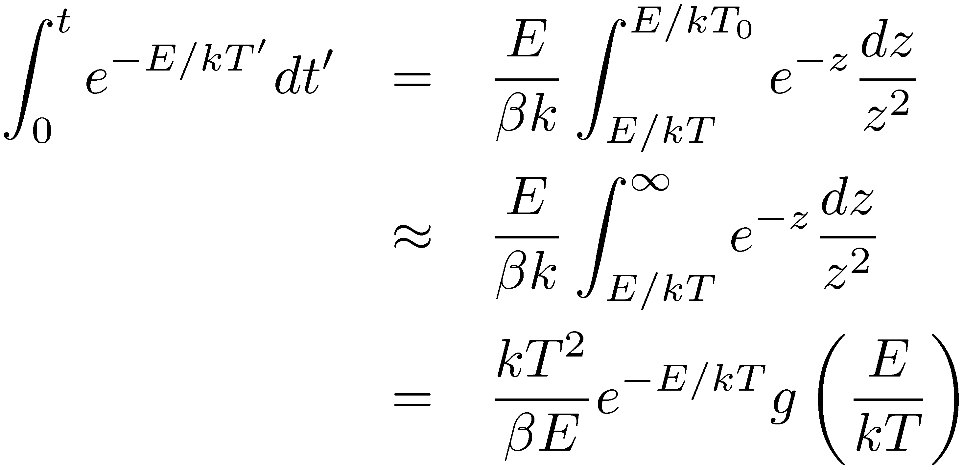
I_{m} expression of Hoogenboom (1)
With T(t) = T₀ + ¯t, we consider:
Correct for T₀ ¿ T_{m}

Slide 10
I_{m} expression of Hoogenboom (2)
with
and E₂(x), the exponential integral of second-order
By taking again:
Considering g_{m} = 1 → I_{m} underestimation of 10%

Slide 11
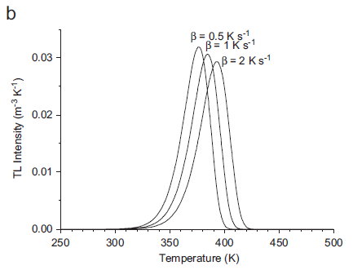
Variation of the GP(T) with ¯
GP(T,¯) for n₀ = 1 m⁻³, E = 1 eV and s = 10¹² s⁻¹ ([¯] = Ks⁻¹)
¯ ↗ → shift of the GP to high T, ↘ of the height and ↗ of ! with a constant area → opposite behaviour compared to s → normal because of the ratio s/¯ in the expression of I(T)

Slide 12
Approximated expression of I(T)
Approximation of Kitis → the integral is approximated by asymptotic series →
with ¢ =2kT/E and ¢_{m}=2kT_{m}/E
Useful expression utile for fitting

Slide 13
Second-order kinetics (1)
Unlike Randall and Wilkins, Garlick and Gibson consider that retrapping is dominating →
2 more assumptions → N À n (trap is far from saturation) and n = m →
Thus → dn/dt / n² → second-order reaction

Slide 14
Second-order kinetics (2)
By assuming equal probabilities for recombination and trapping → A_{m} = A_{n} and T = constant →
with ® = s/N exp(-E/kT) → second-order equation
We observe now a decrease hyperbolic and no more exponential

Slide 15
Second-order GP
Assuming again that → →
Garlick-Gibson’s expression for the second-order GP

Slide 16
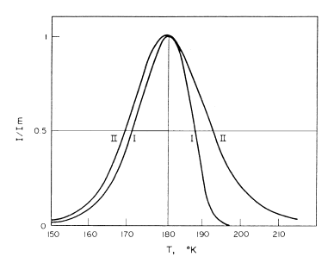
Form of the second-order GP
Comparison between GP of first and second order
The half width at half maximum for high T > the half width at half maximum for small T
Typically ¹_{g} = 0.52 (larger than for first-order) → significant concentration of released e⁻ are retrapped before they recombine → delay in the luminescence emission and spreading out of the emission over a wider temperature range

Slide 17
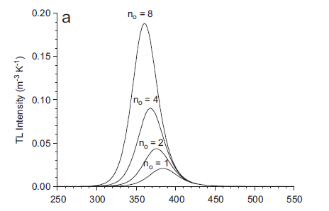
Variation of the second-order GP with n₀
GP⁽²⁾(T,n₀) for E = 1 eV, s = 10¹² s⁻¹ and ¯ = 1 Ks⁻¹ ([n₀] = m⁻³)
T_{m} ↘ when n₀ ↗ → main difference compared to first order
Area of the peak / n₀ as for first-order but the intensity of the peak is no more directly proportional to n₀ (even if the deviation is small)

Slide 18
Approximated expression of I(T)⁽²⁾ (second-order)
Approximation of Kitis (with again ¢ =2kT/E and ¢_{m}=2kT_{m}/E) →

Slide 19
General-order kinetics
In most of the practical cases → we are faced with models of first- (largely dominating) or second-order ↔ the displayed conditions have to be respected
If conditions are not respected → empirical expression for general-order kinetics of May and Partridge →
with b, the general-order parameter and [s’] = m^{3(b-1)}s⁻¹
For b ≠ 1 (with s’’ = s’n₀^{(b-1)})→

Slide 20
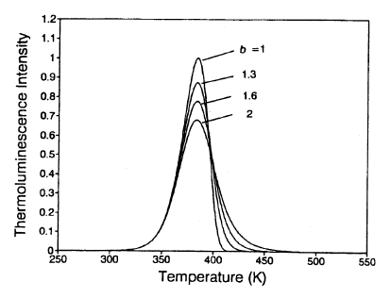
Comparison of ≠ orders GP
GP(T,b) for n₀ = 1 m⁻³, E = 1 eV, s = 10¹² s⁻¹ and ¯ = 1 Ks⁻¹ for b = 1, 1.3, 1.6, 2

Slide 21
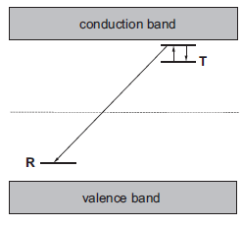
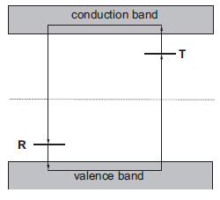
Discussion about various assumptions (1)
QE assumption → more complex models (without QE) give results very close to those obtained for a first-order GP
Assumption of the simple model: recombination via a transition from an e⁻ into the conduction band → other possibilities exist:
(a)
(b)
Recombination with a thermally stimulated e⁻ in the trap
e⁻ and h⁺ are simultaneously released

Slide 22
Discussion about various assumptions (2)
(a) → the trap has to be in the proximity of a centre → however, traps and recombination centres « really » isolated are rare → frequent phenomenon → the frequency factor s is replaced by the « suitable quantity »
(a) → probability of retrapping is zero → first-order equation → that explains, among other things, why first-order kinetics is in reality dominating
(b) → eqs. of first- or second order valid by replacing E and s by adapted quantities → more complicated

Slide 23
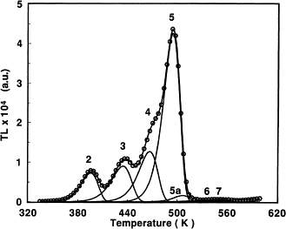
Discussion about various assumptions (3)
The presence of more than 1 trap (→ several possible E values) implies a « glow curve » (GC) composed of several GP →
A GC can (generally) be deconvoluted into several GP → attention: the parameters of each GP (E and s) have not the same meaning as for a simple GP
GC of LiF: Mg,Ti

