Slide 1
Chapter IX: Thermoluminescent dosimeters

Slide 2
Thermoluminescent dosimeters (TLD)
Following the radiation absorption → some materials (semiconductors or insulators, not metals) retain a part of the absorbed energy in metastable states
When this E is liberated as UV radiation, visible or IR → phenomenon called luminescence
The luminescence process can be accelerated due to an external stimulus (heat, light)
When external stimulus = heat → thermoluminescence
When thermoluminescence is used for dosimetry → thermoluminescent dosimeter (TLD)
References:
A.J.J. Bos, High sensitivity thermoluminescence dosimetry, Nuclear Instruments and Methods in Physics Research Section B 184 (2001) 3-28
A.J.J. Bos, Theory of thermoluminescence, Radiation Measurements 41 (2007) S45–S56

Slide 3
Luminescence
When ionizing radiation interacts with matter → a large number of molecules are excited or ionized
When these molecules return to the ground state → possible creation of luminescence centers → possible emission of photons in the visible or near to the visible energy range → luminescence
3 types of luminescence
Fluorescence: light emission occurs “immediately” after absorption (more precisely: < 10⁻⁸ s, i.e. time for atomic transition)
Phosphorescence: light emission is delayed because excited state is metastable (time between absorption and emission can be from ¹s to days, months)
Delayed fluorescence: a center of phosphorescence can be transformed into a fluorescence center following an external excitation → « normal » fluorescence but after a much longer time

Slide 4
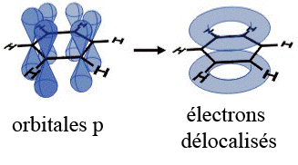
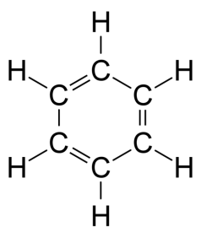
Example fluorescence ↔ phosphorescence: Benzene
Benzene (C₆H₆) → π-electrons → spin = 0 (singlet: S_{i}) or spin = 1 (triplet: T_{i})
Energy absorption → radiationless decay from high energy levels to S₁₀ state
Transitions between S₁₀ and S_{0i} with light emission (fluorescence)
Transition between S₁₀ and T₁₀ → slow transition to S₀ (phosphorescence) or excitation to S₁₀ due to outside

Slide 5
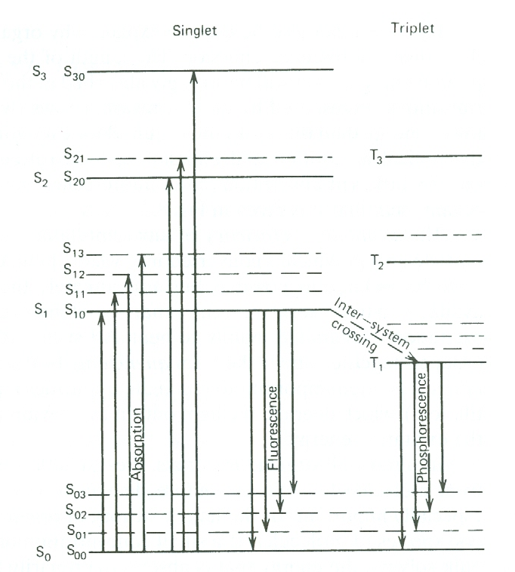
Energy levels of benzene

Slide 6
Model: 1 trap – 1 recombination centre
Energy band model
Intensity of light
First-order kinetics
Second-order kinetics
General-order kinetics
Luminescence efficiency

Slide 7
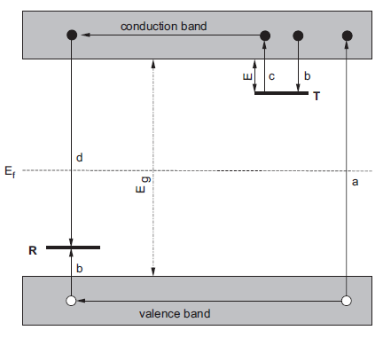
Energy band model (1)
E_{g} : energy band gap
E_{f} : Fermi level
T: electron trap (with E, E of the trap or activation E)
R: recombination centre

Slide 8
Energy band model (2)
Semiconductors or insulators → band structure
Structural defaults or impurities (→ complete characterization is impossible → never 2 identical TLD) → levels inside the forbidden band gap → simple model → 2 levels: 1 below the conduction band (T) and another above the valence band (R)
E_{T} > E_{f} → empty at equilibrium and before irradiation
When hº > E_{g} is absorbed → ionization of valence band e⁻ → after thermalization → free e⁻ in the conduction band and h⁺ in the valence band (a transition)

Slide 9
Energy band model (3)
2 possibilities
Direct recombination → excitation of a luminescence centre (corresponding to a recombination centre)
Trapping of an e⁻ at T and of a h⁺ at R (b transition)
The probability p of liberation per time unit (c transition) of the trapping e⁻ is given by the equation of d’Arrhenius:
with s, the frequency factor or attempt-to-escape factor (constant in the simple models simples and ≈ 10¹² - 10¹⁴ s⁻¹, i.e. the lattice vibration frequency), k = 8.617 10⁻⁵ eVK⁻¹, Boltzmann’s constant and T, the temperature (in K⁻¹)

Slide 10
Energy band model (4)
If E À kT₀, with T₀ the T during irradiation (T ≈ 300 K) → the e⁻ are indefinitely trapped (or at least during a long time compared to the analysis time)
N(e⁻) = N(h⁺) because they are created by pairs
E(R) < E_{f} < E(T) → non-equilibrium situation → transition to equilibrium is always open but the relaxation rate is slow → metastable state
The return to equilibrium is speeded if T ↗→ the e⁻ migrates to the conduction band up to a recombination centre R (corresponding to a luminescence centre) → emission of light (d transition) → thermoluminescence
Attention: practically some radiationless process occurs

Slide 11
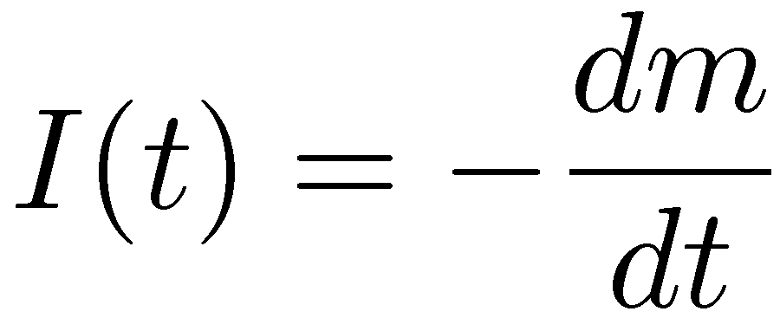
Intensity of light (1)
The intensity of light I(t) in photons per second at any time t during heating is / to the rate of recombination of e⁻ and h⁺ at R (each recombination produces a photon which is detected) → with m (m⁻³), the concentration of h⁺ at R →
The recombination rate is also / to the concentration of free e⁻ in the conduction band, n_{c}, and of h⁺ →
with A_{m}, the probability of recombination (m³s⁻¹) independent on T

Slide 12
Intensity of light (2)
The rate of change of the concentration of trapped e⁻, n, is equal to the rate of thermal release minus the rate of retrapping →
with N, the concentration of e⁻ traps and A_{n}, the probability of retrapping
Moreover → the rate concentration of free e⁻ in the conduction band is equal to the rate of thermal release minus (the rate of retrapping + the rate of recombination) →

Slide 13
Intensity of light (3)
No analytical solution to these equations → hypothesis of Chen and Mc Keever → quasi-equilibrium (QE):
→ the concentration of free e⁻ in the conduction band is quasi stationnary
As dn_{c}/dt ≈ 0 →

Slide 14
First-order kinetics (1)
This eq. cannot be analytically resolved → additional assumption of Randall et Wilkins → negligible retrapping →
If T = cste → p = cste
with I₀: initial intensity
Simple exponential function

Slide 15
First-order kinetics (2)
If T ↗ → p ≠ cste
with n₀: number of e⁻ trapped at t = 0
T↗ → detrapping of e⁻ and recombination → I(t) ↗
T↗ → maximum
T↗ → decrease of the number of charge carriers → I(t) ↘
Peak → first-order « glow peak » (GP)

