Slide 1
Chapter VIII: Photographic films

Slide 2
Photographic films
First (integrating) dosimeters to be developed → based on photographic techniques → dosifilms
Dosifilms were more and more replaced by dosimeters using performing technologies → gradual stopping of production
Always used in a few number of countries (not Belgium) → Africa
In the following → only films for dosimetry (not radiodiagnostic)

Slide 3
Properties of photographic films
Photographic films are relative dosimeters (requiring a calibration) → comparison with calibrated films allows to obtain a dose
Films allows to measure doses due to X-rays, °-rays, neutrons and e⁻
Depending on their composition, they allow measurements in the 50 ¹Gy to 10 Gy range

Slide 4
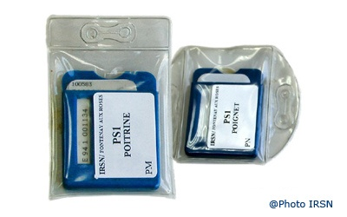
Applications of photographic films
Qualitative and quantitative dosimetry
Quality control for equipment in radiotherapy (position of a collimator, radiation dose profile in a phantom,…)
Films-badges (carried on the chest or on the wrist)

Slide 5
Photographic emulsion
The emulsion consists of microscopic grains of silver bromide – AgBr – (or another silver halide) dispersed in a gelatin layer (10-20 ¹m) on either one or both sides of a supporting film
Incident charged particles produce ion pairs in the grains → conversion of a certain number of Ag⁺ ions of the grain (containing typically 10¹⁰ Ag⁺ ions) to Ag atoms → a few such Ag atoms on a grain constitute a latent image
During the development (chemical process) the Ag atoms in the metallic state act as center for a multiplication process → the developer reduces the Ag⁺ ions of the grains having a latent image in Ag atoms → only one Ag atom in a grain allows the reduction of all of the Ag⁺ ions of the grain
The rest of the silver bromine (non-developed) is removed, leaving behind an opaque microscopic grain of silver
The presence of this elemental silver may be detected optically and quantitatively related to the absorbed dose

Slide 6
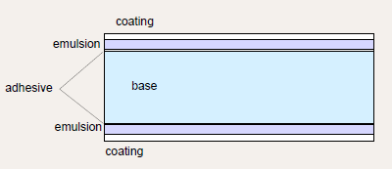
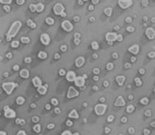
Scheme of a dosimetric film
AgBr micrograins (0.1-3 ¹m) in gelatine

Slide 7
Sensitometry – Optical density
Sensitometry: study of sensitive surfaces → technical discipline that allows to quantify the blackening in photography
The effect of irradiation is measured in terms of film opacity to the light, determined by a densitometer (sensitometric instrument which measures the density – the blackening - of photographic media)
The opacity is defined as the ratio between I₀, the light intensity without film, and I, the light intensity transmitted ? through the film
The optical density (OD) is defined as the logarithm to the base 10 of the opacity

Slide 8
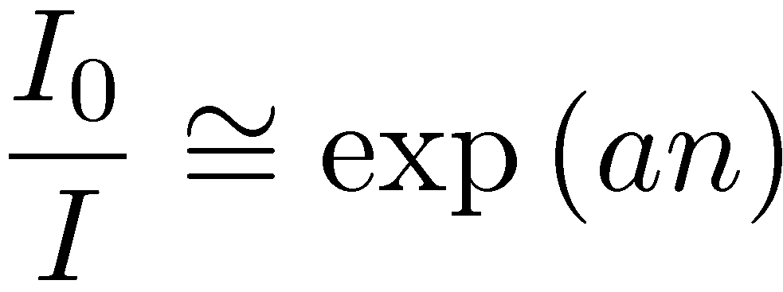
Optical density ↔ Fluence ↔ Dose (1)
With a (cm²/grain), the mean area made opaque per developed Ag grain
With n, the number of developed grains per cm²
We have (assuming n ¿ N, le number of AgBr grains per cm²) →

Slide 9
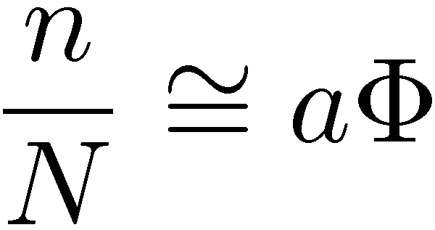
Optical density ↔ Fluence ↔ Dose (2)
3 hypothesis:
The incident ray (X, °, e⁻) gives rise to an electron fluence ? to the film
A single e⁻ hit renders a grain developable
All grains have the same projected area a
In these conditions →
OD is thus / to © and thus to D

Slide 10
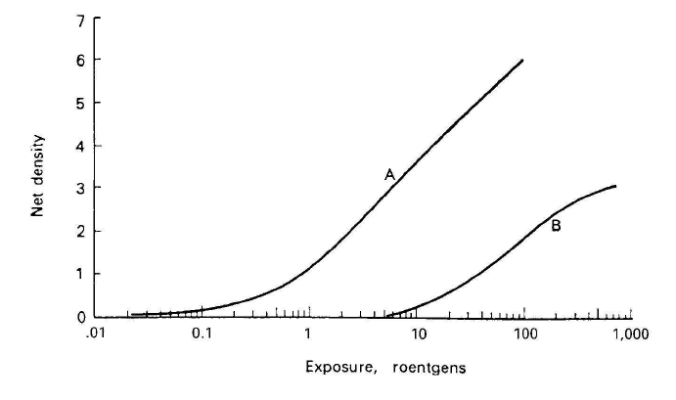
Examples of relations between exposition and optical density
By comparison to a film irradiated with an unknown amount of radiation and a film irradiated with a known quantity → determination of the dose
Relative density
Dose (arbitrary unit)

Slide 11
Characteristics of a OD-Dose curve
Ideally → the relation between OD and dose has to be linear
Practically → it can be linear, linear for a given range of dose or non-linear (depending on the film)
For each type of film the OD-Dose curve has to be determined before the use of the film
The OD-Dose curve is called the sensitometric curve, the characteristic curve or the H&D curve (Hurter and Driffield, pioneers of sensitometry)

Slide 12
Parameters of H&D curve
Gamma: slope of the linear part
Latitude: range of doses for which the H&D curve is linear
Fog: OD of a non-exposed film
Speed: exposition necessary to produce OD = Fog +1

