Slide 1
General theory of volume recombination in an ion chamber (Mie’s theory)
Theory valid for a uniform ionization rate in the chamber
Ion chamber with plane-parallel electrodes
Cylindrical ion chamber
Spherical ion chamber
General extrapolation

Slide 2
Ion chamber with plane-parallel electrodes (1)
d
0
x
X
We consider an ion chamber with k electrodes (area S) separated by a distance d
The OX axis is ? to the electrodes and oriented from the positive electrode to the negative electrode → anode (+) is at x = 0 and cathode (−) at x = d
The electric field produced by the ions is negligible (at first approximation) compared to the applied field E₀
As E₀ is uniform, the drift velocities of positive (u₊) and negative (u₋) ions are constant
The ionization rate q (number of ionizations per unit of time and volume) is assumed to be constant and uniform

Slide 3
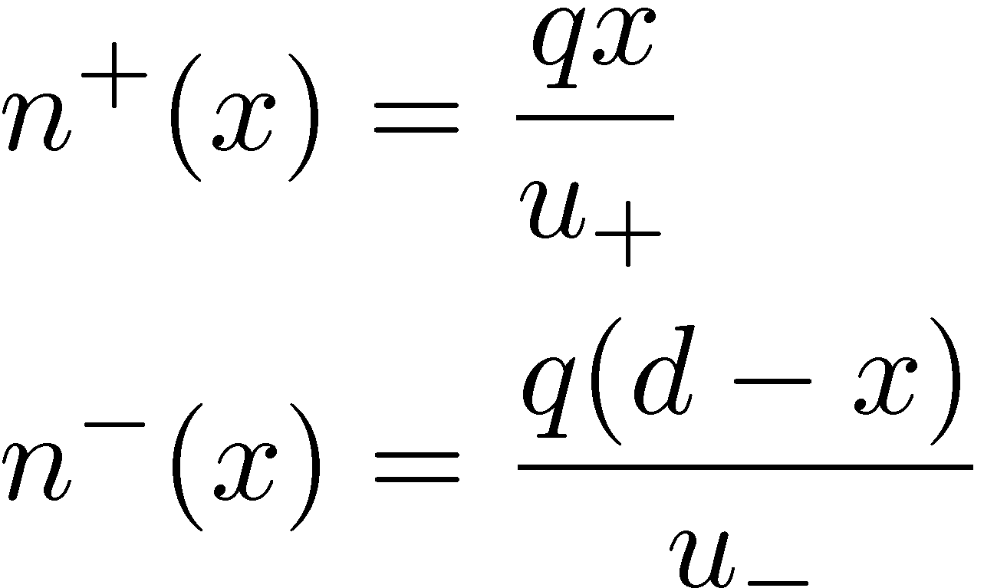
Ion chamber with plane-parallel electrodes (2)
The quantity of + charges produced between 0 and x in the time interval dt is equal to the quantity of charges crossing the plane X = x in the same time interval → with n⁺(x) and n⁻(x) the bulk densities of charges at the distance x of the anode →

Slide 4
Ion chamber with plane-parallel electrodes (3)
The recombination rate R’ (per unit of surface and time - m⁻²s⁻¹) is:
With qd, the number of ionizations per unit of surface and time, we define the collection efficiency of charges f as the ratio between Q_{coll}, the collected charge at the electrodes and Q, the charge produced in the chamber by a constant radiation field →

Slide 5
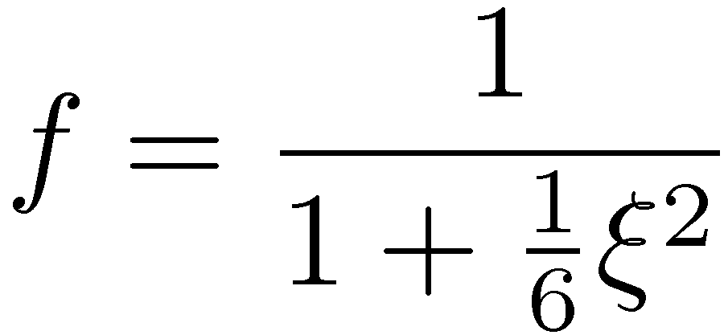
Ion chamber with plane-parallel electrodes (4)
The drift velocity of a charge u is linked to the applied electric field E by u = ¹E (with ¹, the mobility – m²V⁻¹s⁻¹)
In this case the applied potential U₀ = Ed →
with m² a constant of the gas (for air NCTP m² = 6.47 £ 10⁻⁵ V²sm⁻¹)
Calculation accounting for the electric field produced by the space charges (→ non-uniform E) gives →

Slide 6
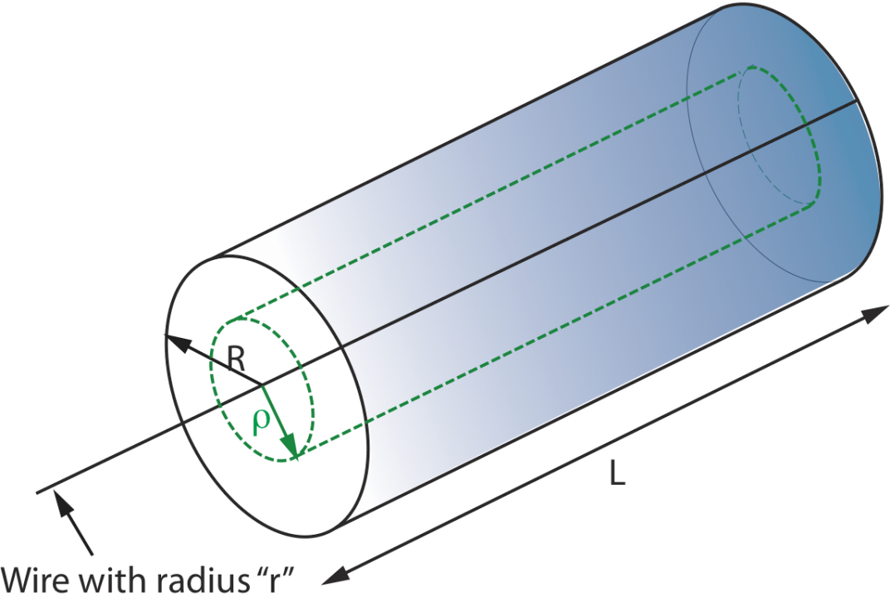
Cylindrical ion chamber (1)
Same arguments can be applied (with u and ¹ dependent on the position r) to a cylindrical ion chamber (with a and b, the intern and extern radii of the electrodes and L, the length of the cylinder):
cathode with radius b
r
r
anode with radius a

Slide 7
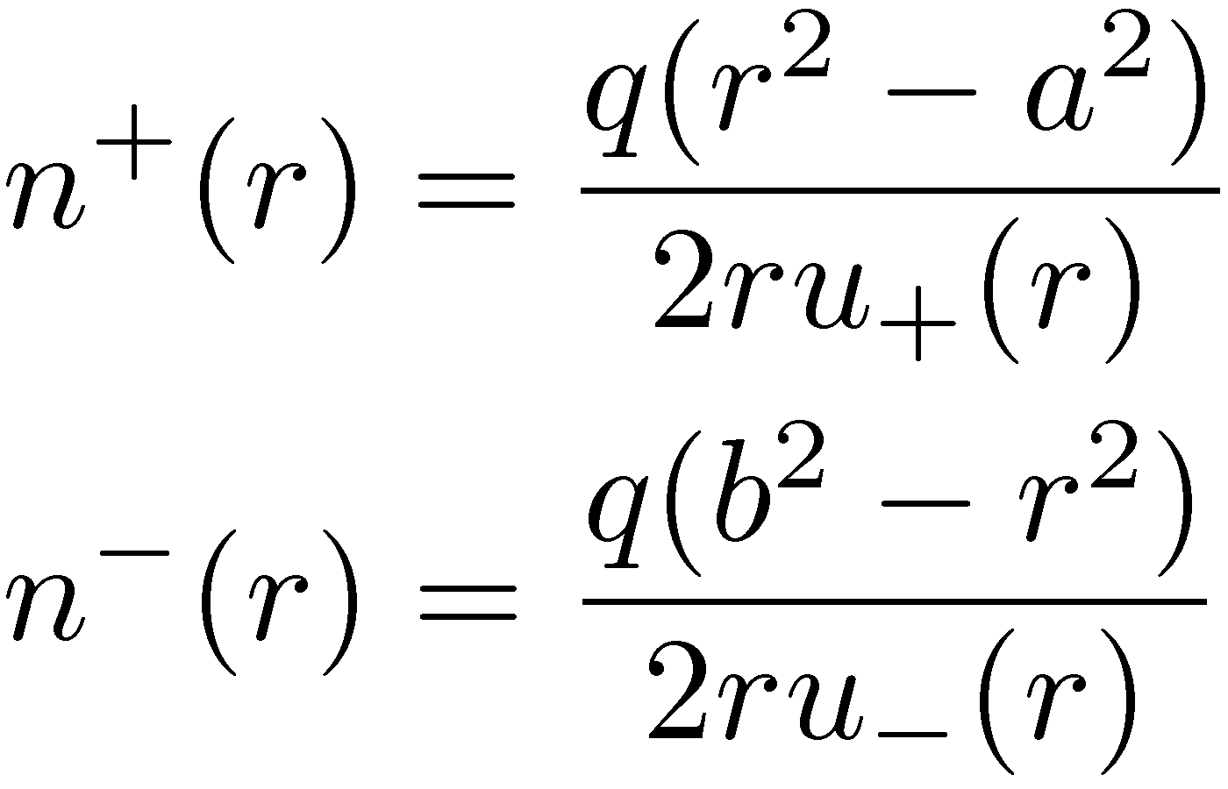
Cylindrical ion chamber (2)
For cylindrical chamber →

Slide 8
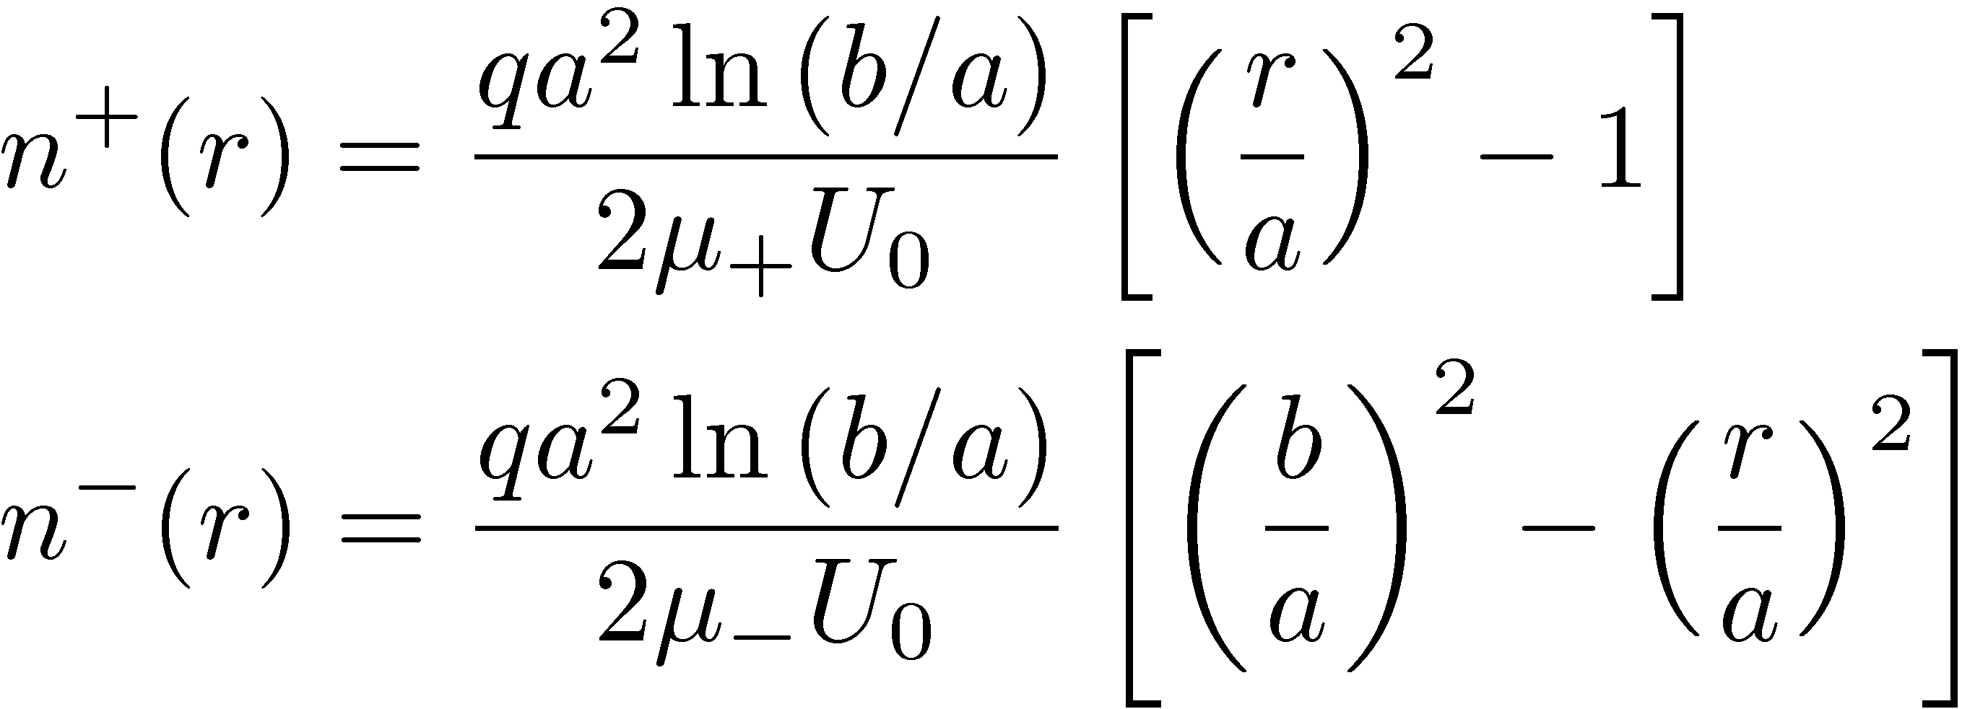
Cylindrical ion chamber (3)
The recombination rate R’’ (per unit of length and time - m⁻¹s⁻¹) is:

Slide 9
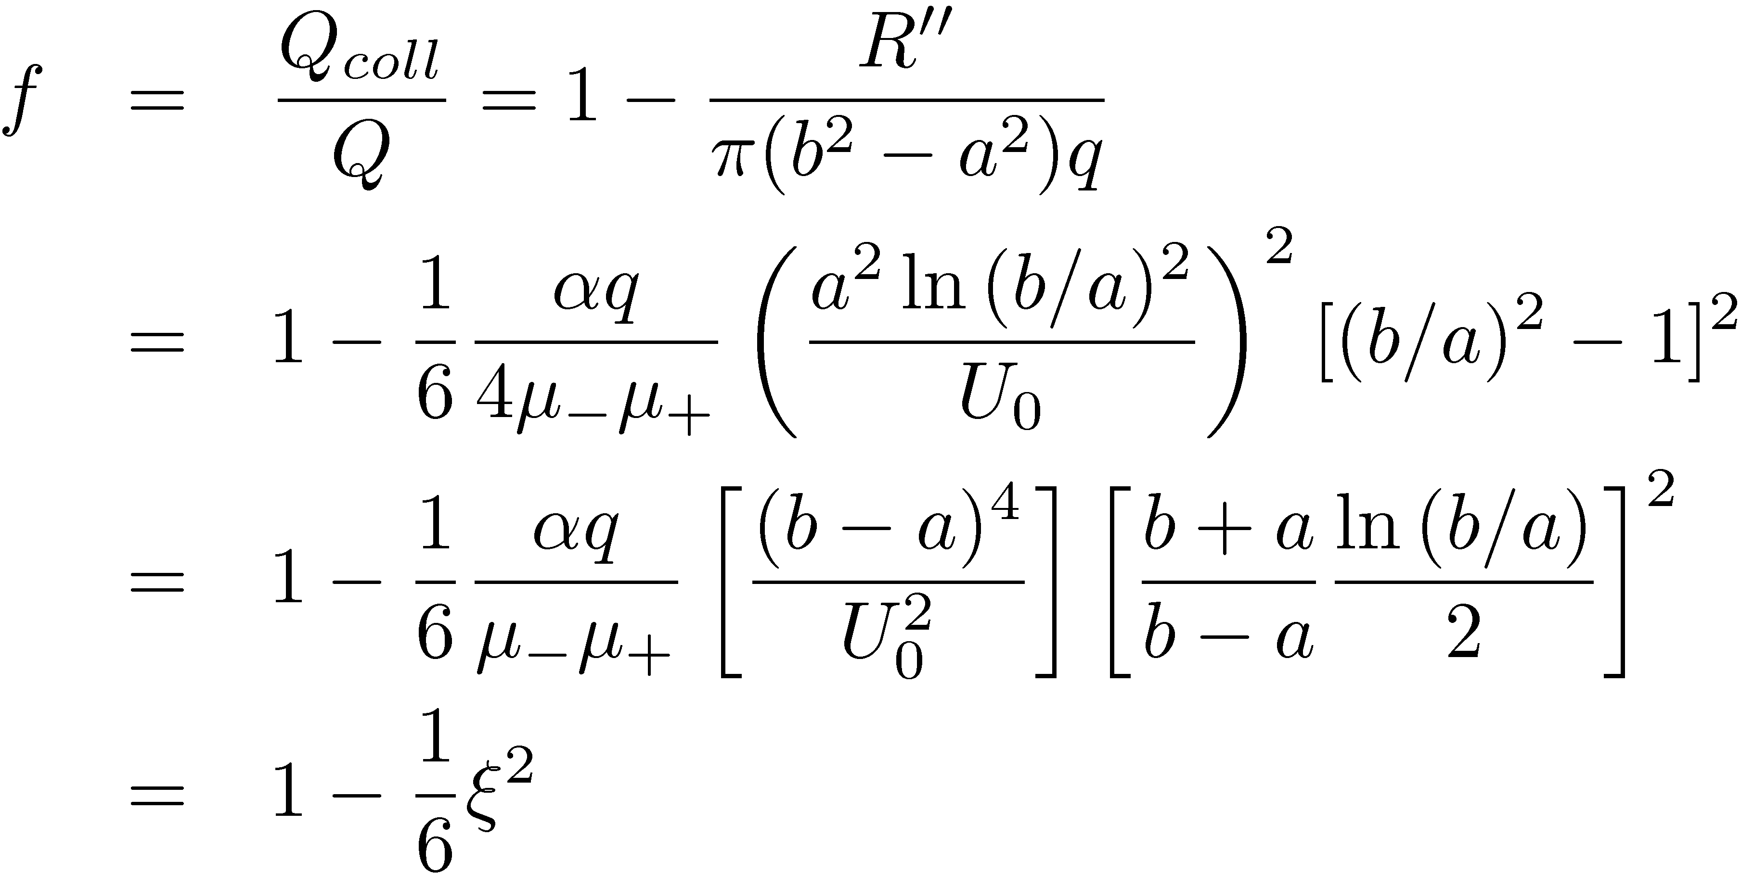
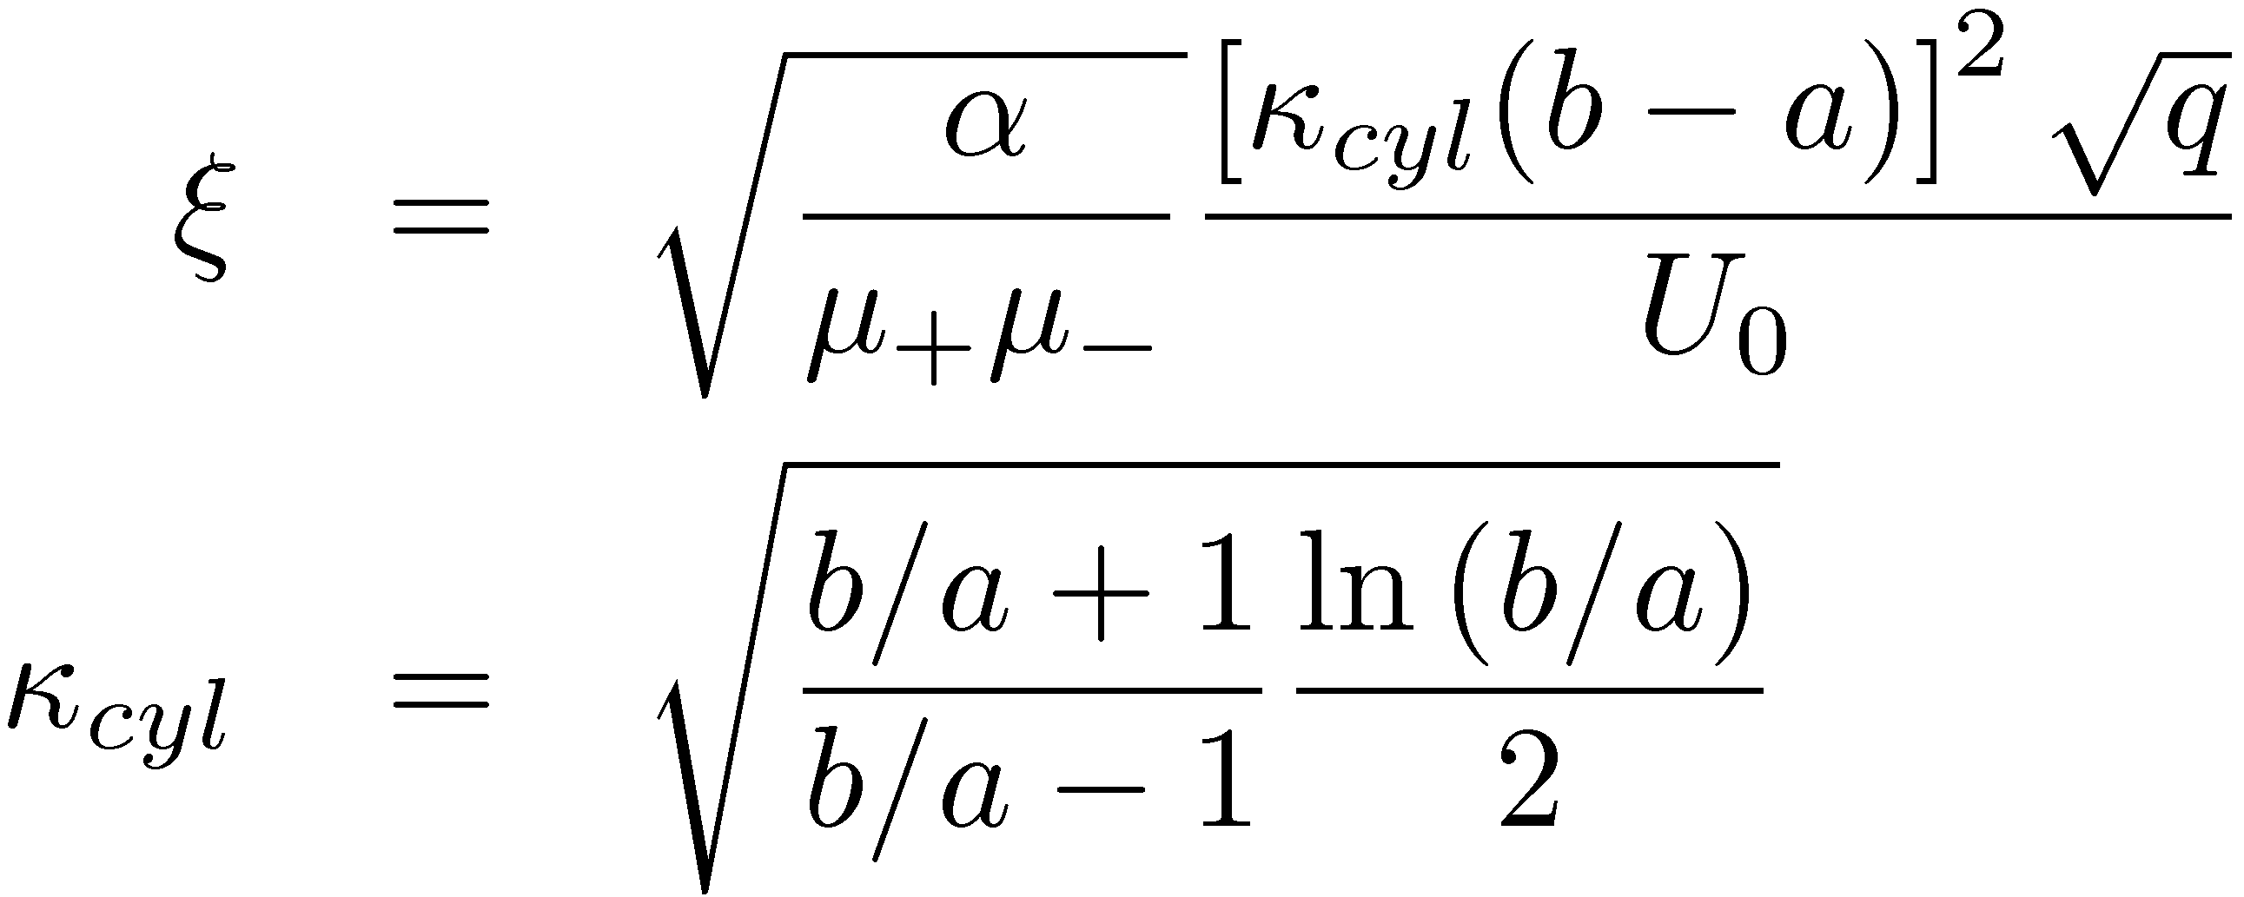
Cylindrical ion chamber (4)
with

Slide 10
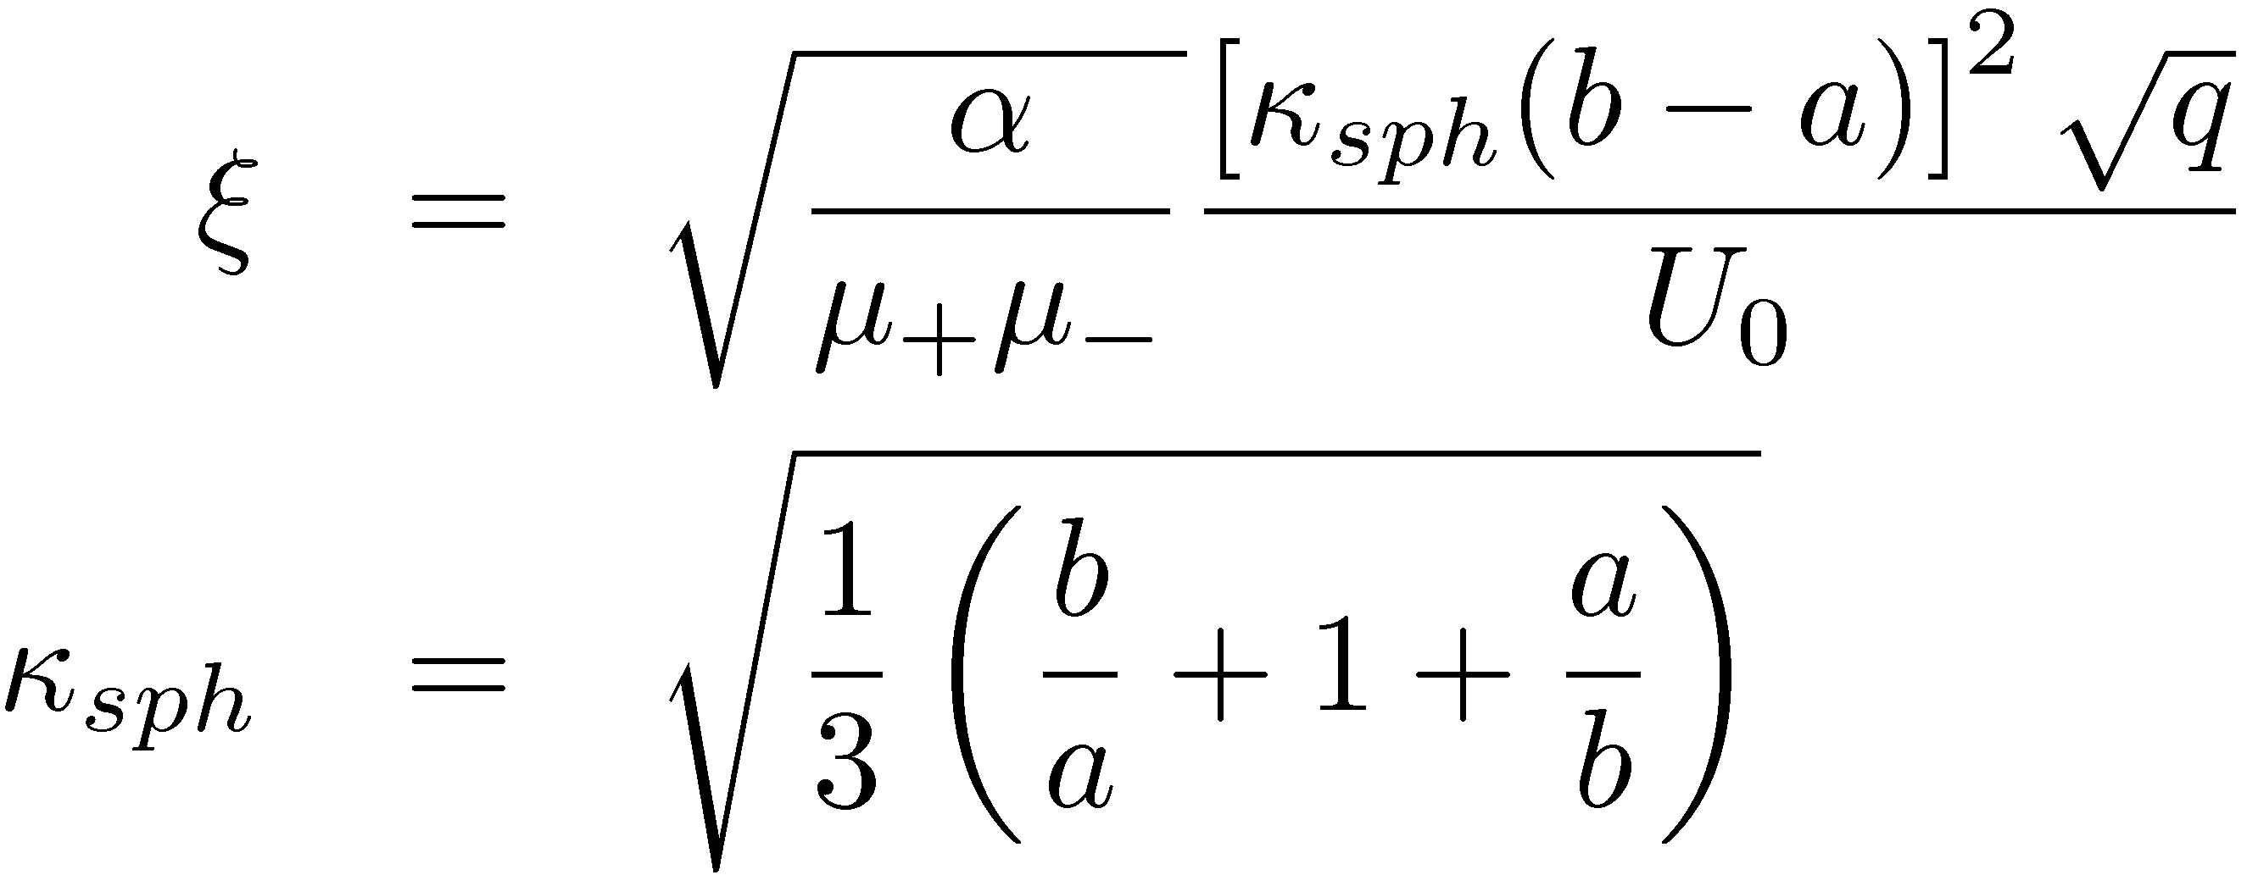
Spherical ion chamber
Same calculation as for a cylinder → with » and κ values corresponding to a sphere →

Slide 11
General extrapolation
Previous relations can be extrapolated and written as →
with c a constant depending on the detector geometry and on the nature of the gas
≠ values of 1/Q_{coll} as a function of U₀→ extrapolation for 1/U₀² = 0 → 1/Q correct for a continuous irradiation

Slide 12
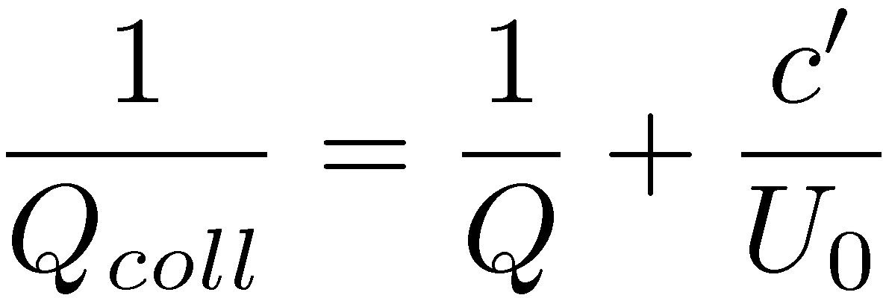
Columnar recombination
If volume recombinations are negligible and only columnar recombinations have to be considered (particles with high ionization density or high pressure gas) → empirical demonstration of Jaffe-Zanstra →

Slide 13
Recombination for pulsed radiation
dt
T
We choose dt: width of radiation pulses and T: charges collection time
If a lot of pulses during T or dt > T → theory of continuous irradiation
If dt ¿ T (dt ≈ ¹s and T ≈ ms) → Boag’s theory

Slide 14
Boag’s theory for pulse irradiation (1)
d
+
-
u₊
u₋
w₀
0
X
w₀: initial width of the irradiated area → evolution of w with time t: w(t) = w₀ - (u₊ + u₋)t with w(T) = 0 → T = w₀ /(u₊ + u₋)
Hypothesis: n⁺ = n⁻ = n →

Slide 15
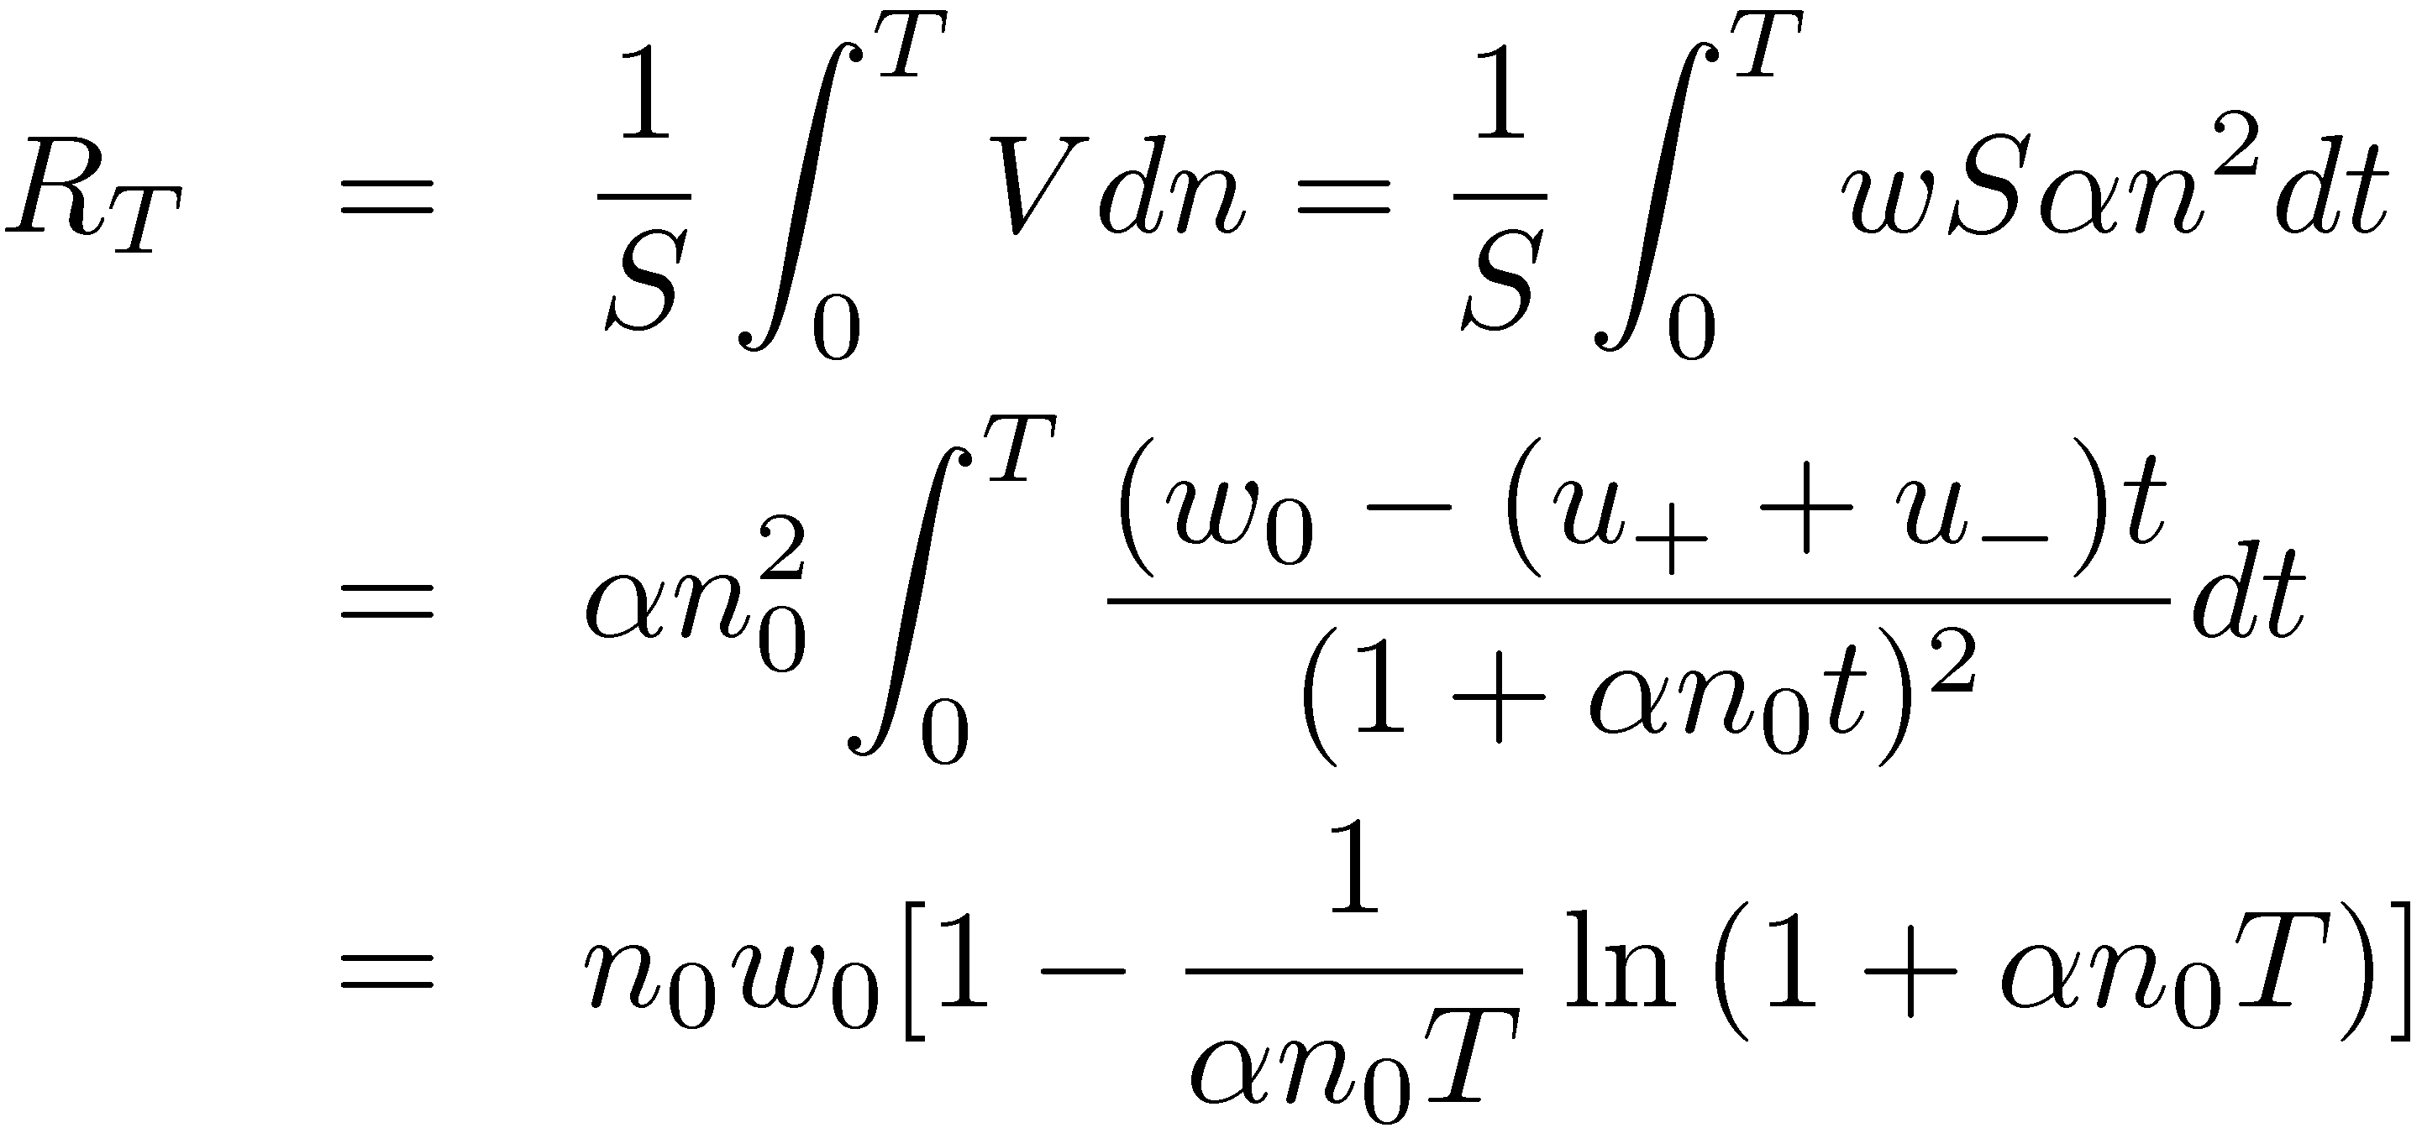
Boag’s theory for pulse irradiation (2)
Integration of the recombination rate during time T → R_{T}: recombination rate per unit of surface - m⁻²) →

Slide 16
Boag’s theory for pulse irradiation (3)
The collection efficiency of charges f →
If w₀ = d →
If small ® →

Slide 17
Boag’s theory for pulse irradiation (4)
For a cylindrical chamber → d must be replaced by
For a spherical chamber → d must be replaced by

Slide 18
Atmospheric corrections: Air density (1)
The collected charge depends on the type and the mass of gas inside the chamber
Most of the time → chamber open to ambient atmosphere → equilibrium of the gas with environment → density of the gas (with [T] = K and [P] = Pa) →
P_{w} is the water vapor partial pressure in air
P_{w} depends the relative humidity (RH) of air defined as the ratio of water vapor partial pressure in air on the saturation vapor pressure at the same T → measure of the link between the content of water vapor in air and its maximal capacity in the same conditions

Slide 19
Atmospheric corrections: Air density (2)
Examples of P_{w}:
at T = 295.15 K and RH = 100% → P_{w} = 2643.33 Pa
at T = 295.15 K and RH = 50% → P_{w} = 1321.73 Pa
Examples of modifications of the density ½: If P = 101325 Pa and P_{w} = 1321.73 Pa → ½_{h} (humid air) < by 0.5% compared to ½_{a} of dry air (P_{w} = 0 Pa)
All these parameters have to be frequently measured during a long series of measurements
The humidity effect is often neglected because it also implies a correction on W/e varying in the opposite direction with the density correction → net error extremely small (< 0.3 %)

Slide 20
Atmospheric corrections: Effect of humidity on W/e (1)
For dry air →
For humid air (W/e)_{h} < (W/e)_{a} but the ½ of air ↘ for humid air and as
→ the effects counterbalance
However humidity of air also influences on dE/dx

Slide 21
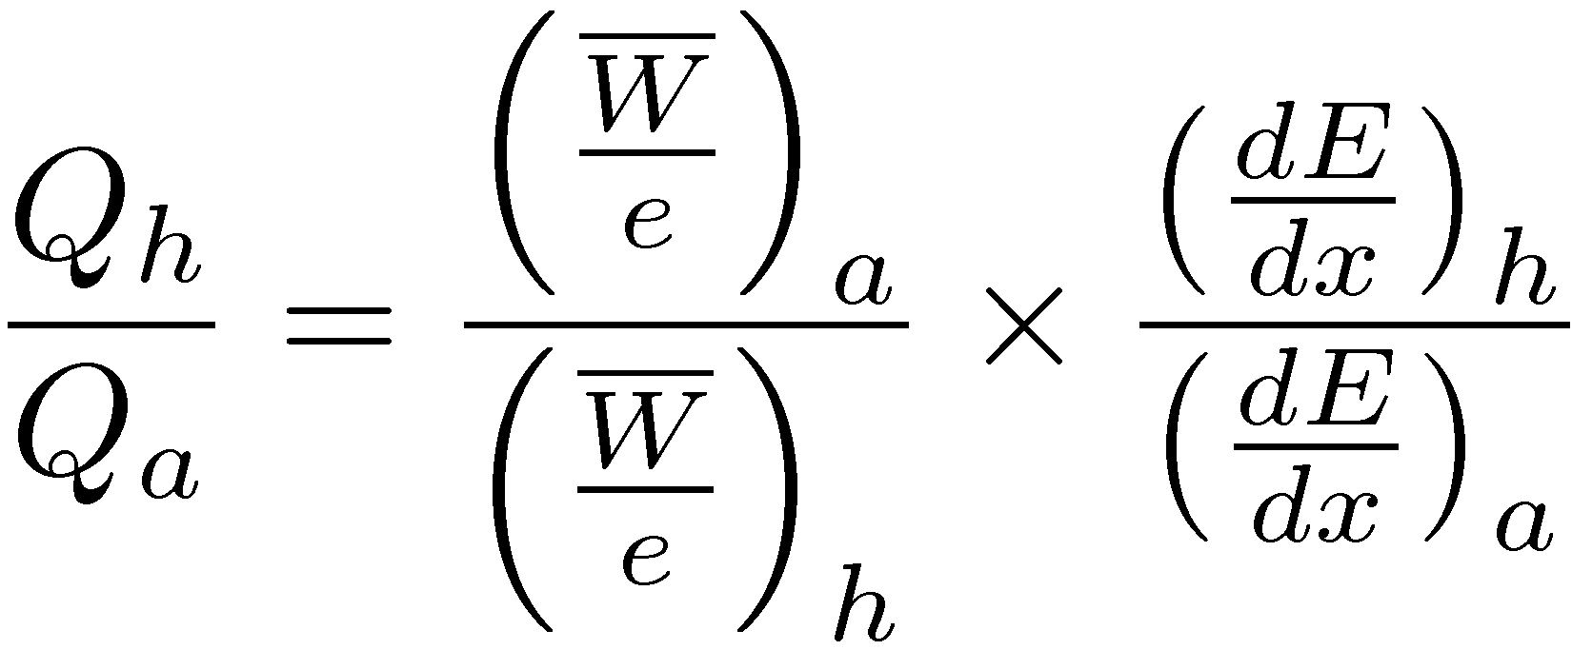
Atmospheric corrections: Effect of humidity on W/e (2)
We consider a cavity ionization chamber under a flux of X-rays (for instance) constant, © = c
We assume that it is filled successively with dry air sec and with humid air →
1st term > 1 and 2nd term < 1 → Q_{h}/Q_{a} is relatively « flat » → 1.0028 § 0.0003 (15% < RH < 75%)

Slide 22
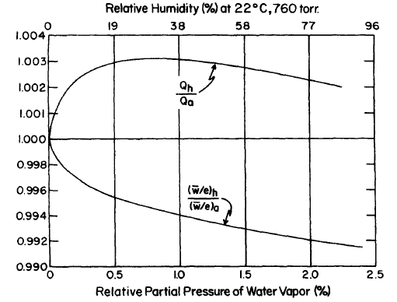
Effects of humidity

