Slide 1
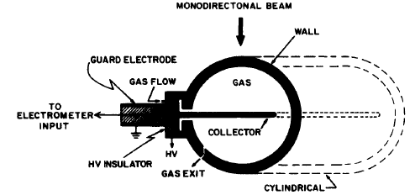
Cavity ionization chamber (with « equivalent-air » walls)
Large number of ≠ designs → always the same principle
A solid envelope surrounds a gas –filled cavity (air,…) and an electric field is applied outside the cavity → collection of ions formed by radiation

Slide 2
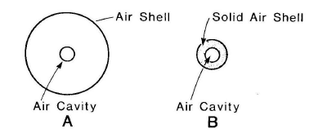
Cavity ionization chamber: Principle for ° (1)
V
A: A spherical air volume V surrounds a air cavity at the center → we assume a uniform photons radiation field in V → the distance between extern and intern walls of V ≥ range of e⁻ in air → the number of e⁻ entering or outgoing the cavity are = → CPE → measure of Q produced (in the cavity) by e⁻ created in V → with known m → calculation of X

Slide 3
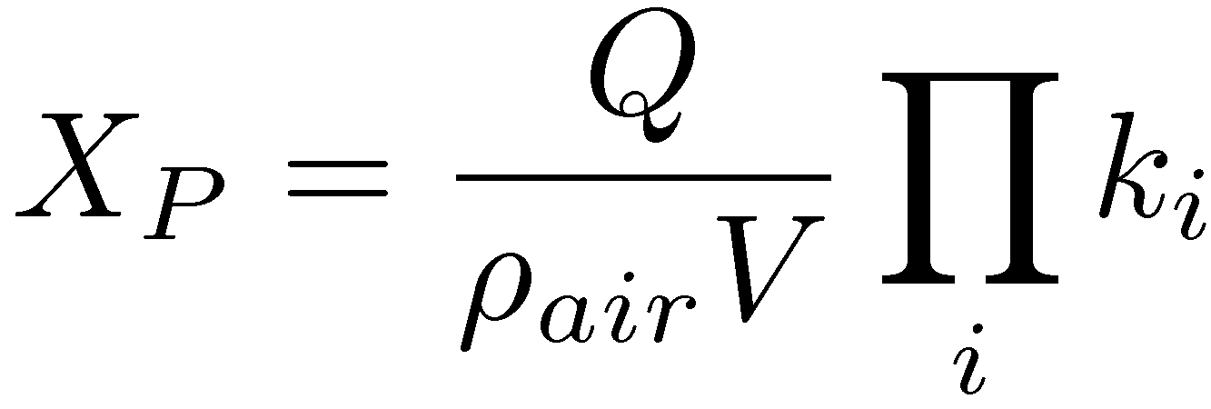
Cavity ionization chamber: Principle for ° (2)
B: The air wall is « compressed » to obtain a solid wall → ↗ density but condition on the range of the e⁻ in air always respected → CPE always respected with a largely smaller wall thickness (ex: 1.25 MeV-° of ⁶⁰Co → ≈ 5 mm)
Practically → an « equivalent-air » medium is chosen for the wall (equivalence of ¹_{en} for incident photons but also of dE/½dx for created e⁻ → conditions OK when Compton effect is dominating) → polystyrene, polyethylene, PMMA, Teflon, graphite,…
The intern wall of the cavity is covered with a conducting medium (colloidal graphite in a alcohol base) → electrode

Slide 4
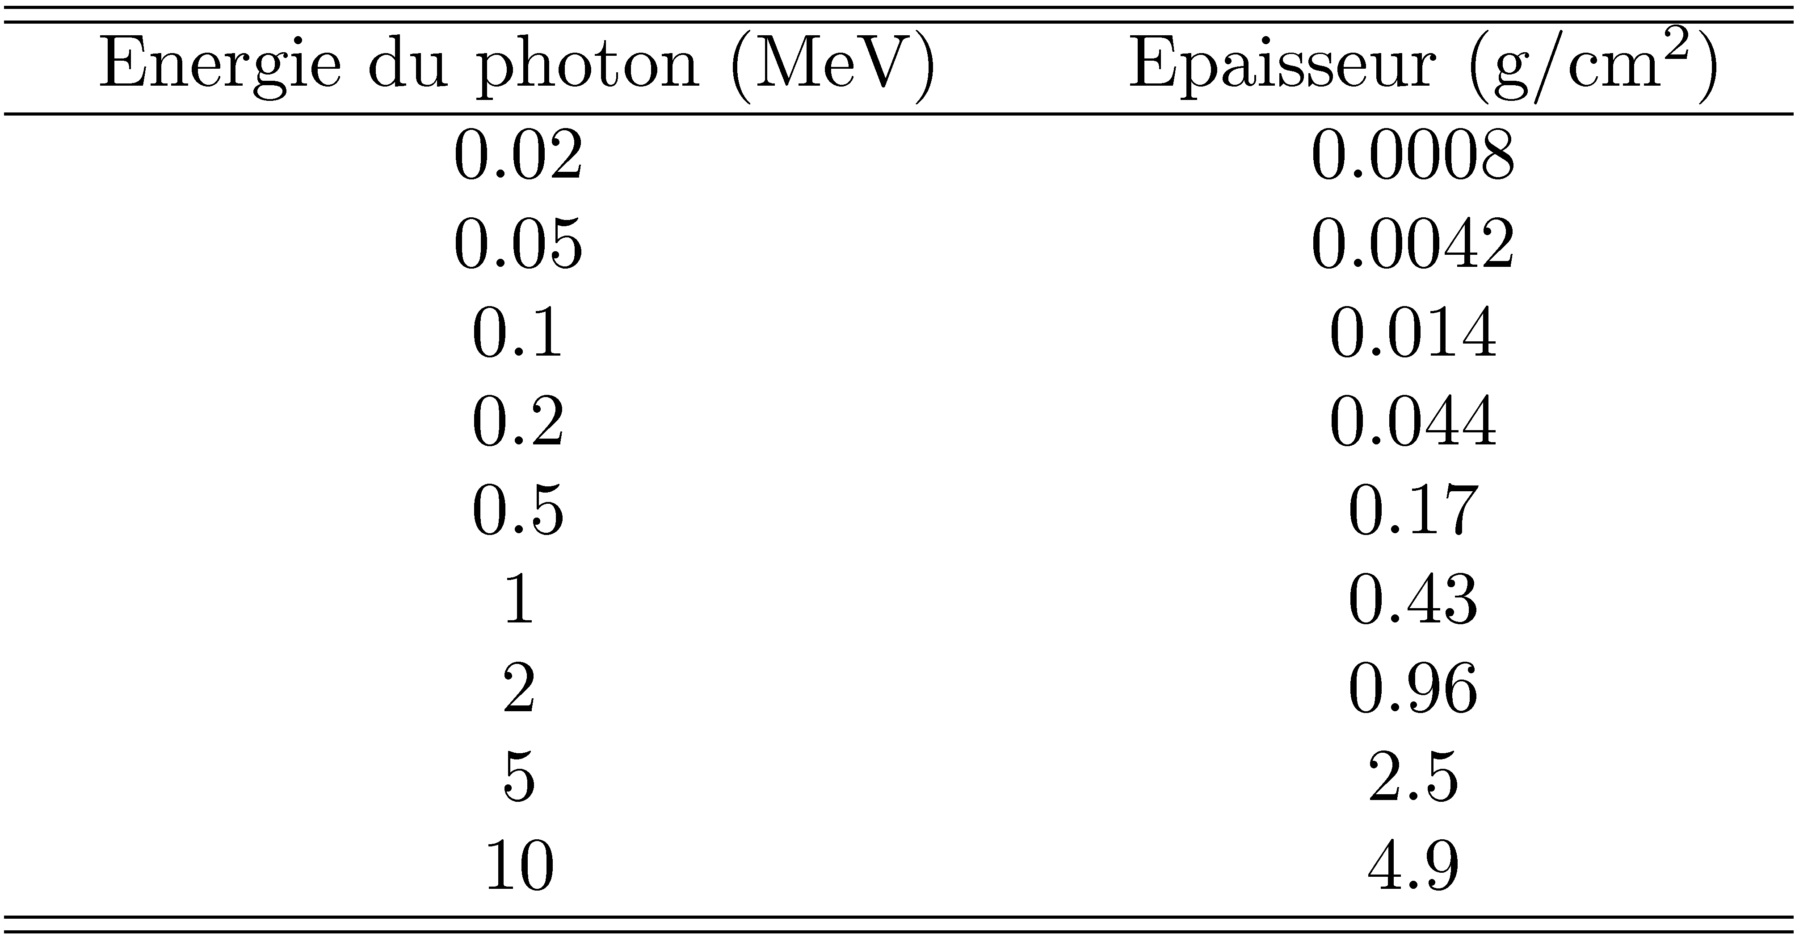
Examples of thicknesses required for CPE
The thickness calculation is based on the range of e⁻ in H₂O → for ionization chamber with tissue-equivalent wall and air cavity → corrections are needed

Slide 5
Cavity ionization chamber: Principle for e⁻
If we consider incident charged particles → V has to be small → the wall has to be thin compared to the range of the incident des particles
If Z equivalence between the wall and the gas of the cavity → equilibrium between the ± e⁻ going from the cavity to the wall and vice-versa if the wall is thick enough
Practically → for incident e⁻ producing ± e⁻ with E < 100 keV → a wall thickness of ≅ 15 mg/cm² is enough (range of a 100 keV e⁻)
Application of the cavity theory to obtain the dose in the medium

Slide 6
Cavity (c) ↔ free-air (f) ion chambers
c: allows the measure of the dose for all types of incident particles and for a large range of E; f: only for photons with E < 500 keV
c: very compact (ratio of 1000 between the ranges of an e⁻ in a solid and in a gas) → allows measures in ≠ points of an irradiated medium
c: measure of multidirectional radiations; f: direction of the beam ? to the aperture
c: via cavity theory → the dose can be determined for all media constituting the wall

Slide 7
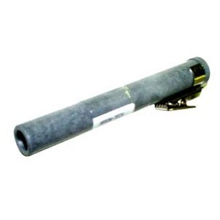
Application: Direct-reading dosimeter
Charged condenser → constant potential at the condenser contacts
When ionizing radiation crosses the dosimeter → air ionization → displacement of the charges towards the electrodes → potential decrease → discharge of the condenser
Potential difference / to exposure
Use:
Alarm
Continuous measurement of the dose

Slide 8
Recombinations
The dose deposited in a gas by ionizing radiation is / to the charge Q produced in the gas
In practical case the measured collected charge Q_{coll} at the electrodes of the chamber is < Q → recombination of ions in the gas
Recombinations occur between positive ions and e⁻ or between positive and negative ions
A ion chamber is said to be saturated if Q_{coll} → Q
Generally if the applied potential U₀ ↗ → we asymptotically approach saturation
Attention: if U₀ ↗ too much → multiplication

Slide 9
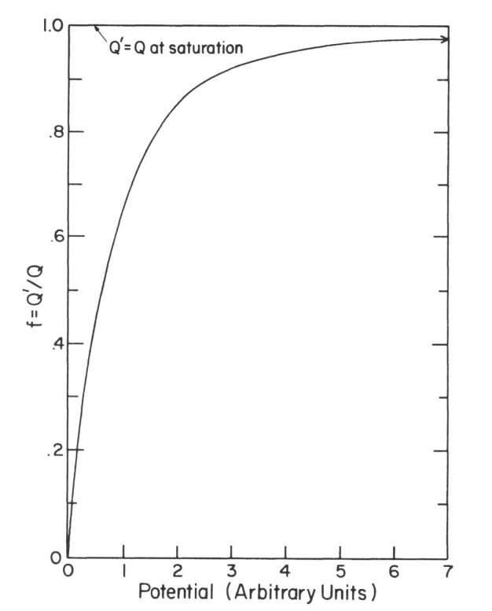
Variation of Q_{coll} as a function of the applied potential
Q_{coll}/Q

Slide 10
Recombinations in an ion chamber
Definition of a recombination collision rate R (m⁻³s⁻¹) and of a recombination coefficient ® (m³s⁻¹) such as:
with n⁺ and n⁻, the volume densities of charge

Slide 11
Types of recombinations
Columnar (or initial ) recombination: ion pairs are formed into a column along the track of the ionizing particle → density of pairs is high along the track until pairs diffuse → columnar recombination is most severe for densely ionizing particles (as ®) compared to electrons that deposit their energy over a much longer track → independent on the irradiation rate and on D
Volume recombination: due to encounters between ions and/or electrons after they left the location of the track → since ions slowly drift to electrodes → ions and/or electrons from independent tracks can recombine → increases with irradiation rate and with D

Slide 12
Type of gas and recombinations
An e⁻ created during an ionization can be fixed (attachment) on a neutral atom of the gas → negative ion
Attachment occurs in electronegative gases (O₂, air, …)
The drift velocity of an ion is v_{d} ≈ 1 cm/s per applied V/cm and for an e⁻ v_{d} ≈ 1000 cm/s per V/cm
The e⁻ are quickly cleared out of the ion chamber → little chance to recombine
On the contrary ions being slowly collected have more chance to recombine
Recombinations are particularly important for electronegative gases and thus for air

