Slide 1
Chapiter VII: Ionization chamber

Slide 2
Types of ionization chambers
Sensitive volume: gas (most often air → direct measurement of exposure) → ionization chamber
Sensitive volume: semiconductor (silicon, germanium, diamond) → solid ionization chamber

Slide 3
Advantages and disadvantages of the solid ionization chambers
Advantages:
Compared to gas detectors → at equal energy, they deliver a more intense pulse (W ≈ 3 eV for semiconductor and W ≈ 30 eV for a gas) → 10 times more electrons → larger accuracy
Density about 2000 times larger than for a gas (1 atm) → detection efficiency, at equal volume, quite larger than for a gas ionization chamber
Very often, it is necessary to cool it down to obtain optimal performances (Ge)
Difficult to obtain large size detectors for reasonable price → small size of the sensitive volume
High price of a diamond detector
Disadvantages:

Slide 4
Organization of the chapter
Free-air ion(ization) chamber
Cavity ionization chamber
Recombinations in a ionization chamber

Slide 5
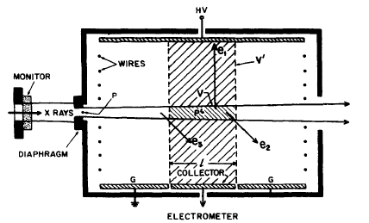
Free-air ion chamber: scheme

Slide 6
Free-air ion chamber: description
Goal: measure of the exposure for photons with an energy varying between 5 keV and 500 keV
The chamber is surrounded by a Pb shielding to exclude rays coming from elsewhere
The central axis of the beam is aligned with the axis of the chamber
The beam enters the chamber from a tungsten diaphragm
On one side of the chamber: 3 plates → collector electrode (length l) and 2 guard electrodes (to determine the total volume)
On the other side: a plate relied to high voltage (to obtain a field of » 100 V/m between the plates)
A set of wires encircles the space between the plates to provide a uniform electric field

Slide 7
Free-air ion chamber: Principle (1)
Photons penetrating into the chamber set « high » energy electrons in motion by photoelectric or Compton effect inside V
These « high » energy e⁻ create secondary ionizations along their path (≈ 40 cm for 500 keV X-rays)
Due to the electric field → positive charges created inside V’ move to the negative electrode and negative charges created inside V’ move to the positive electrode→ presence of a current that can be measured
V’ is called the collection volume
Scattered photons, Bremmstrahlung and recombinations are neglected

Slide 8
Free-air ion chamber: Principle (2)
Reminder of the exposure definition: quotient of dQ by dm, where dQ is the absolute value of the mean total charge of the ions of one sign produced when all the electrons and positrons liberated or created by photons incident on a mass dm of dry air are completely stopped in dry air
If all e⁻ created by the photons in V lose all their energy by ionization in air included in volume V’ → the charge can be measured → measure of exposure
However some of the e⁻ created in V can lose their E outside V’ → non-collected charge
However some of the e⁻ created outside V can lose their E inside V’ → supplementary collected charge

Slide 9
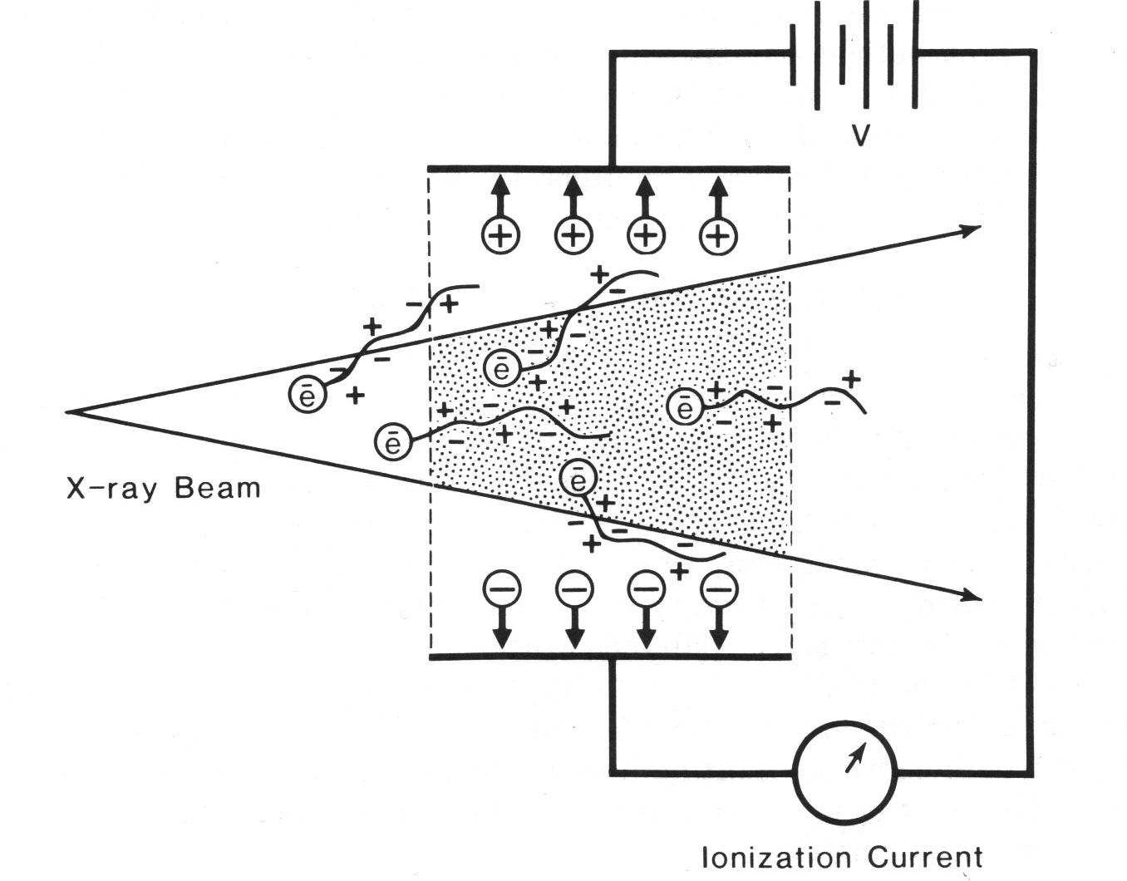
Free-air ion chamber: Charges collection

Slide 10
CPE for volume of collection
To satisfy the exposure definition → CPE is necessary in V’ → compensation between ingoing and outgoing charges
CPE is reached if the range of e⁻ (≈ 40 cm) created by incident photons is smaller than the distance between each plate and the volume V (and also than the distance between V and each end of the box chamber) and if the fluence of the photons beam is constant along the distance l (no attenuation)

Slide 11
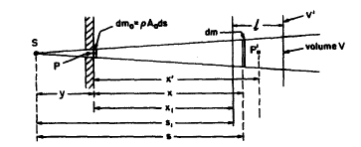
Determination of X at the plane of the aperture (1)
Definition:
P: point at the center of the aperture
A₀: area of the aperture
y: distance between the source S and the aperture
dm₀: disc-shaped mass element at P → dm₀ =½A₀ds
dm: disc-shaped mass element at P‘ at a distance s of the source included inside V → dm =½A₀(s/y)²ds
ª₀: fluence at P

Slide 12
Determination of X at the plane of the aperture (2)
If all e⁻ resulting from interactions of photons inside dm₀ dissipate all their E in air →
We consider the energy fluence in dm (with ¹ the attenuation coefficient in air)→
The ionization caused by the e⁻ originating from dm →

Slide 13
Determination of X at the plane of the aperture (3)
The total charge generated by the e⁻ originating from V (with s₁, the distance between the source and V and x₁, the distance between the aperture and V)→
with x₁+l/2 the distance between P and P’

Slide 14
Determination of X at the plane of the aperture (4)
The exposure (for a volume A₀l) at P is given by →
Typically ¹ ≅ 2-3% → ¹(x₁+l/2) < 0.01

Slide 15
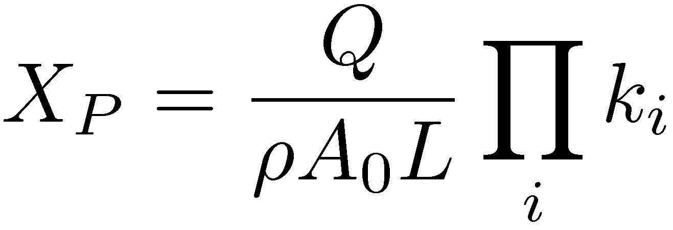
Result of a measurement in a free-air ion chamber
k_{TP}: correction due to temperature and pressure effects
k_{D}: correction due to the aperture estimation
k_{A}: correction due to the attenuation of the beam in air
k_{S}: correction due to recombinations
k_{H}: correction due to humidity
k_{sc}: correction due to ionizations produced by scattered photons
…

Slide 16
Remark on the maximal energy of photons
If E of X-rays ↗ → range of e⁻ ↗ → to maintain CPE → dimensions of the chamber ↗ → problem of non-uniformity of the field (+ difficult to neglect recombination)
Solution: ↗ of the air pressure → in that case ↗ of the attenuation and of scattering of photons in air
Practically → free-air ionization chamber limited to E < 500 keV

Slide 17
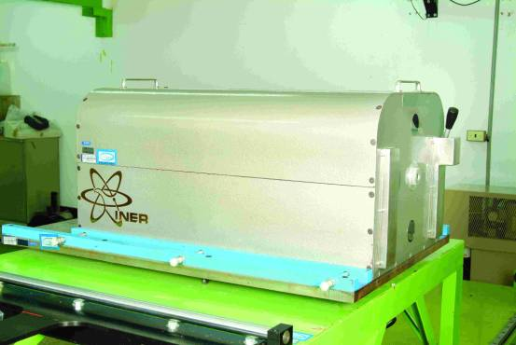
Example of free-air ionization chamber
National Radiation Standard Laboratory (NRSL), Taipei, Taiwan
Standardization laboratories → calibration

