Slide 1
Chapter VI: Experiment dosimetry: Introduction

Slide 2
Types of measurements
Detector for immediate (instantaneous) measurements → dose rate → monitor → called « dosimeter » (ex: ionization chamber)
Detector for integrated (total) measurements on a time → dosimeter → called « integrating dosimeter » (ex: films, thermoluminescent dosimeters,…)
Detector for the identification of incident particles → spectroscopes

Slide 3
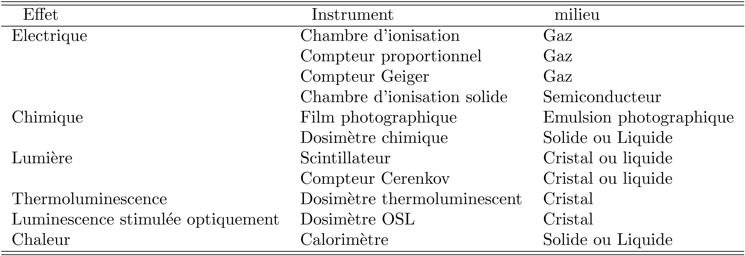
Types of monitors or dosimeters

Slide 4
Types of integrating dosimeters
Dosifilms (photographic films)
Thermoluminescent dosimeters
OSL dosimeters
Calorimeters
Chemical dosimeters
Electronic dosimeters
…

Slide 5
General characteristics of dosimeters
Absoluteness
Precision and accuracy
Dose range
Stability
Energy dependence
Miscellany

Slide 6
Absoluteness
An absolute dosimeter allows a measurement of the absorbed dose without requiring calibration in a known field of radiation
Some kind of calibration not involving radiation is possible (as electronic calibration)
However a calibration is always useful to rely the measurement to a standard measurement→ in an absolute dosimeter an error may go undetected

Slide 7
Precision and accuracy
The precision depends on fluctuations in instrumental characteristics, on ambient conditions and on the stochastic nature of radiation fields
The precision may be determined by repeated measurements → large precision ↔ small standard deviation
The accuracy expresses the proximity of the value given by the dosimeter r (reading) and the true deposited dose D_{g}→ impossible to evaluate the accuracy of data from data themselves → usefulness of calibration

Slide 8
Dose range
Definition of the sensitivity of a dosimeter: s = dr/dD_{g}
It is desirable to have a linear response (i.e. a constant sensitivity) throughout the dose range to be measured → r / D_{g}
If nonlinear → it requires that a calibration be carried out at a multiplicity of doses
Lower limit of the useful range of dose: background r₀ → r = sD_{g} + r₀ → r₀ has to subtracted from a dose reading
Upper limit of the useful range of dose (inherent limit imposed by the dosimeter itself) → decrease in the dose sensitivity s (ultimately to a negative value)

Slide 9
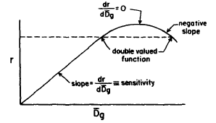
Upper limit of the dose range

Slide 10
Stability
Stability before irradiation → no modification of the properties before irradiation because of external conditions (temperature, humidity,…)
Stability after irradiation → no modification of the reading in time (fading) → practically unavoidable → necessity of a measurements protocol to make them as reproducible as possible → standardization of the dosimeter reading

Slide 11
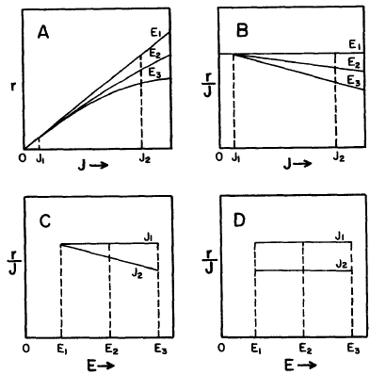
Energy dependence
The energy dependence of a dosimeter is the dependence of its reading r (per unit of the quantity to be measured J – dose, exposure) upon the energy E of the radiation

Slide 12
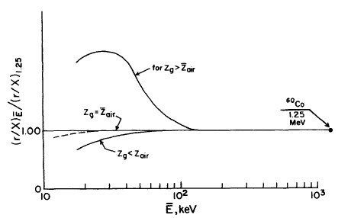
Example of energy dependence
Typical energy dependence curve in terms of the response per unit exposure (normalized to the response of ⁶⁰Co °-rays) for a dosimeter made in a material g (Z_{g})
Photoelectric effect in air and attenuation in g
Photoelectric effect in g
Photoelectric effect in air

Slide 13
Miscellany
Geometric configuration
Price
Reusability
Archival storage
Control
…

