Slide 1
Chapter XII: Chemical dosimeters

Slide 2
Chemical dosimeters
Introduction
Fricke dosimeter
Polymer gel dosimeter
Alanine dosimeter
Radiochromic film

Slide 3
Principle of chemical dosimeters
In a chemical dosimeter → the dose is determined from a measurable modification of the chemical state of the considered medium (gas, liquid or solid)
Any well-characterized chemical reaction may serve as the basis for a chemical dosimeter

Slide 4
Fricke dosimeter: Composition
The standard Fricke dosimeter is a solution composed of ferrous sulfate (FeSO₄ → Fe as Fe²⁺) and of sulfuric acid (H₂SO₄) in water or in a gel (→ Fricke dosimetry is thus assimilated in this case to gel dosimetry)
Organic contaminants can significantly affect performance → high purity is necessary
NaCl is sometimes added to reduce or eliminate any sensitivity to organic impurities → NaCl has no effect on the dosimetric reaction except at high dose → in this case, to be avoided

Slide 5
Dosimetric principle
The detector is based on the reaction ferrous sulfate → ferric sulfate (Fe₂(SO₄)₃) i.e. → Fe²⁺ → Fe³⁺
The ionizing radiations induce this reaction either by direct absorption (rare) either via the free radicals produced in water → H* and OH* (frequent in water because water is the dominating medium → radiations especially interact with water)
Chemical reactions →
HO₂*: hydridodioxygen
OH*: hydroxyl
H₂O₂: hydrogen peroxide
1ère étape
2ème étape
because acid medium
3ème étape

Slide 6
Measurement of the production of Fe³⁺
The measurement may be done by
Chemical titration
Nuclear magnetic resonance (measurement of the paramagnetic properties)
Optical absorption → most often used because good sensitivity, only requires small samples and easy to implement (Fe³⁺ → blue color)

Slide 7
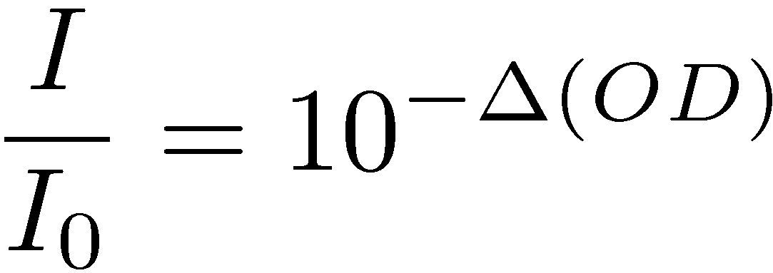
Optical absorption
Principle of optical absorption → measurement of ¢M: the variation of molar concentration (mol/l) of Fe³⁺ before and after the irradiation
We consider the ratio between the light intensity transmitted through the irradiated sample (I) and another one which was not irradiated (I₀) →
with ¢(OD) the modification of optical density
And we have with the Beer-Lambert expression →
with ²: the molar absorption (or extinction) coefficient (² = 2187 l/mol at 25 °C for Fe³⁺), l: the size of the sample (≈ 1cm)

Slide 8
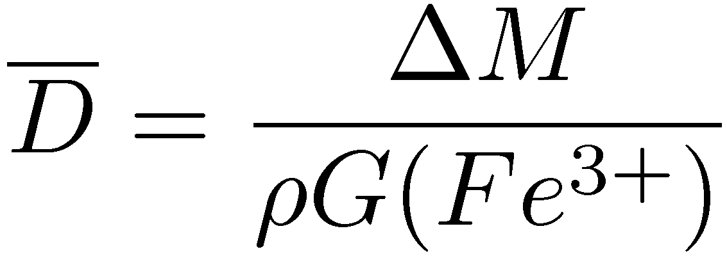
Dose ↔ Optical absorption
By definition →
with ½, the « density » of the solution (in kg/l) and G(Fe³⁺) (in mol/J), the chemical yield of Fe³⁺ (i.e. the quantity of Fe³⁺ produced per unit of incident energy → depends on the type and on the energy of the incident particles) → for ⁶⁰Co-° → G(Fe³⁺) = 1.607 £ 10⁻⁶ mol/j
We obtain thus →

Slide 9
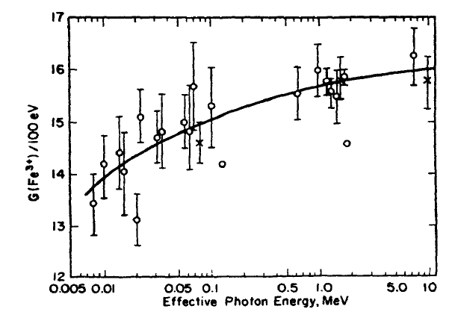
Chemical yield as a function of E for °-rays

Slide 10
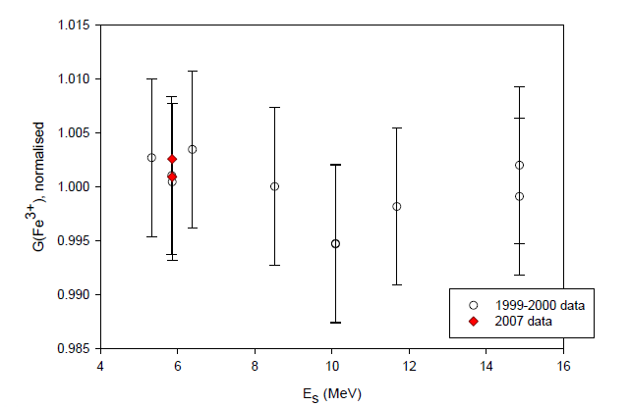
Chemical yield as a function of E for e⁻

Slide 11
Applications of Fricke dosimeters
Dose response linear between ≈ 4 Gy and 4000 Gy
Z and ¹_{en}/½ close to values of water → tissue-equivalent
Variable shape and volume
Absolute dosimeter
Little stable in time → major defect
Use and readout are complex → major defect
High lower dose limit → major defect
Large dependence on E and on particle type → major defect
Gradual disappearance

Slide 12
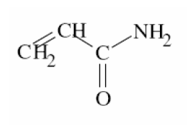
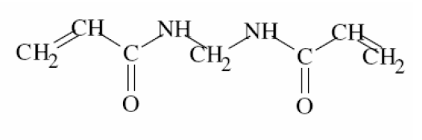
Polymer gel dosimeter
In a polymer gel → monomers dispersed into a matrix → example: acrylamide (C₃H₅NO) dispersed into gelatin
Exposed to irradiation → the monomers follow a polymerization reaction (polyacrylamide)→ polymerized gel in 3D
The degree of polymerization depends on the dose
The dose can be evaluated by RMN, tomodensitometry (scanner-X), optical tomography (IR), …

Slide 13
Advantages and disadvantages of gels
Easily commercially available and cheap
Due to the large proportion of water in gel → water-equivalent → little corrections needed for the energy response
Possible 3D measurements
Perfectly adapted for measurements showing large spatial variations of dose → application in stereotaxic radio-surgery
Access to a RMN, scanner machine is necessary → not so obvious
Little sensitive → applications in radiotherapy

Slide 14
Alanine dosimetry
The irradiation of the alanine amino acid produces stable alkyl free radicals →
Concentration of free radicals / absorbed dose and measured by electron paramagnetic resonance or EPR (technique similar to RMN but the spins of the e⁻ are excited instead of the spins of the atomic nuclei)

Slide 15
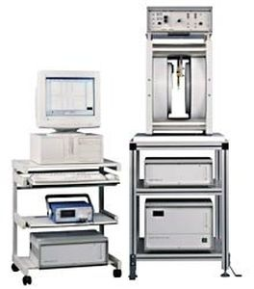
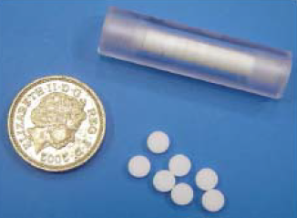
Alanine for dosimrtry
Pastilles of alanine
Machine of EPR

Slide 16
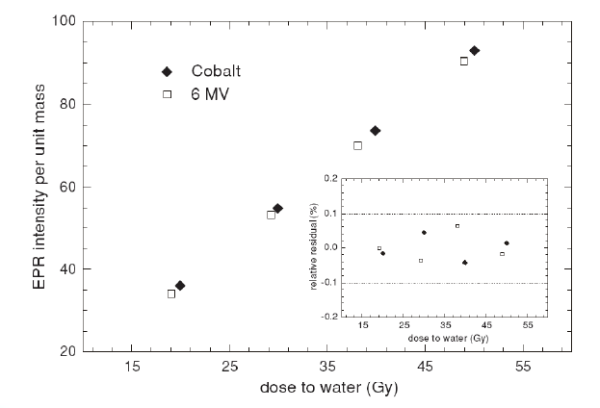
Dose response

Slide 17
Advantages and disadvantages
Relatively tissue-equivalent
Good linearity with the dose
Small volume
High lower dose limit → applications in radiotherapy
Large range of dose measurement → 0.5 – 100 kGy
Need an EPR machine → little available → major defect

Slide 18
Radiochromic film
Radiochromic films are translucent films showing a blue color after irradiation
After the irradiation, the diacetylene crystals (monomers) constituting the film are polymerized giving the blue color of the irradiated film
Reaction → diacetylene monomers ( ) → acetylene polymer ( ) with a carbene (carbon atom with 2 non-bounded e⁻) linked to the end of each polymer chain
Analyze by densitometry

Slide 19
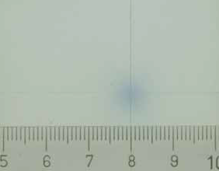
Example of result with a radiochromic film
Positioning test for a Gamma Knife

Slide 20
Characteristics of the radiochromic films (1)
High lower dose limit (» Gy) → applications in radiotherapy
No development → no quality control needed
Films without « grain » → very good spatial resolution
Perfectly adapted for measurements showing large spatial variations of dose
Dose response linear between » Gy and a few kGy

Slide 21
Characteristics of the radiochromic films (2)
Little sensitive to sun light
Can be cut in any requested shape
Not very different from tissue-equivalent
Possible storage
Small sensitivity → important defect
Could potentially play an increasing role for dosimetry in radiotherapy

