Slide 1
Another effect of irradiation on a MOSFET
Another effect of irradiation on a MOSFET → ↗ of the number of traps (several orders of magnitude) at the SiO₂-Si interface (« interface » means on both sides → in the Si and in the SiO₂)
Phenomenon not completely explained
Observation → ½ of the traps created by the irradiation are donors and ½ are acceptors → in the Si more traps (of 2 types) → whether for a nMOS or for a pMOS → more difficulties to obtain the channel → |V_{TH}| ↗ (+ distortion of the characteristic)
For a pMOS → this effect adds up to ¢V_{TH} (because ¢V_{TH} < 0) because of h⁺ trapping
For a nMOS → this effect offsets ¢V_{TH}
In practice → use of a pMOS

Slide 2
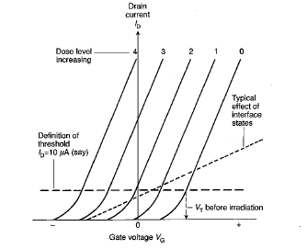
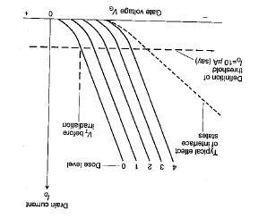
Modification of I_{D} - V_{GS} (global effect)
nMOS pMOS

Slide 3
Remarks on the use of a MOSFET
Lower detection limit « relatively high » → main use in radiotherapy and curietherapy
For « classical» available MOSFET dosimeters → lower limit ≈ 1 cGy
Investigations for an improvement of this lower limit → currently: ≈ 100 ¹Gy
Measurements are available at any moment → dose or dose rate
The ¢V_{TH} shift caused by previous measurements must be known (because of the accumulation of the h⁺ in the insulator)
Limited life time of a MOSFET detector

Slide 4
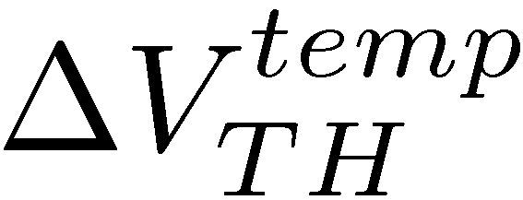
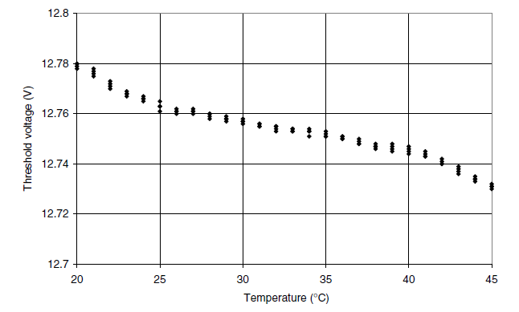
Temperature effect
Very sensitive to temperature (→ as for diodes) → apparition of a term
Between 20 °C and 40 °C → ≠ of 50 mV for ¢V_{TH} → ≠ of 10 cGy
Generally → 1 °C → mV
D = 100 Gy

Slide 5
Solution to the T problem: dual MOSFET
Dual MOSFET: 2 identical MOSFET, build on the same Si chip and operating at 2 ≠ gate voltages
During irradiation → each element gives a voltage shift → the ≠ between the 2 voltage shifts gives a signal / to the dose
For a dual MOSFET → variation of ≈ 0.015 mV/°C

Slide 6
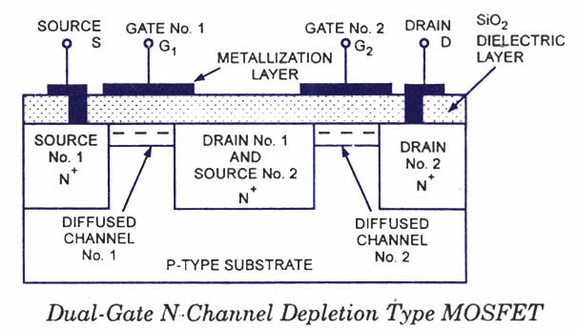
Dual MOSFET

Slide 7
RADFET
To improve the sensitivity of the detector → several linked MOSFET → RADFET (RADiation-sensing Field-Effect Transistor)
Properties identical to the dual MOSFET but larger sensitivity: « theoretically » < ¹Gy → practically less good

Slide 8
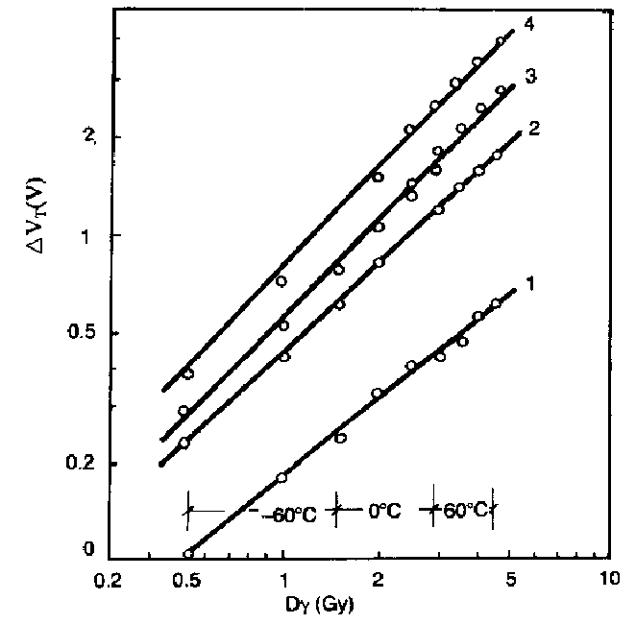
Response as a function of the dose: High doses
V_{GS} = 9 V
V_{GS} = 6 V
V_{GS} = 3 V
nMOS for 1 MeV °
V_{GS} = 0 V

Slide 9
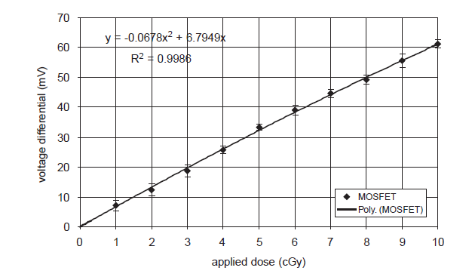
Response as a function of the dose: Small doses
Dual pMOS for 6 MeV °

Slide 10
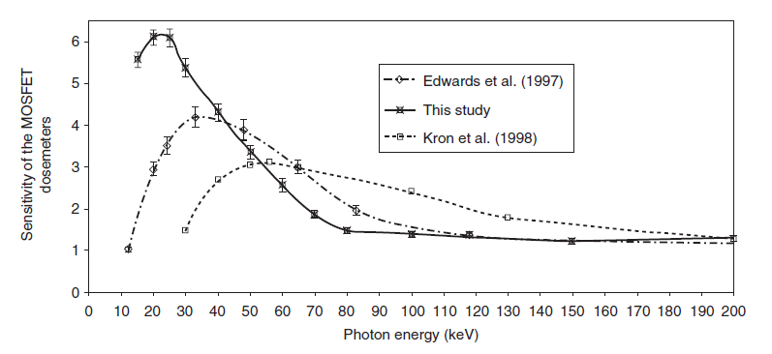
Energy response
Wang et al. (2005)
Energy responses obtained in ≠ studies (6 MeV °) for ≠ MOSFET → in all cases → non-linearity for E < 100 keV

Slide 11
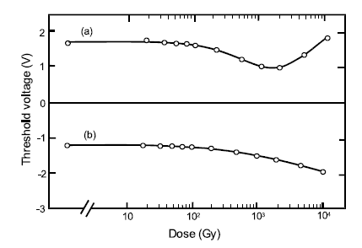
Effect of the cumulated dose
As for diodes → the irradiation introduces supplementary defects in the material → modification of the sensitivity as a function of the dose (for high doses)
≠ Behaviour for nMOS and pMOS ↔ because ≠ types of defects and thus of traps
nMOS
pMOS

Slide 12
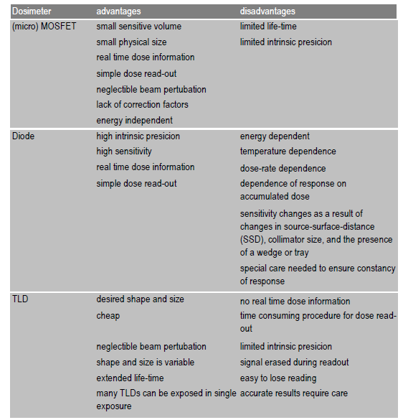
Comparison TLD-Diode-MOSFET

Slide 13
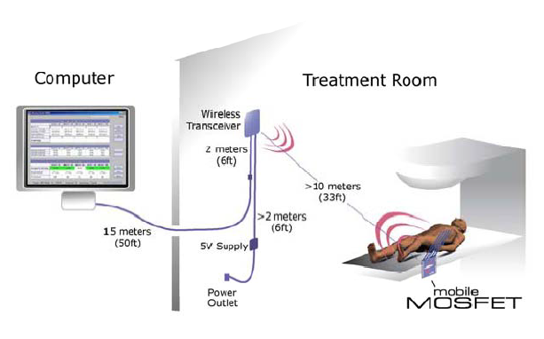
Applications (1)
Mobile MOSFET system from Best Medical → wireless

Slide 14
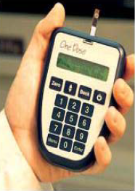
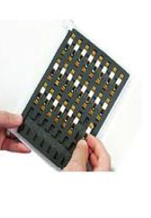
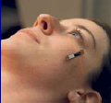
Applications (2)
OneDose MOSFET system from Sicel Technologies Inc. → wireless

