Slide 1
MOSFET dosimeter: Definition of MOSFET
MOSFET → acronym for Metal-Oxide Semiconductor Field Effect Transistor
Field effect transistor → use of an electric field to control the shape and the conductivity of a « channel » in a semiconductor material → modulation of the current passing through (between the « source » and the « drain ») with a voltage applied on the central electrode called « gate »
For the MOSFET → the gate (metal or polycrystalline silicon) is electrically isolated from the substrate (semiconductor) by a dielectric (as SiO₂) → no current injected by the gate
Can be n- or p-type channel

Slide 2
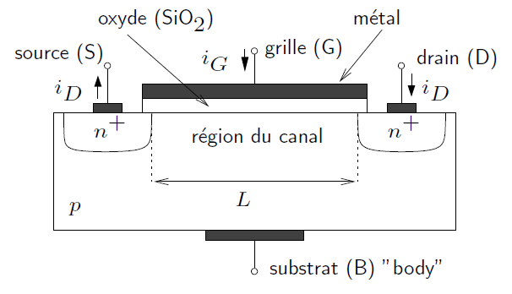
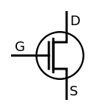
Scheme of a n-type channel MOSFET (nMOS)
Typical characteristics → L ≈ 1-40 ¹m, SiO₂ thickness ≈ 0.02-0.1 ¹m, ? width ≈ 2-500 ¹m, n regions strongly doped (n⁺): n ≥ 10¹⁷ cm⁻³

Slide 3
Principle of operation (n channel)
Assumptions:
V_{S} = V_{B}
We apply a positive difference of potential V_{DS} = V_{D} - V_{S} > 0 between the drain and the source
Without grid polarization → V_{GB} = V_{G} - V_{B} = V_{GS} = 0 → no current between the source and the drain → I_{D} = 0
V_{GS} ↗ →
V_{GS} ≤ V_{TH} → I_{D} = 0 → Cutoff mode: when the gate voltage is smaller than the « threshold voltage »
→ h⁺ repelled to the substrate → creation of a depletion zone
→ e⁻ thermally generated in the substrate or coming from n⁺ regions are attracted at the surface of the substrate
V_{GS} > V_{TH} and V_{DS} < (V_{GS} - V_{TH}) → I_{D} linearly ↗ → Linear mode (or triode mode or ohmic mode): creation of a conduction channel of e⁻ → the transistor operates like a resistor
V_{GS} > V_{TH} and V_{DS} > (V_{GS} - V_{TH}) → I_{D} independent of V_{DS}: Saturation mode (or active mode): I_{D} / (V_{GS} - V_{TH})²

Slide 4
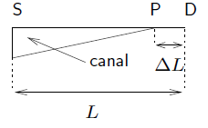
Saturation mode
We have V_{GS} > V_{TH} → when V_{DS} ↗ → V_{D} > V_{S} → V_{G} - V_{D} < V_{G} - V_{S} → V_{GD} < V_{GS} → the density of e⁻ decrease in the channel near the drain → the channel is pinched at point P (pinch-off point), close to the drain → ↗ of the resistance of the channel → saturation of I_{D}
I_{D} is thus independent (practically → weakly dependent) of V_{DS} and principally controlled by V_{GS}

Slide 5
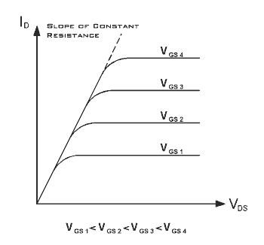
Characteristic curves I_{D} = f(V_{DS})

Slide 6
Characteristic curve I_{D} = f(V_{GS})
I_{D}
V_{TH}
V_{GS}

Slide 7
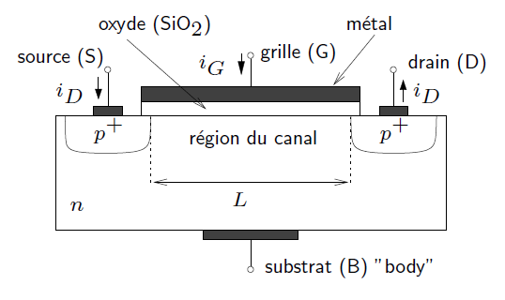
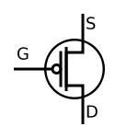
Scheme of a p-type channel MOSFET (pMOS)
Similar to the n-channel MOSFET but the doped regions are opposite, I_{D} is opposite, V_{GS} and V_{DS} have opposite polarities and the drain current is made of h⁺

Slide 8
Effects of radiation on MOSFET (1)
The MOSFET under irradiation may be in passive mode (V_{GS} = 0) or in active mode (V_{GS} > 0) → V_{GS} > 0 → the recombination ↘ → more sensitive and more linear response
Ionizing radiations produce e⁻ - h⁺ pairs in the metal, the oxide coating and the semiconductor constituting the MOSFET
In the metal and in the semiconductor, the e⁻ - h⁺ pairs are quickly removed because these materials have a weak resistance
On the contrary in the SiO₂ (W ≈ 17 § 1 eV for SiO₂) → the pairs, either immediately recombine, either split off because of the present electric field → however ≠ behaviour due to their ≠ mobility (5 to 12 orders of magnitude)
If we suppose a voltage V_{GS} > 0
→ the e⁻ drift to the gate and, because of their large mobility (¹ = 20 cm² V⁻¹s⁻¹) → they reach the metal and leave the oxide in a time ≤ 1 ps
→ the h⁺ drift to the SiO₂-Si interface more slowly because of their small mobility (strongly dependent on T → ¹ = 10⁻⁴-10⁻¹¹ cm² V⁻¹s⁻¹) and are trapped at the interface (always in the oxide) → giving origin to a fixed + charge → modification of the characteristic curve of the MOSFET

Slide 9
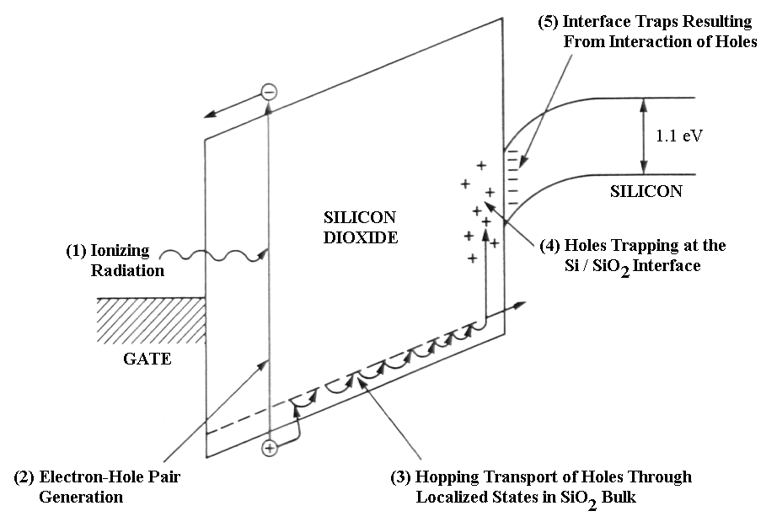
Effects of radiation on MOSFET (2)

Slide 10
h⁺ transport in the SiO₂
Due to the small mobility of the h⁺ → the transport in the oxide can take a few seconds (depending on T)
Model for the transport of the h⁺ in the SiO₂ → « Small Polaron Hopping » (SPH): transport (or hop) of the small (charge confined in a small volume) polaron (quasi-particle composed of a charge and of its polarization field)
SPH model based on the strong interaction between the h⁺ and the lattice → the interaction gives origin to a distortion of the lattice close to the h⁺→ ↘ of the energy of the system
The h⁺ polarizes the medium → this polarization then interacts back on the carrier → implies a large distortion of the lattice in the immediate vicinity of the h⁺ → the h⁺ becomes localized at a particular site → ↗ of the effective mass of the h⁺
The carrier, which is in practice self-trapped, is called small polaron

Slide 11
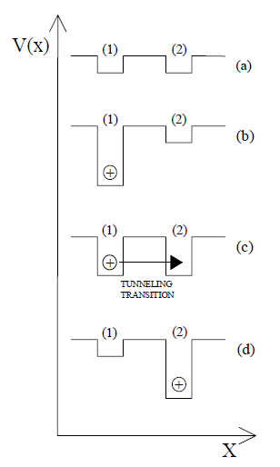
SPH model
Initially empty localized trap
Capture of a h⁺ by a site → distortion of the lattice potential around the trap site
Thermal fluctuations of the system → interaction with another site → transfer of the h⁺ by tunnel effect
Final state

Slide 12
Trapping of the h⁺ at the interface SiO₂-Si (1)
When the radiation-induced h⁺ have completed the crossing of the oxide → they are trapped at the SiO₂-Si interface → production of a + charge Q_{T} at the SiO₂-Si interface
Consequently → production of a - image charge at the surface of the semiconductor
→ has a positive role in the formation of the n-channel for a nMOS → the voltage to be applied to the gate to create the n-channel is smaller → V_{TH} ↘
→ has a negative role in the formation of the p-channel for a pMOS → ↗ of the |V_{GS}| to be applied to have the formation of the p-channel p → V_{TH} ↘
Q_{T} implies thus a (negative) modification ¢V_{TH} of the threshold voltage V_{TH} (but also to a lesser extent of the leakage current) → shift of the I_{D} - V_{GS} characteristic curve
This modification ¢V_{TH} can stay for a period of time varying from milliseconds to years
¢V_{TH} is a measure of the dose absorbed in the oxide

Slide 13
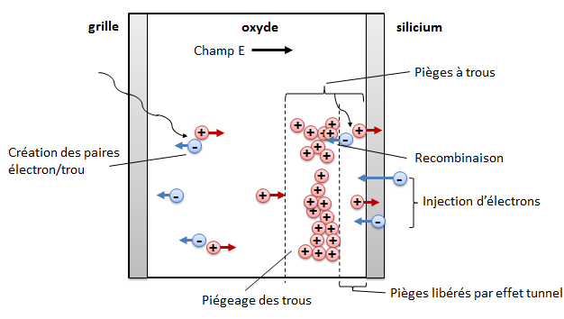
Trapping of the h⁺ at the interface SiO₂-Si (2)

Slide 14
Modification of the I_{D} - V_{GS} characteristic curve
I_{D}
¢V_{TH}
V_{TH}^{après}
V_{TH}^{avant}
V_{GS}
Modification of the I_{D} - V_{GS} characteristic curve for a nMOS exposed to ionizing radiation

Slide 15
Mathematical expression of ¢V_{TH}
In active mode (V_{GS} > 0) → we consider q: the e⁻ charge, ε_{ox}: the permittivity of the oxide, ½_{ox}: the density of the oxide, W: the energy necessary to create one e⁻ - h⁺ pair, f_{y}(E): the fraction of created charges which do not recombine, f_{t}(E): the fraction of trapped holes, d_{ox}: the thickness of the oxide coating, D: the dose →
In passive mode (V_{GS} = 0) → decrease of sensitivity and loss of linearity →

