Slide 1
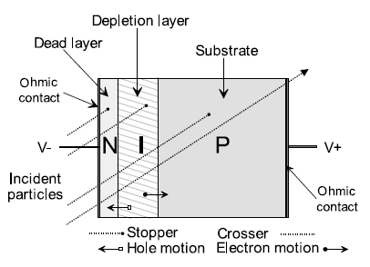
Principle of diode detector (1)

Slide 2
Principle of diode detector (2)
When an ionizing radiation passes through the diode → creation of e⁻ - h⁺ pairs
When the pairs are created in the depletion zone or at a distance < L_{p,n} (the diffusion lengths of the carriers) of the depletion zone (« sensitive part » of the diode) → they undergo the electric field → they reach the boundaries of the depletion zone → voltage pulse is collected
Only pairs created in the sensitive part of the diode (d + L_{p} + L_{n}) will be collected → sensitivity of the diode / depth of the depletion zone
The diode is used in reverse bias for the measurement of small doses and without polarization for high doses (in radiotherapy) → depth of the depletion zone reduced to minimum
For diodes used in spectrometry → difference → the particle has to deposit all its energy in the depletion zone → size ↗

Slide 3
Type of diode used in dosimetry (1)
The sensitivity of a diode detector is linked to the life time of the charge carriers created → if recombination → charge is lost → sensitivity ↘
The life time is itself linked to the concentration of defects (= traps) in the diode
The irradiation will introduce additional defects in the material (radiative damages) → sensitivity depends on the dose and on the dose rate
It is possible to show that the number of additional traps as a function of the dose rate created in a n-type semiconductor is larger than for a p-type → the irradiation affects more importantly the life time of the e⁻ than the one of the h⁺
In practice in dosimetry → p-type diode (« large » volume of p-type associated with a « small » volume of n-type) because the loss of sensitivity is largely more important for n-type diodes than for p-type

Slide 4
Type of diode used in dosimetry (2)
Diodes for dosimetry are ≠ of diodes used in spectrometry
To minimize the perturbations in the medium (Bragg rule: no perturbation of the fluence by the detector) → diode smallest as possible (classical dimensions: 1 £ 1 £ 1 mm³)
Size not too small anyway → sensitivity / size of the depletion zone → compromise must be found
The material surrounding the diode is also important → generation of secondary charged particles → as tissue-equivalent as possible: electric contacts in Al, supports in plastic, carbon,…

Slide 5
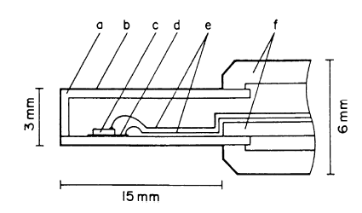
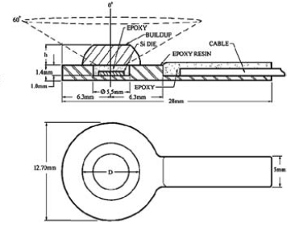
2 examples of diode dosimeters
polyethylene
carbon cover
Si diode
carbon epoxy
cables in Al
PMMA
Diode developed by Sun Nuclear Corporation

Slide 6
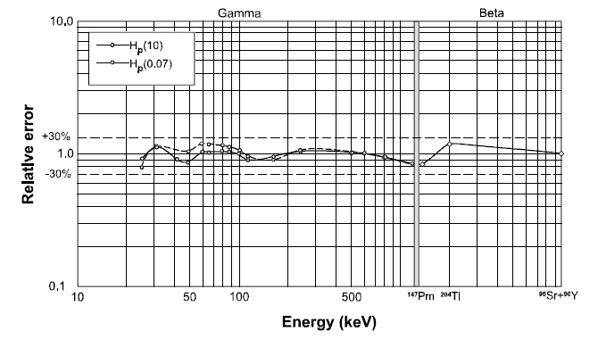
Energy response
Difficulty for small energy ° → photoelectric effect is dominating → overestimation of the dose → problem → use of filters
X, ° rays: 20 keV to 6 MeV
¯: > 60 keV
Dosimeter DMC-2000 XB: MGP Instruments

Slide 7
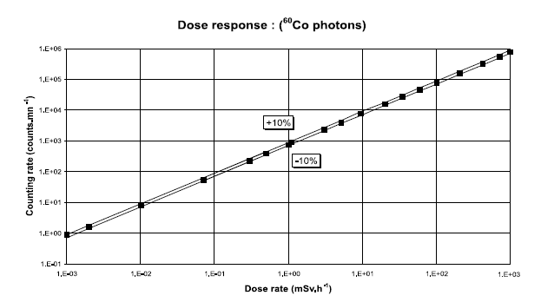
Response in dose
In pulse mode (for not too important dose rates → not for radiotherapy) → linear dose response
Dosicard: Canberra

Slide 8
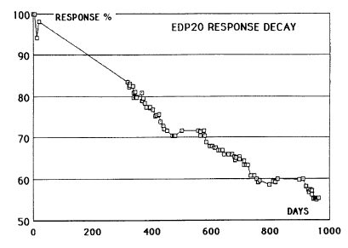
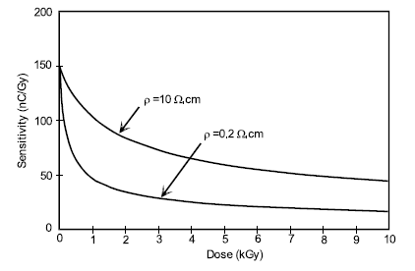
Effect of cumulated dose (1)
As written above → irradiation produces additional defects in the material
When the dose ↗ (remark: high doses) → sensitivity ↘
(a)
(b)
(a) Diode EDP-20: Scanditronix - Wellhöfer → dose rate: 45 Gy/j, ° of 25 MeV
(b) Response as a function of the cumulated dose for 6 MeV °

Slide 9
Effect of cumulated dose (2)
To precisely determine the dose at a given time → the decay curve of the sensitivity and the previous irradiation level should be known → problem
Solution → pre-irradiation before use to reach a (about) constant level of sensitivity

Slide 10
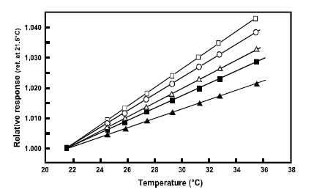
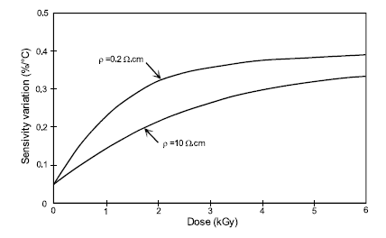
Temperature effect
When T ↗ → the concentration of carriers ↗ → large dependence of the diode response as a function of T → problem
In practice → SVWT (sensitivity variation with temperature) = 0.1%/°C for a non pre-irradiated diode
For p-type diode pre-irradiated at 5 kGy (20 MeV °) → SVWT = 0.35-0.4 %/°C → SVWT depends on the cumulated dose (and also on the dose rate)
SVWT as a function of the cumulated dose for 6 MeV °
Response in T for ≠ diodes

Slide 11
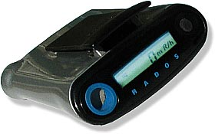
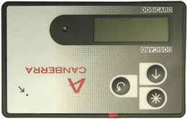
Examples of available personal dosimeters
ES600 of Labomoderne Dosicard of Canberra

Slide 12
Characteristics of ES600 and of dosicard
Very similar
For ¯ and °
Measure of dose: 1 ¹Gy < D < 10 Gy
Measure of dose rate: 1 ¹Gy/h < D/h < 1 Gy/h
Accuracy: < ± 15% at ¹³⁷Cs, up to 1 Sv/h
Non-volatile EEPROM memory
Digital readout of the dose and of the dose rate
Alarm
Storage of data

Slide 13
Neutrons detectors with diodes (1)
Neutrons detectors based on the used of 2 diodes
Diode 1 (called neutron diode): covered with an organic medium (plastic: PE,…) doped with ¹⁰B (≈ 10¹³/cm³ B atoms) → sensitive to neutrons and °
Diode 2 (called ° diode): « nude » → no sensitive to neutrons and sensitive to °
The 2 diodes are side by side and ? to ionizing radiations (neutrons + °)

Slide 14
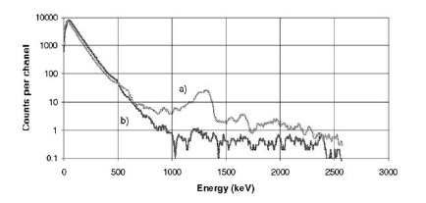
Neutrons detectors with diodes (2)
Thermal n interact with 1 in 2 ways →
H(n,n)p → emission of protons
¹⁰B(n,®)⁷Li → emission of ®
The ≠ between signals from diodes 1 et 2 allows to discriminate the contribution due ° from the contribution due to neutrons
Diode 1
Diode 2
Pic ®
Measured spectrum

Slide 15
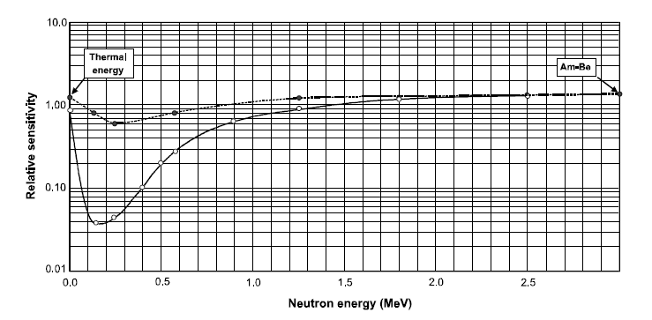
Neutrons detectors with diodes (3)
If the size of the plastic coating is large → important moderation of high energy neutrons → it is possible to study neutrons with high E
The quantity of ¹⁰B is chosen to obtain a response to thermal neutrons equal to the response to fast neutrons

Slide 16
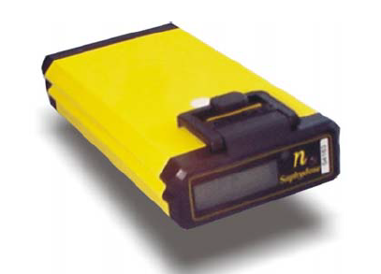
Neutrons detectors with diodes (4)
For very high E (E > 10 MEV) → addition of Pb → reaction (n,2n)
To improve the precision for a large range of E → system with 3 or 4 diodes with ≠ coatings → multi-elements detector (Saphydose detector)
Saphydose Detector of Saphymo

