Slide 1
Chapter XI: Electronic dosimeters

Slide 2
Types of electronic dosimeters
Electronic dosimeters include both passive (integrators) or active (real-time measurement) dosimeters
We discuss here about dosimeters made of silicon (even though dosimeters made of germanium, diamond, etc. also exist → less used or more expensive)
2 devices will be considered (→ no bipolar transistors, no solid ionization chambers) →
Diode
MOSFET (Metal-Oxide Semiconductor Field Effect Transistor)
References:
J. Barthe, Electronic dosimeters based on solid state detectors, Nuclear Instruments and Methods in Physics Research B: 184 (2001) 158–189
A. Holmes-Siedle, L. Adams, Handbook of radiation effects (Oxford Science Publication) 1994

Slide 3
Introduction
Electronic dosimeter → personal dosimeters, dosimeters for radiotherapy, for curietherapy,…
Si is used for electronic dosimeters → well known material
Several advantages of the electronic dosimeter :
Z = 14 → « relatively » tissue-equivalent → for E < 150 keV → increase of the interaction cross section compared to tissues (photoelectric effect)
Better sensitivity than a gas (factor 20000) due to its larger density (factor 2000) and to its smaller ionization energy (factor 10)
Smaller size → B-G conditions satisfied and possibly placed into a confined volume (human body)
Good mechanical stability
Possibility to measure doses or dose rates
Possibility to make neutrons dosimetry (not studied here)

Slide 4
Diode dosimeter: Definition of the diode
Si diode → junction of 2 types of semiconductors →
p-type diode: crystal of p-type (excess of h⁺) with a thin layer at the surface of n-type (excess of e⁻)
n-type diode: crystal of n-type with a thin layer at the surface of p-type
Thin metal layers are deposited on the semiconductors to make the anode (contact with the p-region) and the cathode (contact with the n-region)

Slide 5
n-type semiconductor
Silicon and Germanium are tetravalent
If a pentavalent impurity (doping) atom as arsenic, phosphorus, antimony (donor element) is introduced → replacing an atom lattice → an extra electron does not fit into the valence band
This extra e⁻ is weakly bound → easily excited to the conduction band → localized level just below the bottom of the conduction band
Ionization energy of this extra level: a few 0.01 eV → comparable to thermal energy → e⁻ in the conduction band without h⁺ in the valence band → n-type semiconductor
Practically concentration of donor N_{D} À n_{i} → electron concentration n ≈ N_{D} (N_{D} »10¹⁵ atoms/cm³) →

Slide 6
p-type semiconductor
If a trivalent impurity atom as gallium, boron, indium (acceptor element) is introduced → replacing an atom lattice → no enough electron to fill the valence band → excess of hole
A captured e⁻ in this hole is less bound than normal e⁻ → localized level just above the top of the valence band
e⁻ in the valence are easily excited to this level → extra hole in the valence band without e⁻ in the conduction band → p-type semiconductor
Practically concentration of acceptor N_{A} À n_{i} → hole concentration p ≈ N_{A} (N_{A} »10¹⁵ atoms/cm³) →

Slide 7
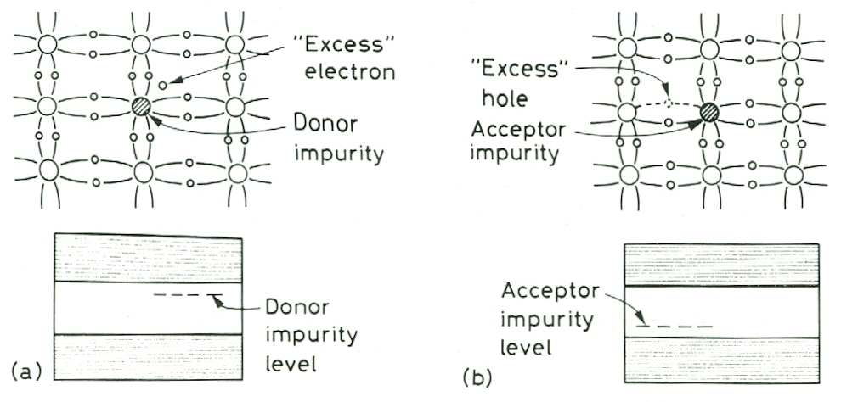
Representation of doped (extrinsic) semiconductors

Slide 8
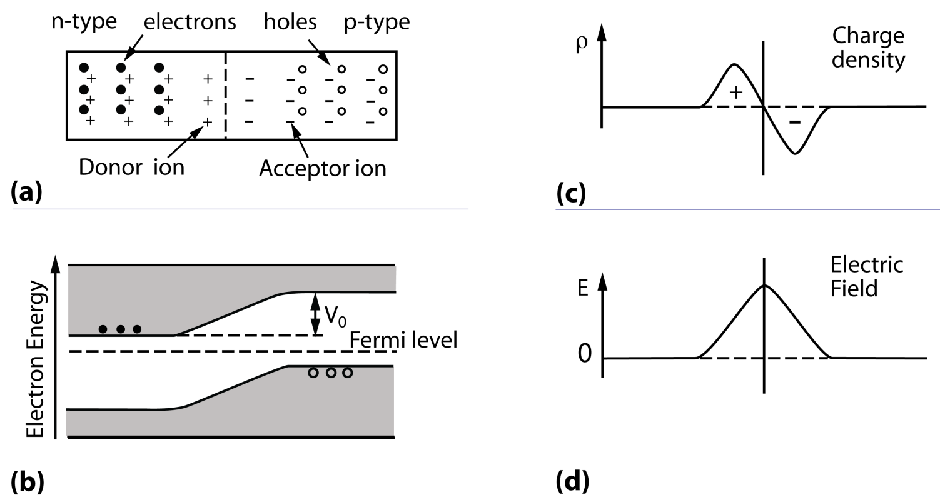
Principle of the diode
≠ density of charge → diffusion of majority e⁻ from n-region to p-region and of majority h⁺ from p-region to n-region → in the junction zone: recombination of e⁻ and h⁺ → positive ions in the n-region and negative in the p-region → electric field (10³ V/cm) in this region (called depletion region)

Slide 9
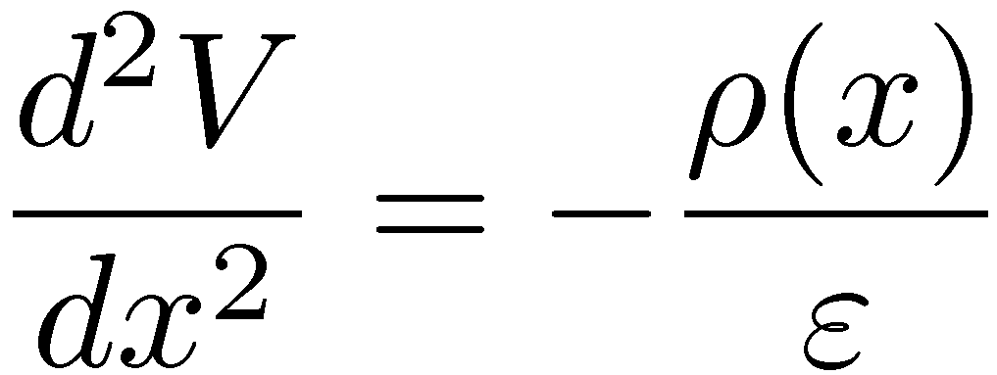
Depletion depth (1)
The width of the depletion zone (= d) depends on the concentration of n and p impurities. It can be determined from Poisson’s equation (with ε the dielectric constant):
If we consider an uniform charge distribution about the junction and with x_{n} and x_{p} the extents of the depletion zone on the n- and p-sides and a contact potential V₀ →
Since the charge is conserved: N_{A}x_{p} = N_{D}x_{n} (with N_{A} ≈ p the acceptors concentration and N_{D} ≈ n the donors concentration)

Slide 10
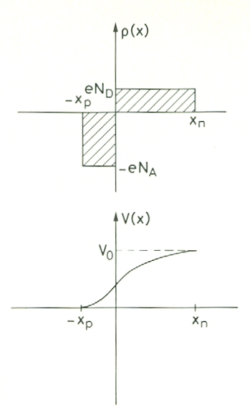
Depletion depth (2)

Slide 11
Depletion depth (3)
Integrating Poisson’s equation:
Since dV/dx = 0 at x = x_{n} and x = -x_{p}:
One more integration:

Slide 12
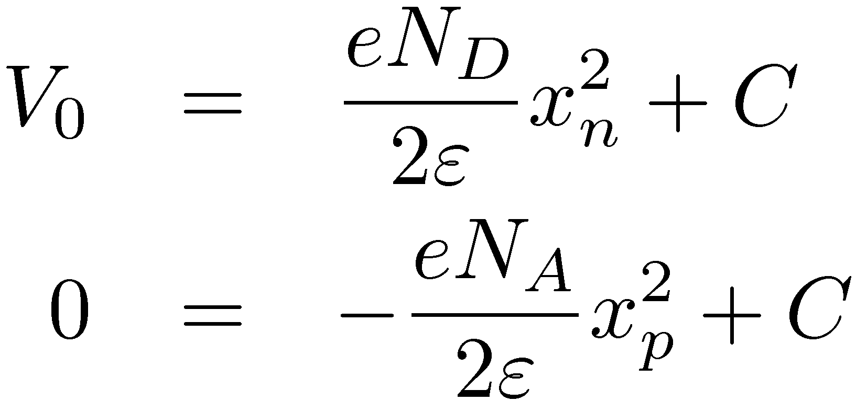
Depletion depth (4)
As solutions are equal at x = 0 → C = C’ and as V(x_{n}) = V₀ and V(-x_{p}) = 0:
Eliminating C:
Using the charge conservation equation:
and
d = x_{n}+x_{p}

Slide 13
Depletion depth (5)
Considering for instance N_{A} À N_{D} → x_{n} À x_{p} →
Extension of the depletion zone to the n-side
For Si with ½ = 20000 Ωcm and V₀ = 1V → d ≈ 75 μm

Slide 14
Applied voltage
If an external voltage is applied such as the anode is at a larger potential than the cathode potential (direct polarization) → decrease of the potential at the junction → a current will flow → no use in in dosimetry
If an external voltage is applied such as the anode is at a smaller potential than the cathode potential (inverse polarization) → re-enforcement of the potential difference at the junction → no current
This voltage attracts h⁺ in the p-region away from the junction and similarly for the e⁻ in the n region → enlarge the depletion zone (use in previous equation V_{B}+V₀ ≈ V_{B} because V_{B} À V₀) → 5 mm in Si
V_{B} is limited → attention to the breakdown (by Zener or avalanche effect)

Slide 15
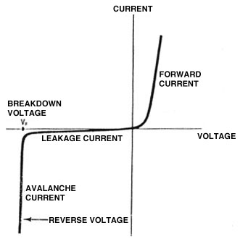
Current – voltage feature

