Slide 1
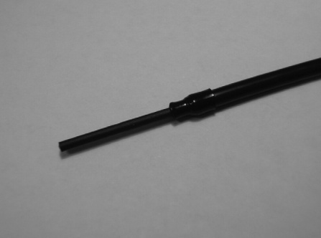
Al₂O₃:C dosimeters in practice
As monocrystal
→ very sensitive → excellent for the measurement of small doses
→ may be heated → deep traps are emptied → may be indefinitely reused
→ lack of uniformity between 2 crystals → large variability between dosimeters of this type → individual calibration
As powder (Landauer Inc.) → crystals grinded into powder and embedded in a plastic matrix
→ very good uniformity
→ cannot be heated → deep traps are not emptied → loss of sensitivity in the end
Microcrystals and optical fiber
→ in-vivo dosimetry
→ real-time dosimetry
→ to be investigated
Ø = 300 ¹m

Slide 2
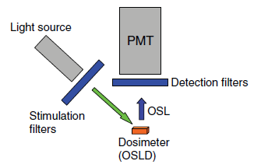
OSL Readers: Basic properties
A basic installation requires:
A light source for the stimulation (LED, laser,…)
Filters to select the wavelength of the light source
Filters to select the wavelength of the luminescence light
A light detector (photomultiplier,…)
The associated electronics

Slide 3
Wavelength of the stimulation light
The more efficiency wavelength of the stimulation light is blue (¸ ≈ 470 nm) but it too close of the maximum of luminescence (¸ = 420 nm)
In practice in dosimetry green is used (¸ ≈ 525 nm)

Slide 4
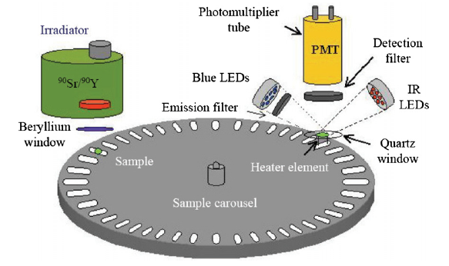
OSL reader in practice (1)
OSL reader for research
→ High-capacity automatization
→ allows OSL or TLD measurements
→ calibration source is often incorporated
→ equipped with blue and/or green LEDs

Slide 5
OSL reader in practice (2)
OSL Landauer reader → in POSL mode
→ OSL stimulated by laser Nd:YAG (532 nm) with short period
→ the OSL intensity is measured between pulses
→ as a function of the dose → ≠ stimulation powers
OSL Landauer reader → in CW-OSL mode
→ short stimulation (1s) by green LEDs
→ number of LEDs (and thus power) depending as a function of the dose to be measured

Slide 6
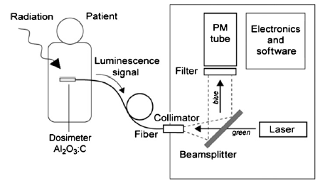
OSL reader in practice (3)
System with optical fiber
→ the optical fiber delivers the OSL stimulation and carries back the OSL luminescence
→ green laser for stimulation
→ also POSL mode
→ allows in-vivo and real-time measurements

Slide 7
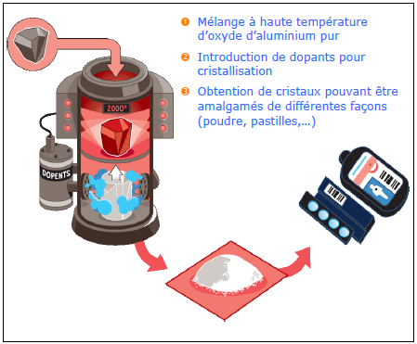
OSL dosimeter: In practice at ULB (1)
Dosimeters Landauer IPLUS in Al₂O₃:C
From crystals in aluminium oxide → aluminium oxide powder applied between 2 plastic films

Slide 8
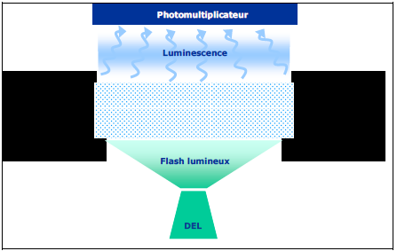
OSL dosimeter: In practice at ULB (2)
For IPLUS → optical stimulation realized from a set of electro luminescent diodes emitting continuously a 532 nm light (green) → CW-OSL
Signal emitted from detectors (blue light of about 420 nm) measured with a photomultiplier

Slide 9
OSL dosimeter: In practice at ULB (3)
Dosimeter re-analyze: The optical stimulation maintain more than 99% of information in the detector → possible multiple reading and storage of the dosimeter for later investigations
No required calibration: The sensitivity of the detector is determined during the fabrication process → the sensitivity value carved on the detector is automatically taken into account during the reading process
Stable sensitivity in time: Sensitivity defined for ever
Very weak fading: Smaller than 1,5 % / month and <4% / year → the fading does imply to be corrected during the dose estimation
Response to neutrons: No neutron sensitivity highlighted here

Slide 10
OSL dosimeter: In practice at ULB (4)
Temperature and hygrometry: Range of use: -10°C to 40°C and from 0 % to 90%
Exposition to light: no particular restriction in normal conditions
Strong and light dosimeter: Strong, compact, light, fully customize dosimeters
Types of radiations:
photon: energies from 16 keV to 6 MeV (with a maximum energy of 18 MeV)
beta: energies larger than 250 keV
Possible reutilization: dose maximum of 100 mSv and maximum number of reutilizations: larger than 1000
Homogeneity of the pack sensitivity: < 10% (generally < 2,4%)

Slide 11
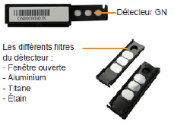
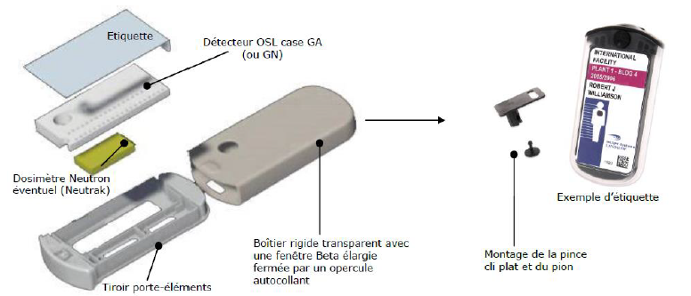
OSL dosimeter: In practice at ULB (5)
Detector with :
A detector card with 4 pastilles in Al₂O₃:C
A filter holder box with a barcode printed in a legible form and composed of 4 filters: plastic, aluminium, titanium, tin

Slide 12
Radiophotoluminescence dosimetry (RPL)
Again luminescence process stimulated by light
For radiophotoluminescence (RPL) → no ionization of the defect but excitation of the defect → during relaxation → emission of light
Main advantage → the trapped carriers are preserved → the measurement can be indefinitely repeated → storage
Process ≠ from OSL → another class of dosimeter (even with optical stimulation)
Very recent development → this technology need to prove itself
Reference:
T. Yamamoto, D. Maki, F. Sato, Y. Miyamoto, H. Nanto, T. Iida, The recent investigations of rdiophotoluminescence and its application, Radiations Measurements 46 (2011) 1554-1559

Slide 13
History
Discovery and first application in 1951 by Schulman
Problem → Photoluminescence inherent to considered materials → emission of light without irradiation → important noise → brake on its use while properties are extremely interesting
Recently → development of a pulsed laser system + perfectly controlled materials + improved electronics → decrease of the noise to a correct level
Possibly a very valued method in the future (currently: Japan and IRSN in France)

Slide 14
Simple model for RPL (1)
2
1
We have n₁, the concentration of e⁻ trapped in 1 (ground state of the trap), n₂, the concentration of e⁻ trapped in 2 (excited state of the trap), ® and ¯, the transition probabilities 1 → 2 and 2 → 1
The material is exposed to a light source with short wavelength (UV) and with intensity I_{in} (constant) → the result is that a light with a larger wavelength and with intensity I_{out}

Slide 15
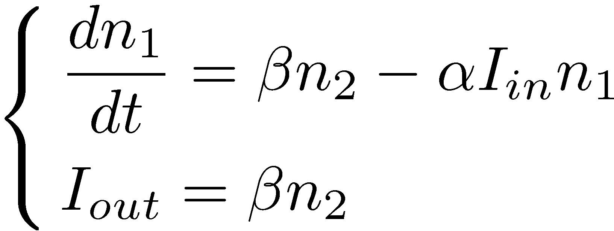
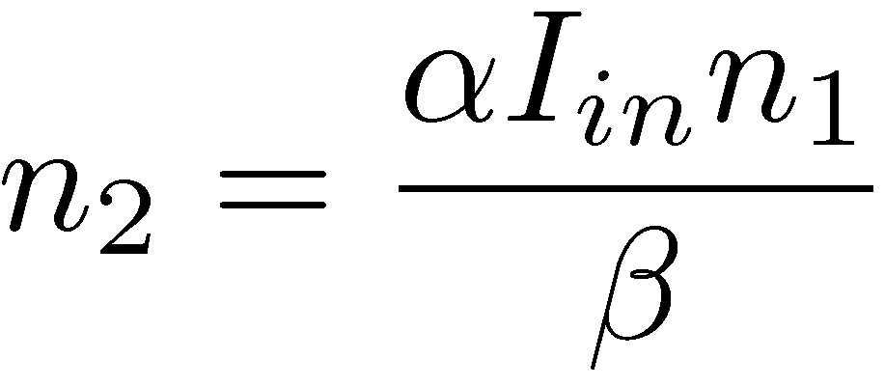
Simple model for RPL (2)
The equations of the process are →
By considering stationary state → dn₁/dt = dn₂/dt = 0 →

Slide 16
Simple model for RPL (3)
The important parameter linked to the dose is n_{t} = n₁ + n₂ →
If the source is a powerful laser → I_{in} > → important denominator
If the source is a LED → I_{in} < → I_{out} = ®I_{in}n_{t}
If signal present even though dose = 0 → I_{out} = ®I_{in}(n_{t} +n_{b}) → effect of pre-dose (photoluminescence)

Slide 17
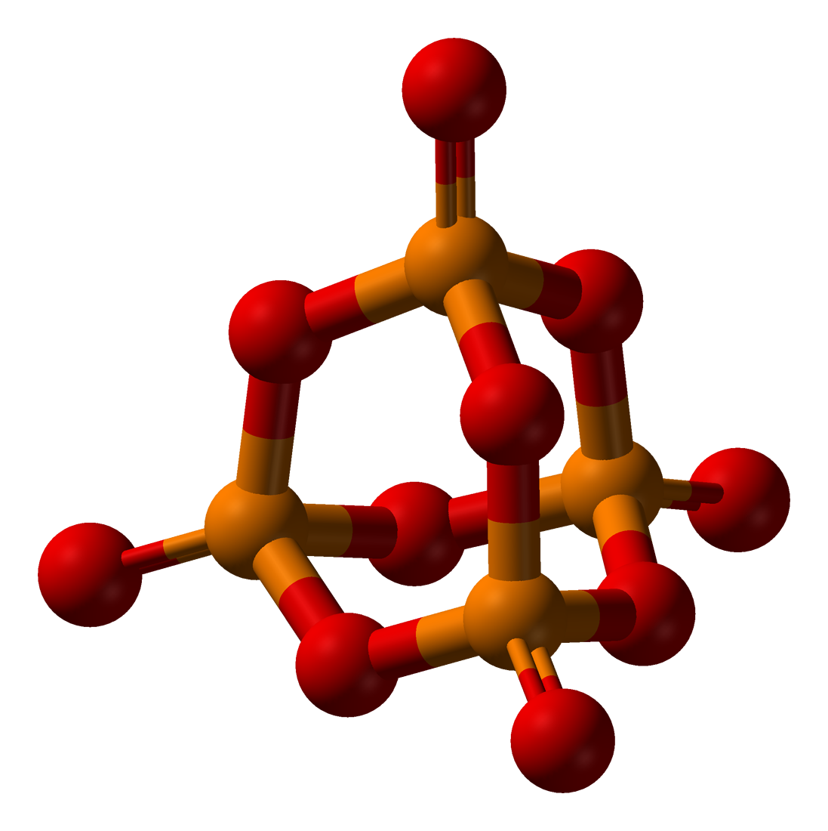
RPL dosimeter: Phosphate glass with silver impurities
Phosphate glass → type of glass in which SiO₂ is replaced by P₂O₅
The P₂O₅ mainly crystallize into P₄O₁₀ → each P atom is surrounded by 4 O atoms as tetrahedron shape →

Slide 18
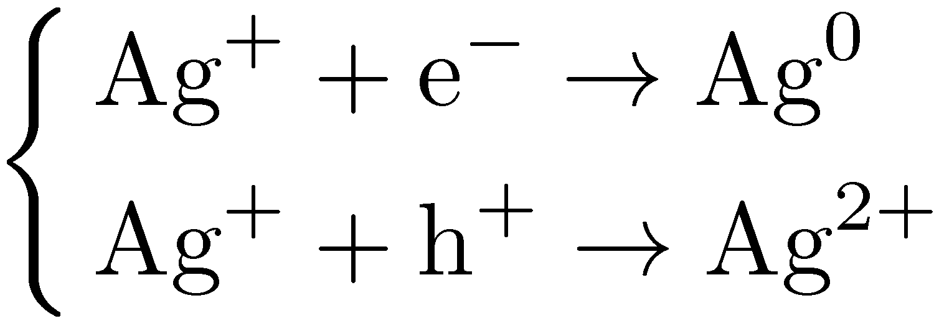
Phosphate glass: Silver impurities
Several compositions exist but all of them contain Ag impurities (example: FD-7 → Na: 11.00%, P: 31.55%, 0: 51.16%, Al: 6.12%, Ag: 0.17%)
The optimum Ag concentration is determined in a phenomenological way
In the phosphate glass, Ag is stable as Ag⁺ ion
The e⁻ and h⁺ created by ionizing radiation in the glass are diffused in it and produce at the end the reactions →

Slide 19
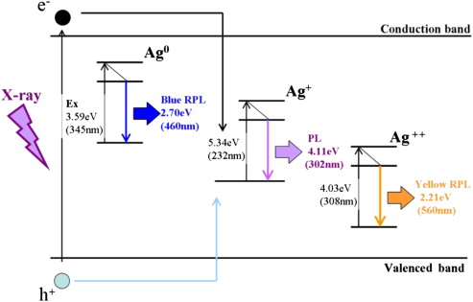
Luminescence mechanism
Ag⁰ are Ag²⁺ are the stable luminescence centers at ambient T
When the glass is exposed to UV radiation (345 and 308 nm) → excitation of Ag⁰ and Ag²⁺ impurities and then relaxation of these impurities by visible light emission (460 nm: blue and 560 nm: yellow-orange)

Slide 20
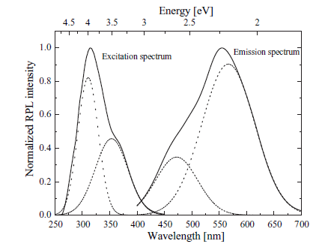
Absorption and emission spectra
There is thus a combination between the 2 visible radiations emitted → the emission spectrum is dependent on the absorption spectrum
yellow-orange is dominating

Slide 21
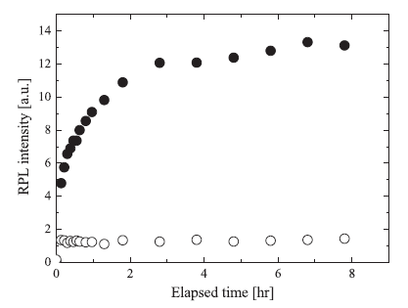
Build-up effect
Particularly for the emission at 560 nm → a waiting time is needed after the irradiation by ionizing radiation to stabilize the RPL light intensity → « build-up » phenomenon
It was suggested that, initially, the h⁺ is trapped by a PO₄ tetrahedron → only after a certain time: Ag⁺ + hPO₄⁺ → Ag²⁺ + PO₄
: RPL à 560 nm
: RPL à 460 nm

Slide 22
RPL dosimetry: In practice
The dosimeters based on the radiophotoluminescence phenomenon are called RPLD
For the FD-7 dosimeters: Z_{eff} = 12.0 → not tissue-equivalent (Z_{eff} = 7.35) → energy dependence for small energies (photoelectric effect)
To correct this non-linearity → addition of filters (for instance: Sn, Al, Cu, PE,…)

Slide 23
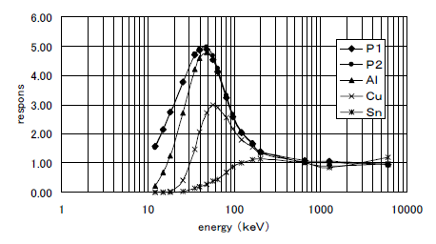
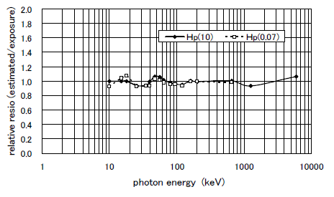
Energy response
(a)
(b)
(a) Energy response for incident ° with ≠ filters
(b) corrected response of the dosimeter (R = ∑_{i}k_{i}R_{i})
→ Linear response equal to 1 (with corrections)

Slide 24
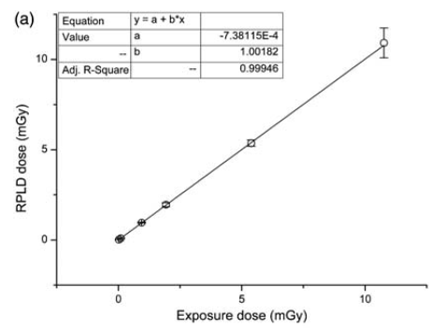
Response in dose: Small doses
Linear response for small doses

Slide 25
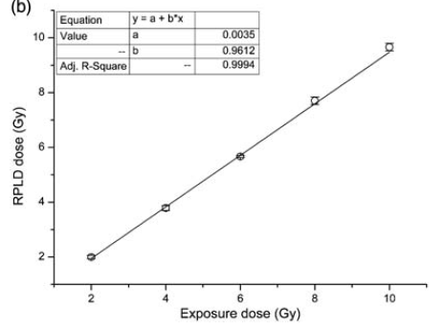
Response in dose: high doses
Linear response for high doses
Linear response for 20 ¹Gy < D < 10 Gy

Slide 26
Fading - Reproducibility
The fading data depend on the considered materials (and on measurement laboratories) but fading ≤ 1%/month is generally observed
The measurements are reproduced several times after various waiting times (t < 10 days) and various doses (20 ¹Gy < D < 10 Gy) give identical results (with variation of 1.5%)

Slide 27
