Slide 1
Al₂O₃:C
Al₂O₃ → as ®-Al₂O₃ : corundum or alpha alumina
Al₂O₃:C is the material most often used in OSL
Al₂O₃:C is the only material used in POSL

Slide 2
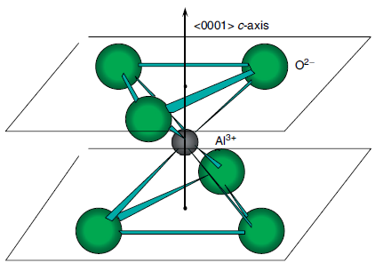
Al₂O₃:C: Structure of ®-Al₂O₃
The crystalline structure of ®-Al₂O₃ is a slightly distorted hexagonal-closepacked O²⁻ lattice with Al³⁺ ions occupying two out of every three octahedral interstices
Each Al³⁺ ion is surrounded by 6 octahedral nearest-neighbor O²⁻ ions

Slide 3
Defects and impurities
The thermodynamic defects are oxygen or aluminium vacancies → centers of type F and V, respectively
The O²⁻ vacancy implies a charge compensation →
the occupancy of the vacancy by 2 e⁻ gives rise to a neutral F-center
the occupancy of the vacancy by 1 e⁻ gives rise to a positive F⁺-center
The addition of carbon impurities causes significant increase the sensitivity of the material
The divalent C²⁺ carbon ion replaces a trivalent Al³⁺ ion → charge compensation → creation of oxygen vacancies as F⁺-center

Slide 4
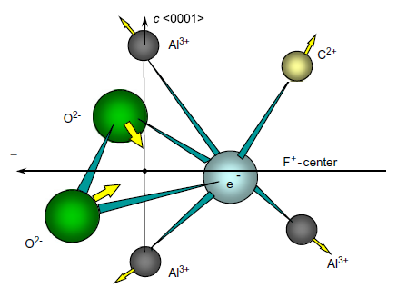
Configuration of an F⁺ -center charge-compensated by a divalent carbon ion

Slide 5
Emission mechanisms
The sensitivity of Al₂O₃:C depends on the concentration of F⁺-centers that are the recombination centers
The main emission band of the Al₂O₃:C is a quite large band centered at 420 nm and ascribed to a F-center of luminescence
The e⁻ are released from the traps and recombine with F⁺-center → creation of excited F-center relaxing and giving luminescence
The lifetime of the excited F-center is 35 ms at ambient T
The identity of the defects responsible for the capture of the charge carriers during the ionization is not known

Slide 6
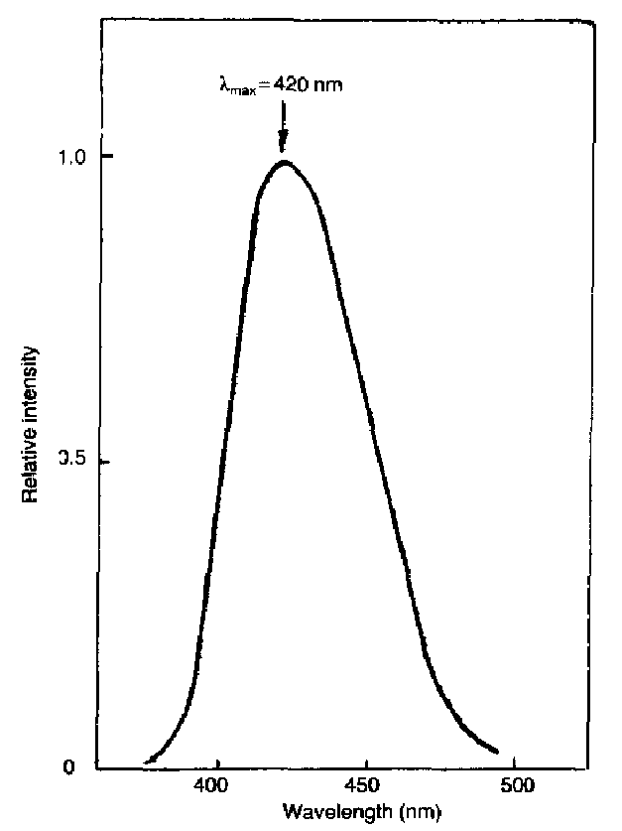
Emission spectrum of Al₂O₃:C

Slide 7
Dosimetric properties of Al₂O₃:C (1)
The energy band-gap of Al₂O₃ is wide (» 9.5 eV) → allows to engineer deep and thermally stable traps and color centers (little sensitive to T)
Al₂O₃:C is very sensitive to radiation (sensitivity → ratio between the number of emitted photons and the absorbed dose) because of the absence of thermal quenching and of very small noise (especially for POSL) → 60 £ more sensitive than the TLD-100 which is the reference
This very good sensitivity allows to make measurements at very small doses → D = 1 ¹Gy
Al₂O₃:C shows a linear response to the dose in a large range → 1 ¹Gy < D < 10 Gy → on 5 decades (supralinearity appears at 10 Gy and sublinearity at 100 Gy)

Slide 8
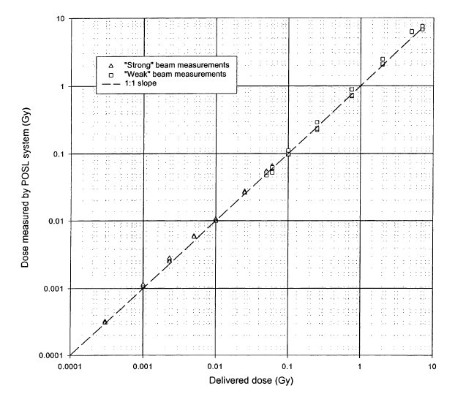
Dose response of Al₂O₃:C
« strong » and « weak » characterize the stimulation power (1.2 W and 0.01 W)

Slide 9
Dosimetric properties of Al₂O₃:C (2)
Possible rereading of the dosimeter → due to the large sensitivity of Al₂O₃:C → in CW-OSL a measurement is precise enough if only a part of the traps is emptied → by considering the fraction of charges released during the 1st measurement, a second measurement is possible (or a 3th, etc.)
In POSL, rereading is more obvious → only a few stimulations pulses are enough → such as ¢n ¿ n → measure could be redo
Also possibility to reuse the OSL dosimeter after heating at high T to empty the traps
Al₂O₃:C is not tissue-equivalent (Z_{eff} = 10.2 ≠ 7.35) → energy dependence (overestimation) for E < 200 kEV → 1 filter could correct this problem

Slide 10
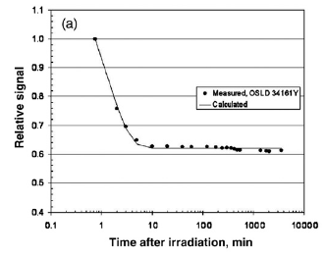
Fading
Fading comparable to TLD-100 (5%/an)
A transient signal appears for t < 10 min → due to shallow traps which are quickly empty → afterwards stable signal

Slide 11
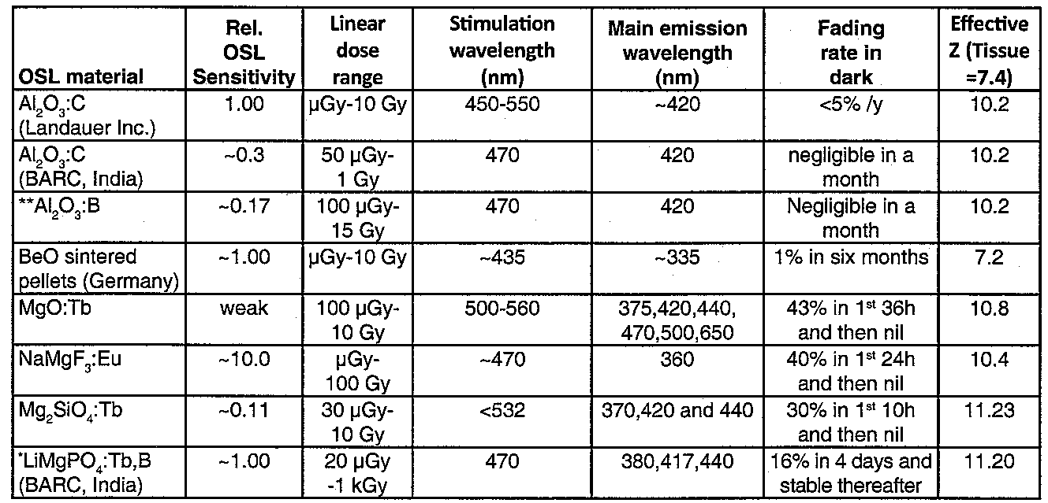
Characteristics of Al₂O₃:C and other OSL

