Slide 1
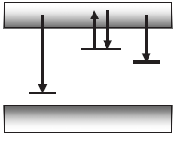
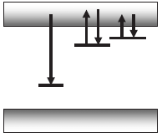
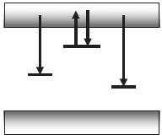
Models with multiple traps and centers
2 independent traps
2 traps including one deep trap not sensitive to the optical stimulation
2 traps including one shallow trap for which thermoluminescence is possible
2 recombination centers including a non-radiative center

Slide 2
Independent traps
We consider 2 traps (1 and 2) optically sensitive and independent → we have the traps concentrations n₁ and n₂ and the escape probabilities p₁ = ¿_{d1}⁻¹ and p₂ = ¿_{d2}⁻¹ → superposition principle →
Superposition principle can be applied to more than 2 traps

Slide 3
Additional deep trap without optical stimulation
Additional deep trap without optical stimulation (trap 2) occurs for a stimulation with long wavelength and thus with insufficient energy to empty the deep traps→ the deep trap is a competitor to the recombination center
The OSL intensity can be written (with N₂, n₂ and A_{n2}, the concentration of available traps, of filled traps and the trapping probability for the deep trap) →
The intensity is reduced due to the trapping in the deep trap
The decrease is no more exponential

Slide 4
Additional shallow trap with thermoluminescence
The last 2 terms combine to produce a long-lived and temperature-dependent component to the OSL decay curve
That may imply (as a function of the parameters) an initial increase of I_{OSL} followed by a decrease → in such circumstances the terms « OSL decay curve » is inappropriate

Slide 5
Second recombination center (non-radiative)
A second recombination center (2) may exist and be non-radiative (or if radiative, outside the detector sensitivity window)
Let be m₁ and m₂, the h⁺ concentrations at R₁ and R₂
As only the recombination e⁻- h⁺ at 1 is radiative →
Again decrease of I_{OSL}

Slide 6
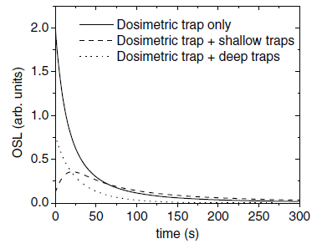
Comparison between the ≠ models

Slide 7
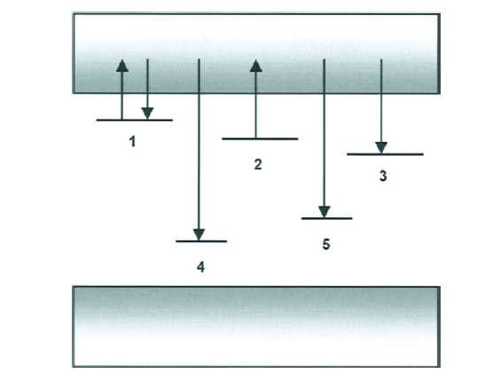
More complex models
In previously models → we add 1 deep trap or 1 shallow trap or 1 recombination center
For realistic materials → they contain multiple traps, deep or shallow, and multiple recombination centres (radiative or not) → model with all these elements →

Slide 8
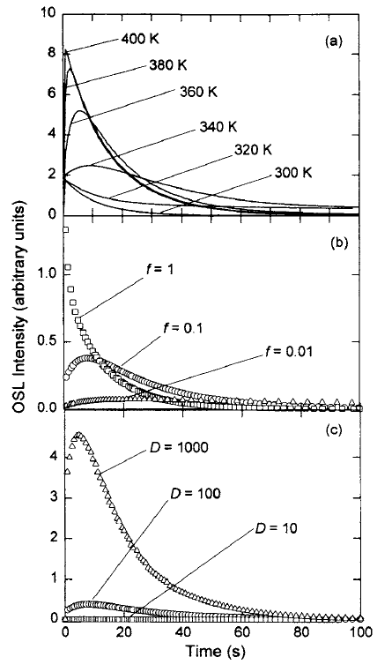
Results for this complex model
p = 1
p = 0.1
p = 0.01

Slide 9
LM-OSL
Alternative method introduced in 1996 by Bulur → the intensity of the stimulation linearly increases
The OSL response is a series of peaks, each peak corresponding to the optical escape of charge from a given type trap → the traps with the largest photoionization cross section are empty first
The traps characterized by slow, medium or fast escape are more easily discriminate than for CW-OSL
Not very often used in practice due to a larger technical complexity than for CW-OSL but also to a larger mathematical complexity

Slide 10
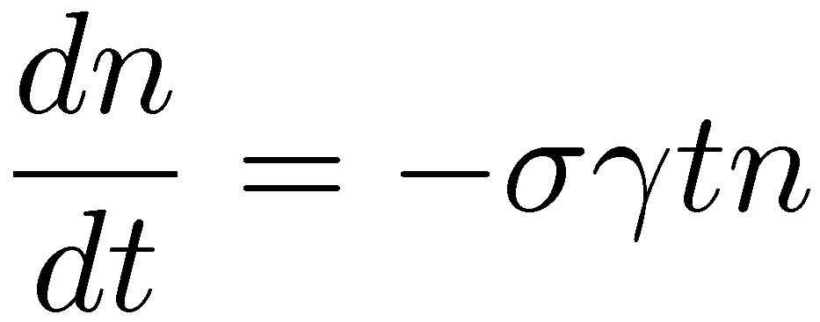
1 trap – 1 recombination center: 1st order
First order → Quasi-equilibrium assumption and Negligible retrapping
We consider for ©(t) →
This equation has a Gaussian as solution →

Slide 11
Characteristic of the first order
The OSL curve shape starts from 0 at t = 0
The curve shows a maximum at
For known ° → it is possible to obtain ¾
The maximum intensity of the curve is →
The integration of I_{OSL} gives n₀

Slide 12
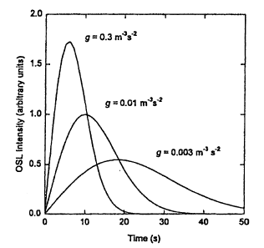
Examples of LM-OSL curves
° = 0.3 m⁻³s⁻²
° = 0.01 m⁻³s⁻²
° = 0.003 m⁻³s⁻²

Slide 13
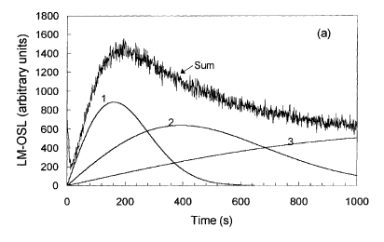
Multiple independent traps
The superposition principle can be applied → for k traps characterized by their occupation n_{i} and their photoionisation cross section ¾_{i} →
OSL curve → sum of k curves having each a maximum dependent on ¾_{i} →
OSL response of quartz

Slide 14
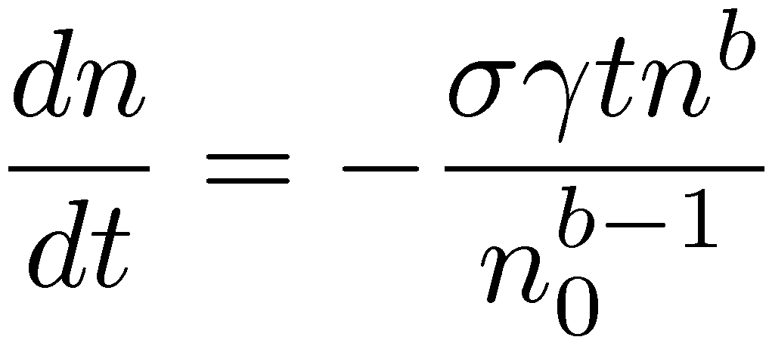
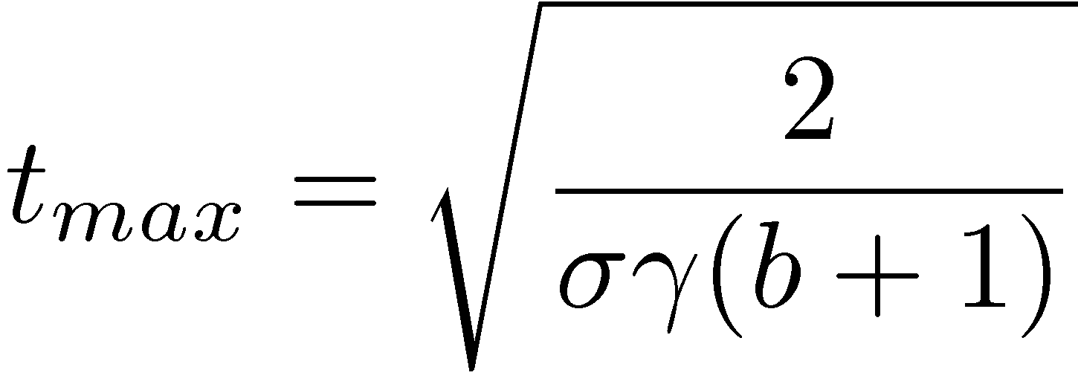
Characteristics at general-order
QE but important retrapping rate
For 1 type of trap →
Maximum t_{max} for a value of I^{max} →
Attention → for several types of traps → retrapping implies that the traps are not independent → the superposition is not possible as for 1st order → complexity
and

Slide 15
POSL
POSL allows to efficiently separate luminescence and stimulation lights
Important decrease of the background due to the scattered stimulation light
Very powerful method for weak dose dosimetry

Slide 16
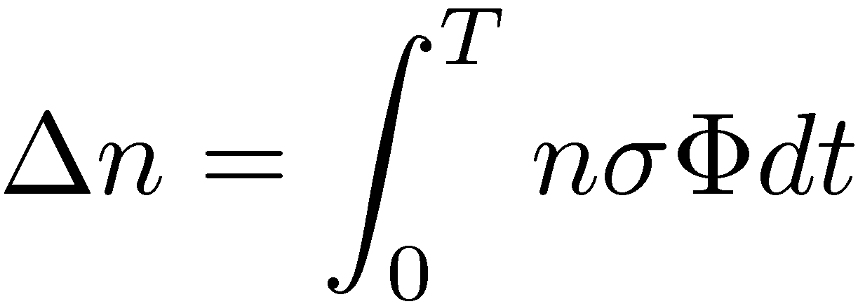
Principles of POSL (1)
We consider several stimulation pulses (supplied by LED or laser) of different intensities ©_{i} and durations T_{i} such that ©_{i} T_{i} = ©T = constant (fixed absorbed energy by pulse).
By considering the 1st order model →
For a weak stimulation (¢n ¿ n → the concentration of charges released by pulse is negligible compared to the concentration of trapped charges) → ¢n / ©T → the charge released from the traps is approximately equal after each pulse

Slide 17
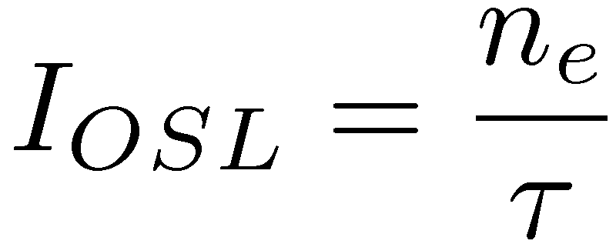
Principles of POSL (2)
Normally when writing rate equations → we consider that each recombination event leads instantly to a photon emission event
In reality → the recombination center is first excited (luminescence center) before relaxation by light emission → existence of a built-in delay ¿ (lifetime of the excited state)
If we have n_{e}, the concentration of excited states →
One photon is emitted when the excited state relaxes →

Slide 18
Principles of POSL (3)
If ¿ ¿ T → conditions of quasi-equilibrium → dn_{e}/dt ≈ 0 and I_{OSL} ≈ -dm/dt as usual (as for CW-OSL)
If ¿ ≥ T → ≠ situation → a certain number of centers relaxe after the end of the stimulation pulse
If ¿ À T → most of the photons are emitted after the pulse (for Al₂O₃:C → 90% of the light emerges after the pulse if it is narrow enough)
For t < T → I_{OSL} ↗ when t ↗ (optical stimulation of the traps)
For t > T → I_{OSL} ↘ when t ↗ (relaxation with a time constant ¿)

Slide 19
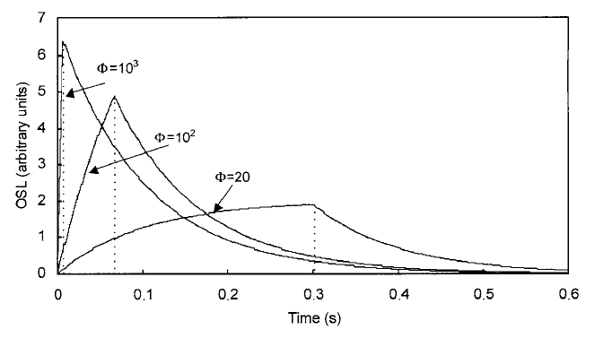
Schematic illustration of POSL
Ф=22
POSL after pulses with © = 10³, 10² and 22 u.e./s → we have the corresponding T: T = 6.6, 66 and 300 ms (¿ = 100 ms was chosen)
The ratio of the areas after and during the pulse ↗ for T ↘

Slide 20
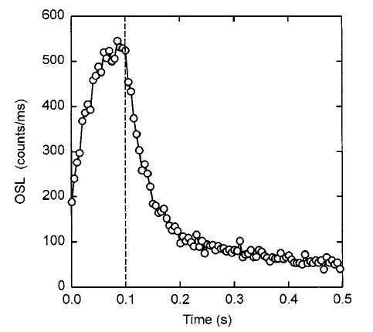
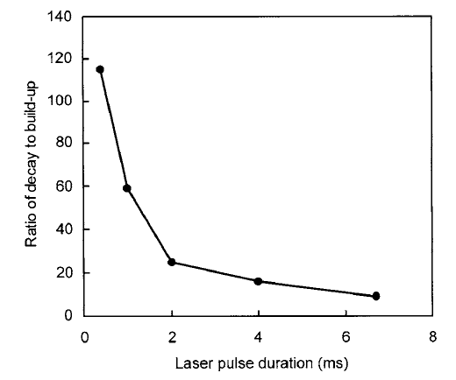
Experimental illustration of POSL
POSL for Al₂O₃:C stimulated by laser during 0.1 ms
Ratio of the areas after and during the pulse for Al₂O₃:C

Slide 21
Determination of the dose by POSL
The total integration of the POSL curve corresponding to 1 pulse is equal to the charges released from the traps and is thus / to n₀
The integration of the curve after the end of the pulse is also / to the charges released from the traps and is thus also / to n₀ but the proportionality coefficient changes as a function of the width T of the pulses
With ¢n ¿ n → only a few stimulation pulses are enough → to make several measurements is possible
POSL especially applied with Al₂O₃:C but very promising

