Slide 1
Chapter X: Optically stimulated luminescence dosimeters

Slide 2
Optically stimulated luminescence dosimeters
Again → luminescence process → now stimulation by light (UV, visible, IR)
When optically stimulated luminescence is used in radiation dosimetry → OSL dosimeter
Fast-expanding during last years
Remark → when a default is excited by light → radiophotoluminescence (RPL) → end of the chapter
References:
L. Bøtter-Jensen, S.W.S. McKeever, A.G. Wintle, Optically stimulated luminescence dosimetry (Elsevier Science) 2003
S.W.S. McKeever, Optically stimulated luminescence dosimetry, Nuclear Instruments and Methods in Physics Research B: 184 (2001) 29–54

Slide 3
History
First « practical » OSL measurements have been made in 1985 with quartz and feldspar → via the determination of the environmental dose absorbed by these materials → determination of the age of archeological or geological materials
The measure of the luminescence of the material is a measure of the dose absorbed since the last exposition to the light → by comparison with reference samples → dating
For personal dosimetry → late development due to the absence of « good » materials (sensitivity to radiation, small Z_{eff}, weak fading,…)
Currently → development of « good » materials → Al₂O₃:C, quartz,…

Slide 4
Advantages of OSL
Techniques of reading simpler than for TLD → only optical
No heating → no thermal quenching
Possible multiple reading → no necessary to stimulate all traps during the first reading
Fast reading process

Slide 5
Escape probability p
Thermoluminescence →
Optical stimulation at a fixed wavelength ¸ →
with ©, the optical stimulation intensity, ¾, the photoionization cross section for interaction of the metastable state and E₀, the threshold optical stimulation energy required to release the e⁻ from the trap

Slide 6
Photoionization cross section (1)
¾(E₀) has an energy threshold → for E < E₀ → ¾(E₀) = 0
≠ expressions have been derived for the dependence as a function of the frequency of ¾(E₀) → ¾(hº,E₀) as a function of the potential energy in the vicinity of the defect
For a shallow trap → hydrogenic potential (and planewave for the e⁻) →
For a deep trap → delta-function potential for the defect (model of Lucovsky) with the assumption that the mass of the e⁻ in the localized state is equal to the effective mass (m_{e}) of the e⁻ in the conduction band →

Slide 7
Photoionization cross section (2)
For a deep trap → model of Grimmeis and Lebedo considering a mass m₀ (rest mass) for the e⁻ in the localized state →
Other models exist but for OSL → deep traps → the models of Lucovsky or of Grimmeis and Lebedo are most often used

Slide 8
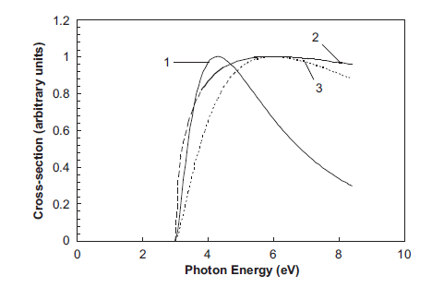
Photoionization cross section (3)
¾(hº,E₀) for E₀ = 3.0 and m₀/m_{e} = 2 (normalized functions to reach ¾_{max} = 1): 1: hydrogenic, 2: Lucovsky, 3: Grimmeis and Lebedo

Slide 9
Modes of optical stimulation
© = constant (and ¸ is constant also) → optically stimulated luminescence in continuous mode (continuous-wave OSL: CW-OSL)
Introduction of a time-dependence for ©(t) or ¸(t) → example 1: linear increase in the intensity of optical stimulation at a fixed ¸ (with ¯© = d©/dt ) →
→ optically stimulated luminescence in linear mode (linear modulation OSL: LM-OSL)
→ example 2: pulsed stimulation → optically stimulated luminescence in pulsed mode (pulsed OSL: POSL) with ¢t, the pulse width and ¿, the period →

Slide 10
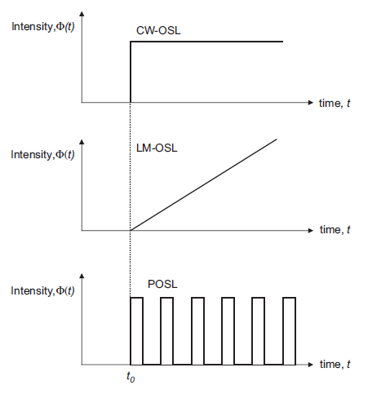
Schematic representation of the three main OSL stimulation modes

Slide 11
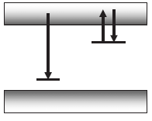
CW-OSL
Most often used mode in practice because of its ease of application
Simplest model: 1 trap – 1 recombination center (as for TL)
Additional complexities can be subsequently considered

Slide 12
1 trap – 1 recombination center: 1st order
Quasi-equilibrium assumption (QE)
Negligible retrapping
Equation similar to equations obtained for TL →
with ¿_{d}⁻¹ = p = ©¾ with ¿_{d} the CW-OSL decay constant
1st order model and exponential decrease of the light intensity
When all traps are empty I_{OSL} = 0

Slide 13
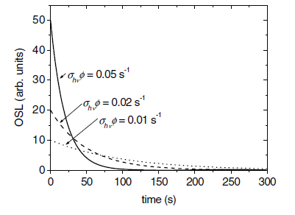
Determination of n₀
n₀ is equal to the area of I_{OSL}(t) →
The initial intensity is / to n₀ and © → I_{OSL}(0) = n₀ ©¾

Slide 14
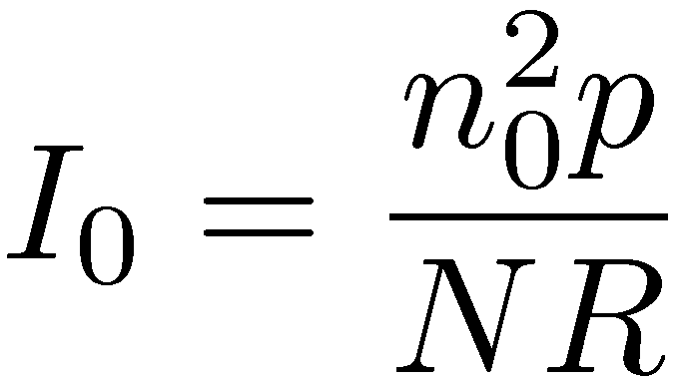
1 trap – 1 recombination center: 2nd order
Significant retrapping rate →
For N À n and R = A_{n}/A_{m} À n/(N-n) → we obtain the 2nd order shape →
with

Slide 15
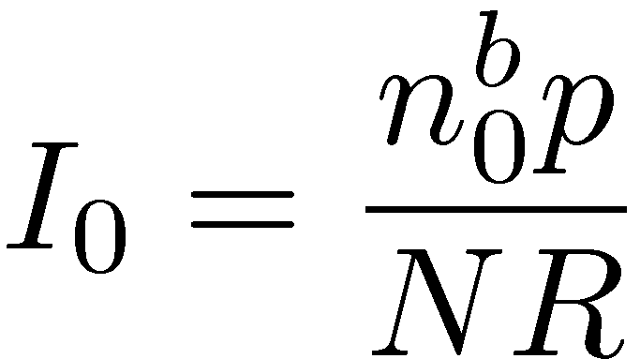
1 trap – 1 recombination center: general-order
with

